Slide 1
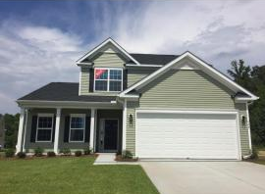
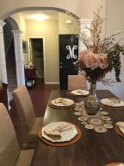
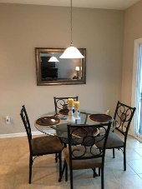
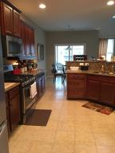
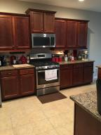
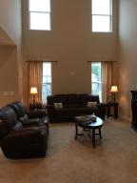
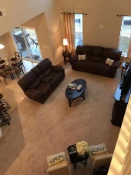
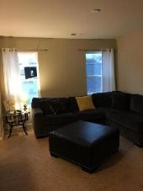
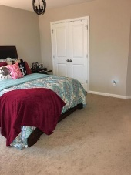
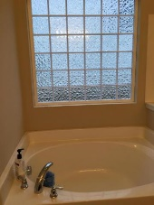
Price Reduction!
444 Gianna Lane
Sophia Landing
Goose Creek, SC 29445
MLS# 17001993
$247,000
***** This beautiful home has just been reduced in price!!!! *****
Seller is also putting $500 towards closing costs***This house features the master down with a 2-story great room with beautiful 18 ft ceilings. You are welcomed with beautiful archways and columns in the foyer. This home features a gourmet kitchen with 42'' staggered cabinets, quartz counters and stainless steel appliances. The first floor features hard wood and a wonderful covered porch off of the breakfast area. The master bathroom features a garden tub with a stand up shower. There are two additional bedrooms, a full bath and a cozy loft on the 2nd floor.
This is a beautiful MUST SEE home!!!!
Jennifer Miller | (520) 204-6040 | jmiller.truecarolinarealty@gmail.com | www.truecarolinarealty.com
True Carolina Realty | 7836 High Maple Circle | Charleston, SC 29418

