Slide 1
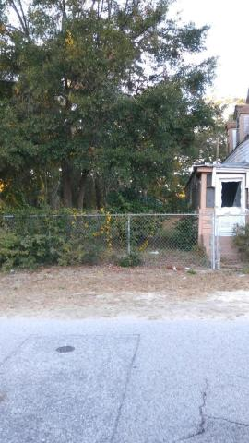


Great Location in Mount Pleasant Old Village
Perfect for a Couple
444 Morrison Street
MLS# 16029990 ~ $475,000
Come build your new home on this great desirable location in the Old Village well established community. Schools are in walking distances and lots of shopping and dining at Shem Creek and many other fabulous locations. There is an old house that needs to be demolished or removed on this property. Please feel free to walk the property.
Coastalina Realty of Charleston 916 Palm Blvd
Ste 101 Isle Of Palms, SC 29451
Sandra Moultrie, REALTOR (843) 532-9715
sandra_moultrie@bellsouth.net
coastalinarealtyofcharleston.com

