Slide 1

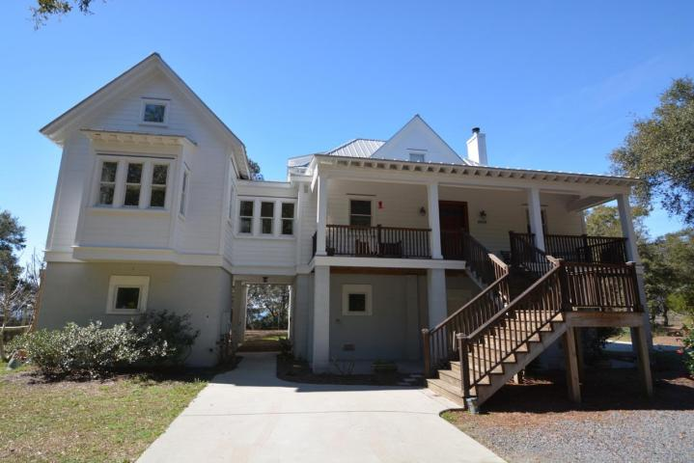
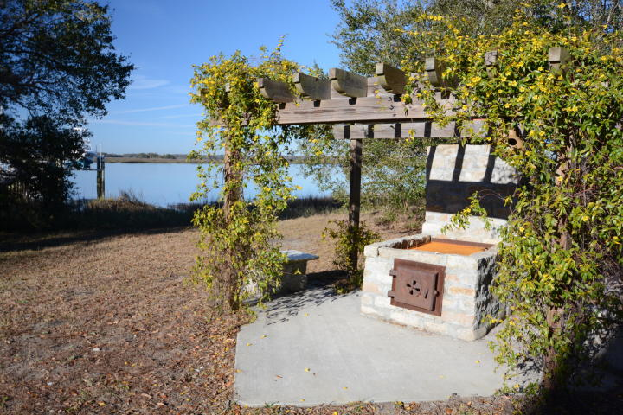
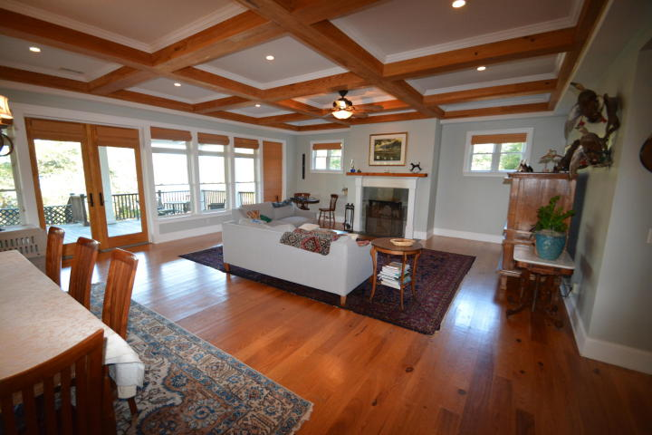
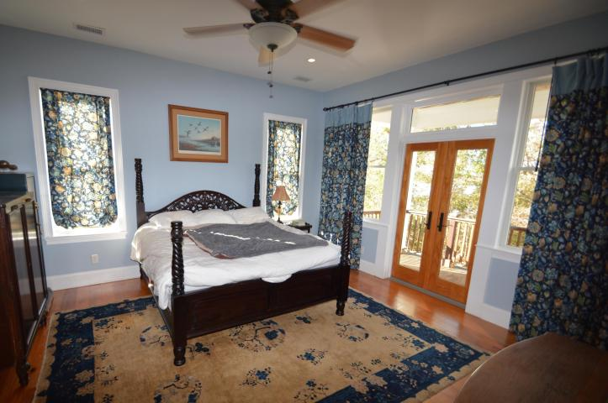
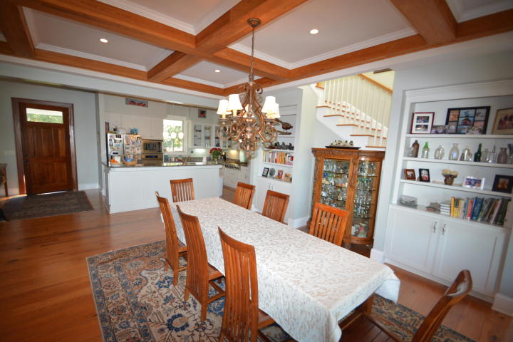
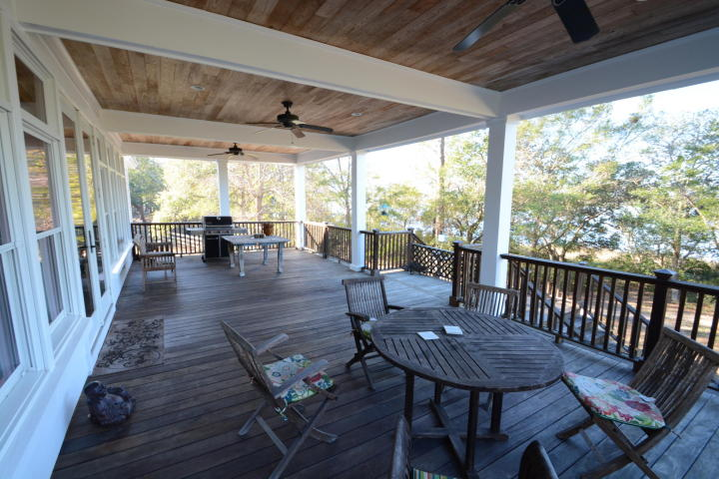
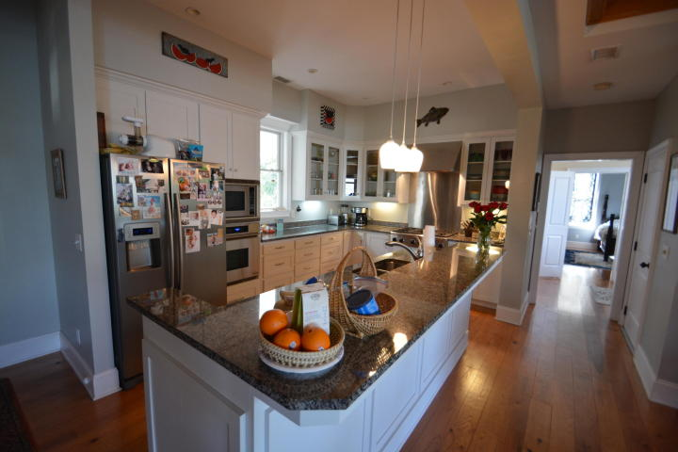
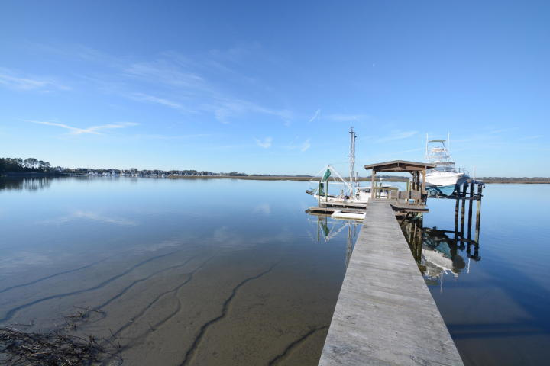
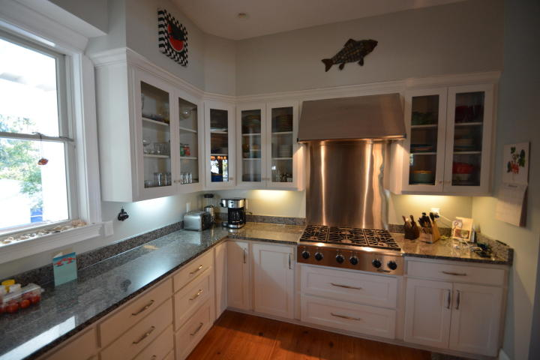
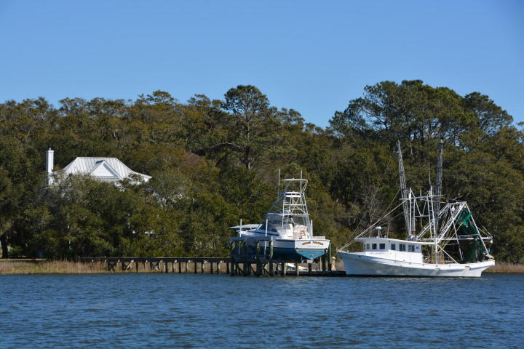
Deepwater Home on Andell Bluff
4458 Betsy Kerrison Parkway
Johns Island, SC 29455 ~ MLS# 17004630 ~ $2,250,000
Once in a lifetime opportunity to own on Andell Bluff! Upgrades galore & amazing views! Coffered ceiling in the family/dining. Butler pantry. Wood floors. Enjoy the views from the master suite balcony! Granite counters & stainless steel appliances convey: Dacor gas cooktop, Dacor convection wall oven, built-in microwave, dishwasher& refrigerator. Elevator.
Raised garden 8x100 ft. Koi pond. Guest cottage that has bed & bath w/electric & AC, great for in-law suite or office. 175 ft. water frontage. 125 ft. walkway to covered pier head, U-shaped floating dock w/3 boat slips & 1 jet dock. Lit dock & electric/water on the dock. Electric boat lift up to 30,000 pounds. Deep water on Bohicket Creek minutes to the Atlantic.
Enjoy the outdoor built-in grill, perfect for oyster roasts & grilling out! The floor plan is Cottage of the year #593 from Southern Living Magazine for June 2007.
Patricia "Patti" Nickerson
(843) 312-7478
pattinickerson@hotmail.com
Michael Albenesius
(843) 343-5870
m.albenesius@gmail.com
4 Carriage Lane Ste 106
Charleston, SC 29407

