Slide 1

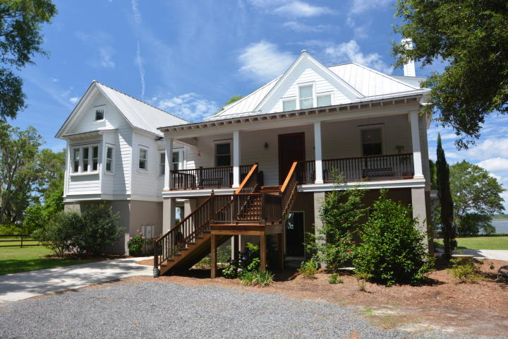
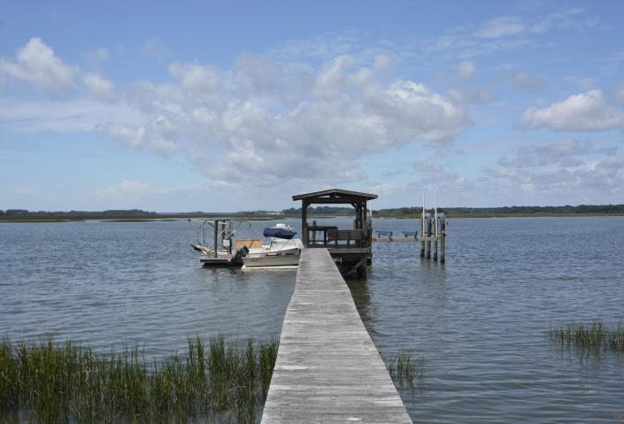
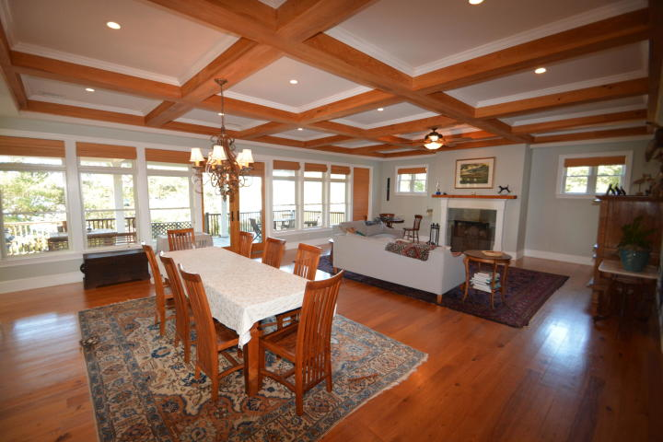
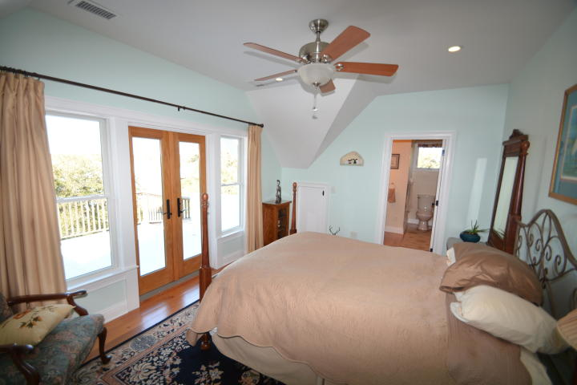
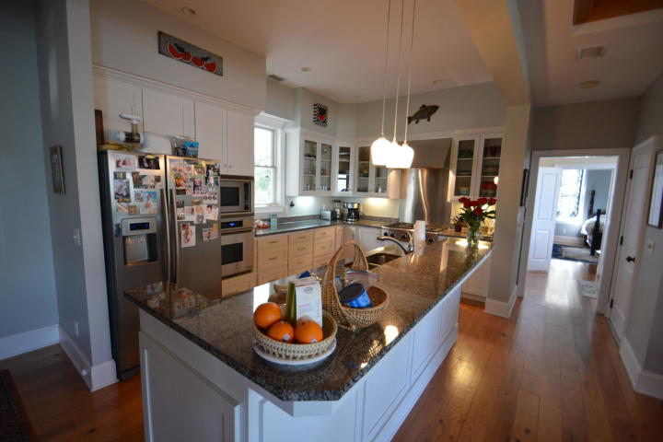
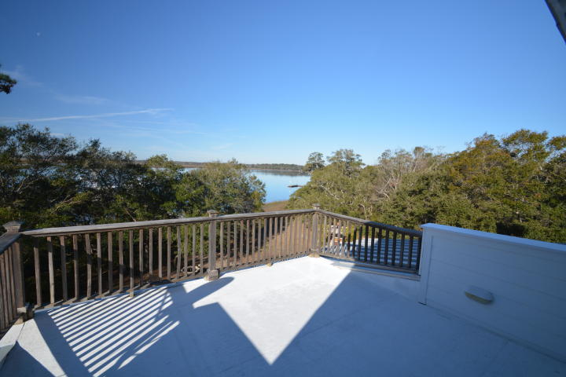
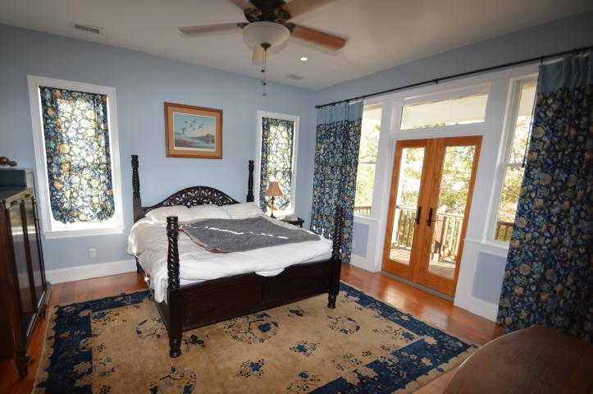
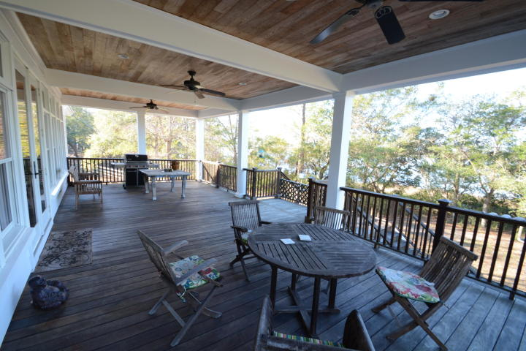
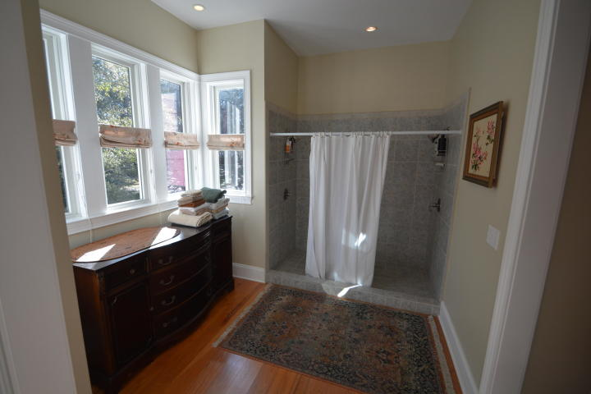
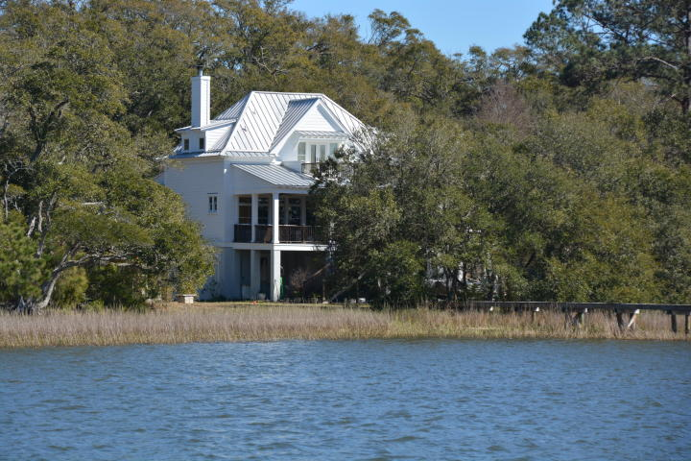
Custom Home on Deepwater Minutes from the Atlantic Ocean!
4458 Betsy Kerrison Parkway
Johns Island, SC 29455 ~ MLS# 19018071 ~ $1,950,000
This home sits on Andell Bluff, deep water on Bohicket Creek minutes to the Atlantic Ocean .Upgrades galore & amazing views!
Coffered ceiling in the family/dining room. Butler's pantry. Wood floors. Enjoy the views from the master suite balcony! Granite counters & stainless steel appliances convey: Dacor gas cook top, Dacor convection wall oven, built-in microwave, dishwasher& refrigerator. Elevator. Raised garden 8x100 ft. Koi pond.
125 ft walkway to covered pier head, U-shaped floating dock w/3 boat slips & 1 jet dock. Electric/water on the dock. Enjoy the outdoor built-in grill, perfect for oyster roasts & grilling out! The floor plan is Cottage of the year #593 from Southern Living Magazine for June 2007.
Patricia "Patti" Nickerson
(843) 312-7478
pattinickerson@hotmail.com
Michael Albenesius
(843) 343-5870
m.albenesius@gmail.com
Michael Albenesius
(843) 343-5870
m.albenesius@gmail.com

