Slide 1

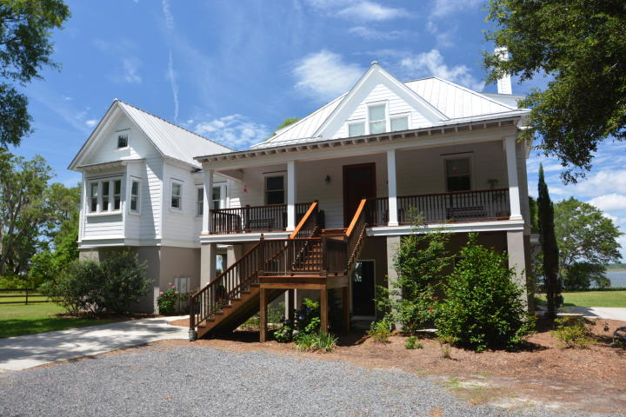
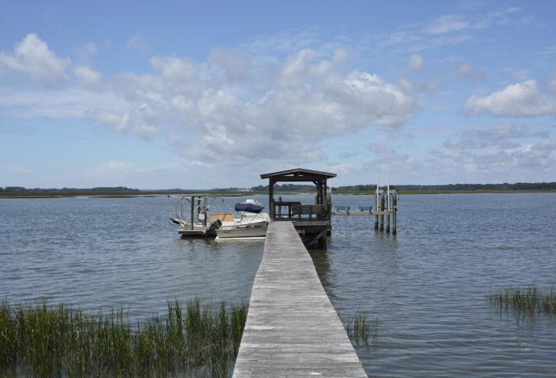
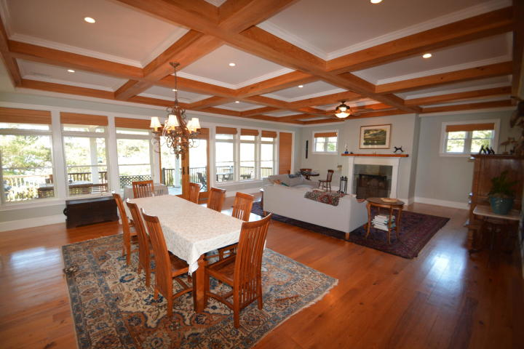
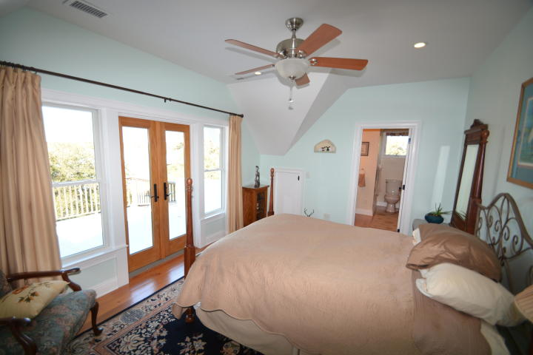
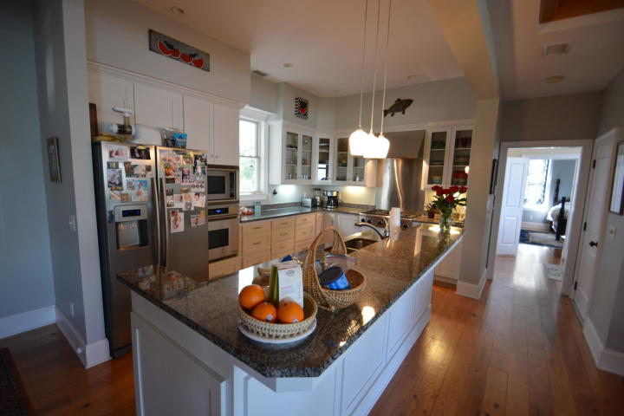
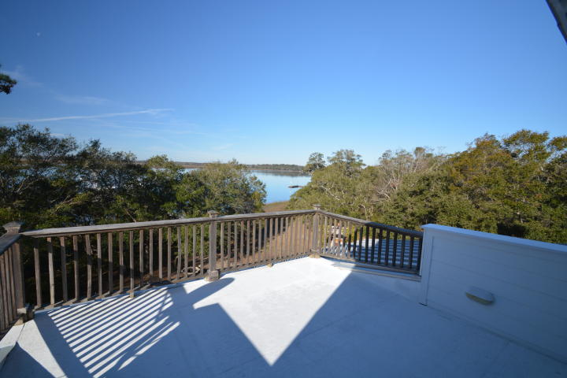
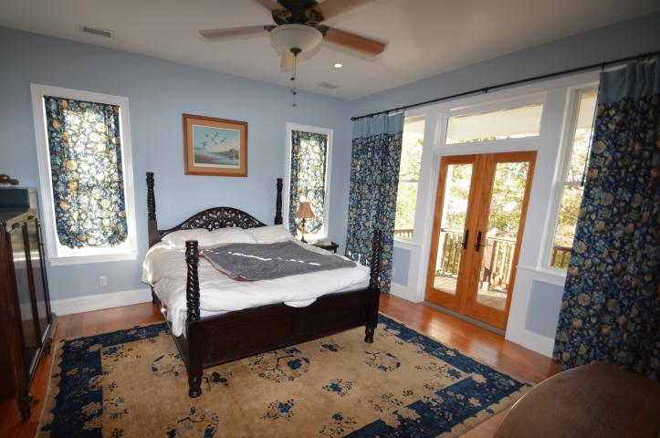
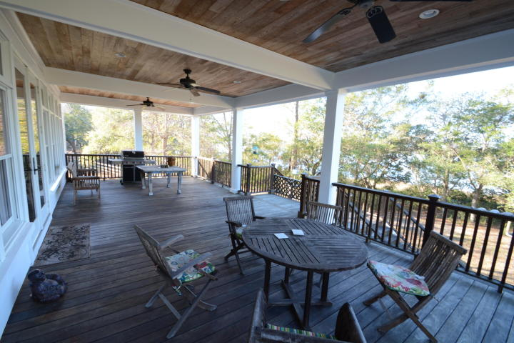
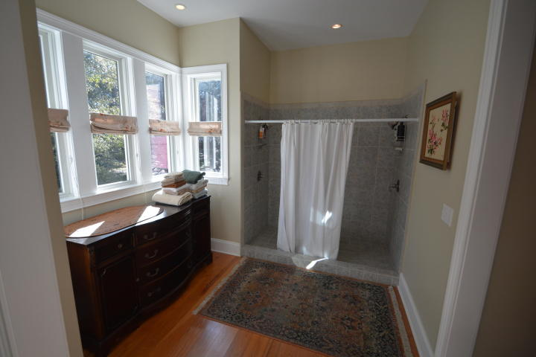
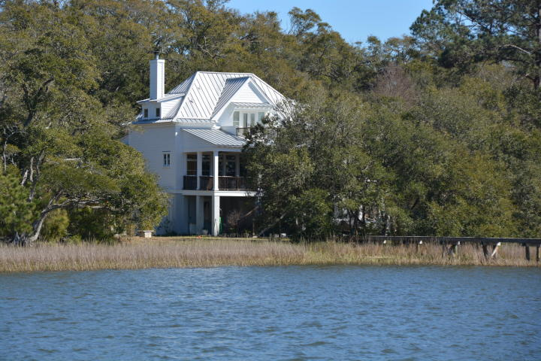
Custom Home on Deepwater
Minutes from the Atlantic Ocean!
4458 Betsy Kerrison Parkway
Johns Island, SC 29455 ~ MLS# 19018071 ~ $1,890,000
This home is a custom built Southern Living Floor plan, sitting on just over 2 acres.
3 Bedrooms 3.5 Bathrooms, with just over 2700 sq. ft. The Atlantic Ocean is just minutes away by boat. Enjoy waking up to the views of the Bohicket Creek from the private master balcony! Upgrades include beautiful detail throughout the home, a large butler's pantry, built-ins, wood floors, gourmet kitchen with granite counters & high end stainless steel appliances. Elevator from garage to 1st floor. Master on main level. One bedroom & One bathroom guest cottage is perfect for guests or in-law suite! 125 ft walkway to covered pier head, floating dock w/3 boat slips. Electric & water on the dock. Enjoy the outdoor built-in grill, perfect for oyster roasts & grilling out! This home is perfect for entertaining!!
Patricia "Patti" Nickerson
(843) 312-7478
pattinickerson@hotmail.com
Michael Albenesius
(843) 343-5870
m.albenesius@gmail.com
Michael Albenesius
(843) 343-5870
m.albenesius@gmail.com

