Slide 1
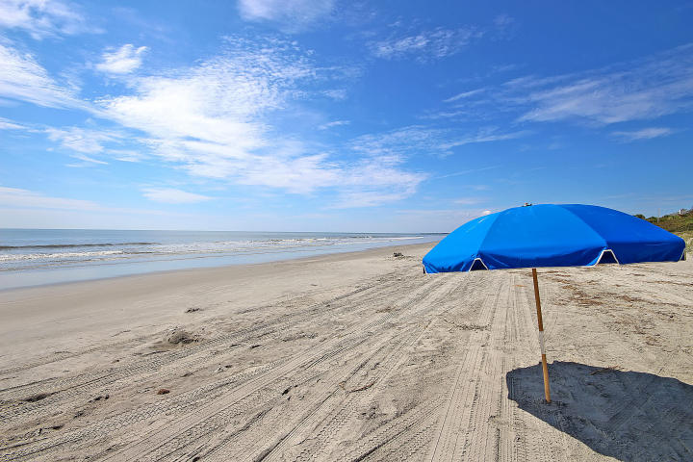
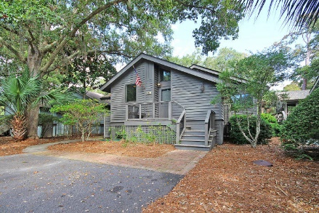
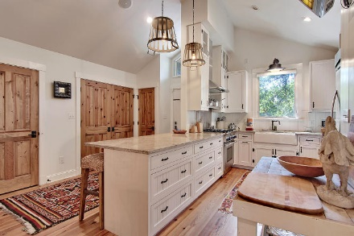
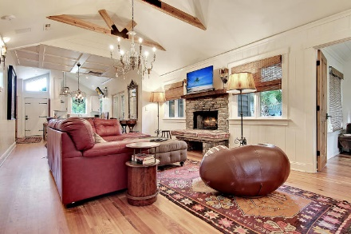
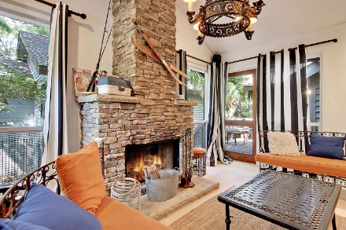
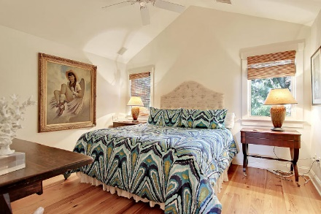
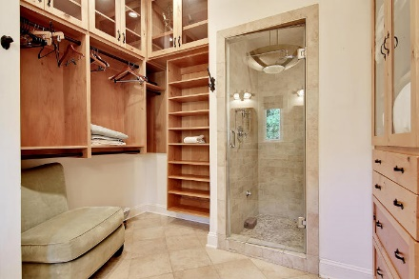
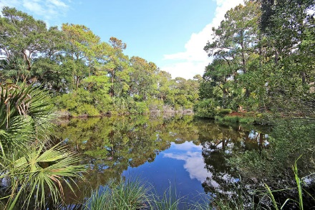
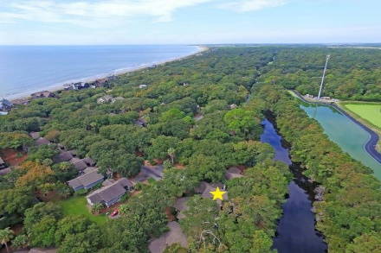
$1000 BONUS TO BUYER'S AGENT AT CLOSING WITH ACCEPTABLE OFFER RECEIVED BY 12/15!
Reduced $200k!
445 Sea Rocket Court
Kiawah Island, SC 29455 ~ MLS# 16024507 ~ $859,000
Want an incredible beach retreat with great vacation rental income history?
This is it!
Set among a maritime forest by lagoon and steps from the beach, this lovely cottage is in desirable Oceanwood on the coveted gated island of Kiawah just about 30 minutes from downtown Charleston...ranked #1 vacation destination by Travel & Leisure magazine.
Enjoy a beautiful beach, nature trails, golf, tennis, and nearby pool. The recently renovated cottage has tons of charm with peaked ceilings throughout and beamed living/dining area with wood burning fireplace, open kitchen, and built-in custom stereo.
Enjoy relaxing on the screened porch with wood burning fireplace and BBQ deck with built-in seating and sun room.
Lisa Quick lisa@mattoneillteam.com 843-452-6688

