Slide 1
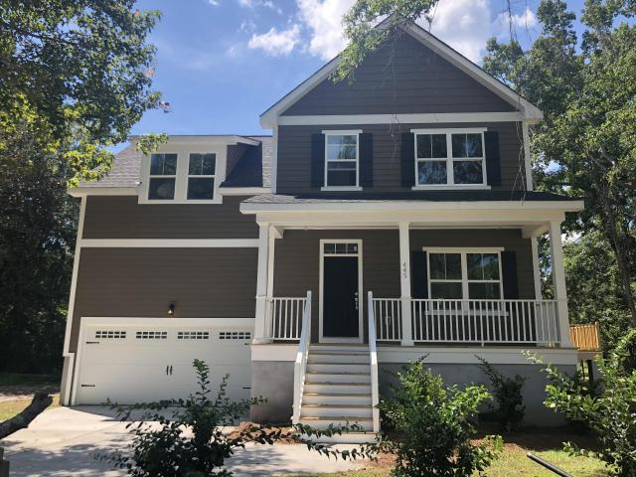
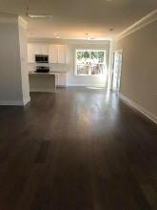
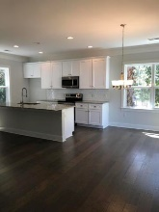
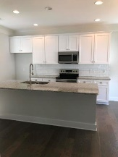
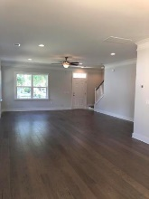
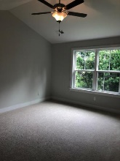
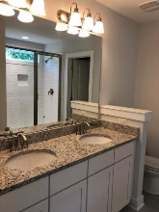
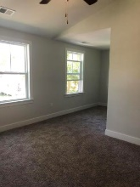
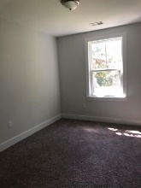
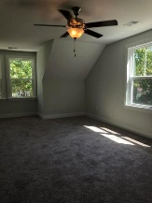
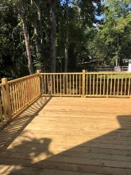
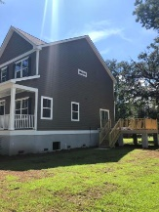
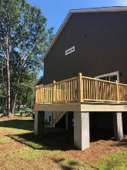
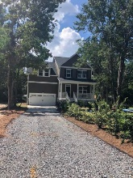
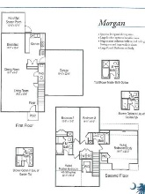


Woodland Shores Open House Saturday & Sunday from 1-3 pm
Starbucks card to first 10 agents
445 Woodland Shores Road
Charleston, SC 29412 ~ MLS# 18020480 ~ $414,990
New Construction on large lot! Conveniently located to Downtown, Restaurants and Folly Beach!! 4 Bedrooms, 2 1/2 Baths, 2 Car oversized Garage (494 sqft ). Downstairs has Open Dining Room, Living Room and Kitchen with Granite, 42'' White Cabinets and Crown Molding. Beautiful Tribano Hardwood floors on 1st Floor. Craftsman Style Trim Package and Tile in Bathrooms. Upstairs had Master Bedroom Suite and 3 additional Bedrooms/Study.
Must See!! ***No HOA Fees***
Juliet Quinn
(203) 257-9154
julietquinnre@gmail.com
The Boulevard Company, LLC | 35 Broad Street | Charleston, SC 29401

