Slide 1

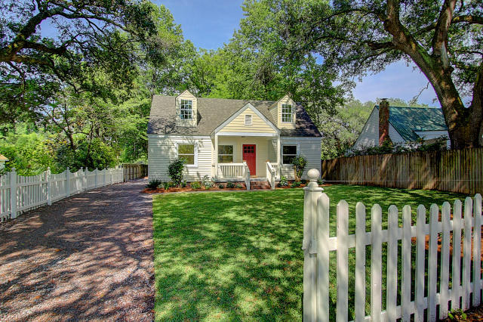
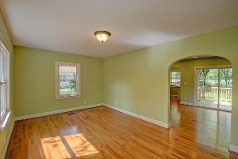
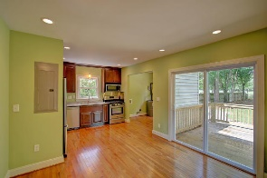
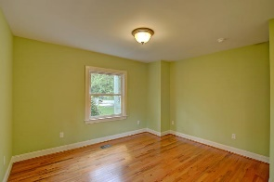
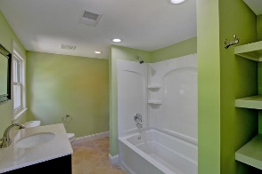
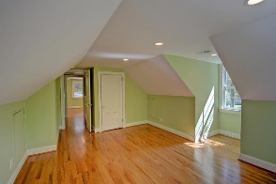
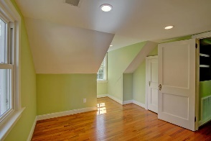
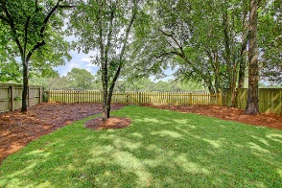
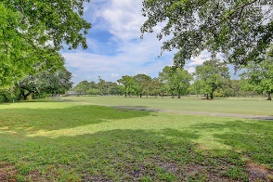
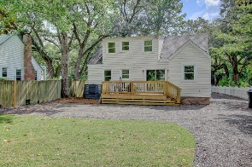


446 Riverland Drive
Charleston, SC 29412
MLS# 16012935
$369,000
Golfer's Delight!
Price Reduced!
Beautiful "White Picket Fence" jewel on a stunningly beautiful golf course lot! Golfers and nature lovers alike will appreciate the beauty of this home nestled under the grand oaks of Historic Riverland Drive and fronting on the Historic 1929 Charleston Municipal Golf Course designed by John Adems. The home has a large downstairs master suite and walk in closet, formal living room, large open kitchen and dining area opening onto the 16' X 16' deck overlooking the course. Two bedrooms and a large full bath upstairs. The 200 ft. deep lot gives plenty of privacy and frames the view to the course. X500 Flood zone. No flood insurance required.
CSA Real Estate Services
339 Cabell Street
Charleston, SC 29407-6928
Charlie Smith
(843) 813-0352
csmith@csarealestate.com
www.csarealestate.com

