Slide 1

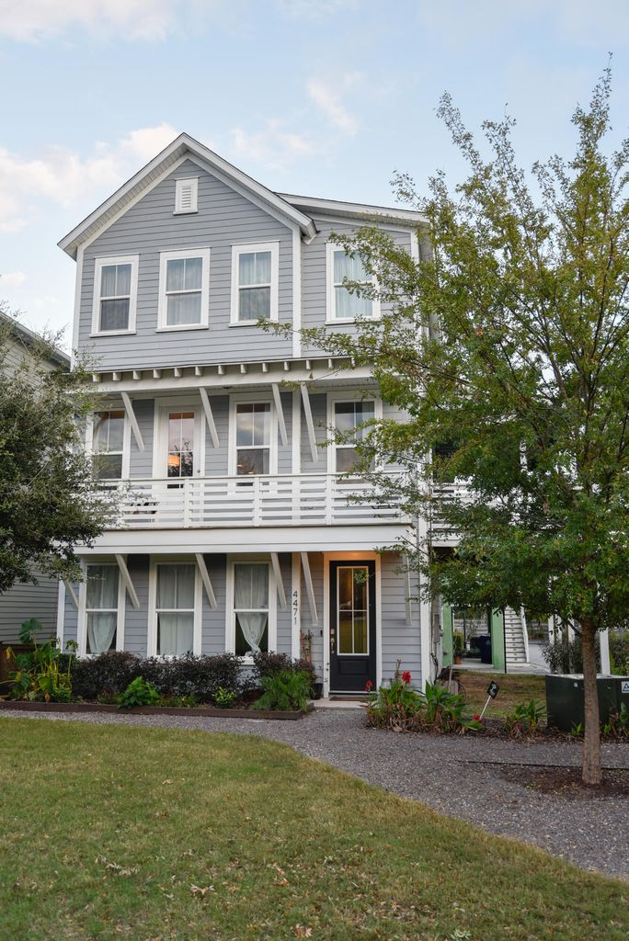
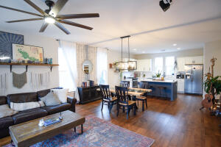
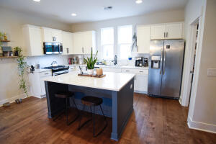
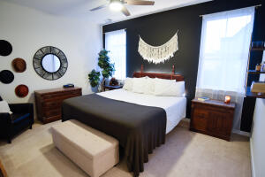
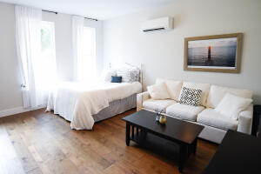
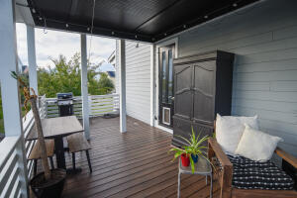
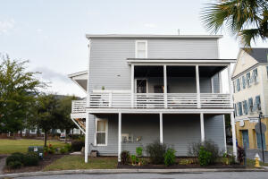

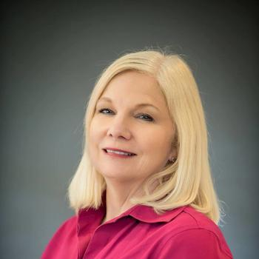
Agent Open Wednesday
4471 Newmans Alley
Mixson
North Charleston, SC 29405
MLS# 22026263
$679,000
Agent Open Wednesday morning 9-11 your chance to see a lovely home facing the Park in Mixson. Come by for coffee and a doughnut and see this great home! Bring a card for door prizes for stopping by!!
Here it is! A chance to own a lovely home in popular Mixson located on the Park. This 4 bedroom 2 full and 2 half bath home was designed with easy living in mind. Living, Dining, Kitchen area all open on the second floor. First floor was finished by owners and offers one bedroom or bonus room and a powder room. Third floor offers a large owners suite with lots of light and plenty of closet space. Additionally, two guest rooms on third floor and full bath. This is a must see. The owners added the side porch for outdoor living space. It is quite large for furniture for comfort and entertaining. Mixson has a lovely pool and clubhouse just steps away. All information provided is believed to be accurate, please check school district and anything else important to a buyer.
Jan Miller
Cell (843) 345-9719 | Jan.Miller@nvrealtygroup.com
NV Realty Group | 91 Broad St, Ste A | Charleston, SC 29401
janmiller.nvrealtygroup.com

