Slide 1
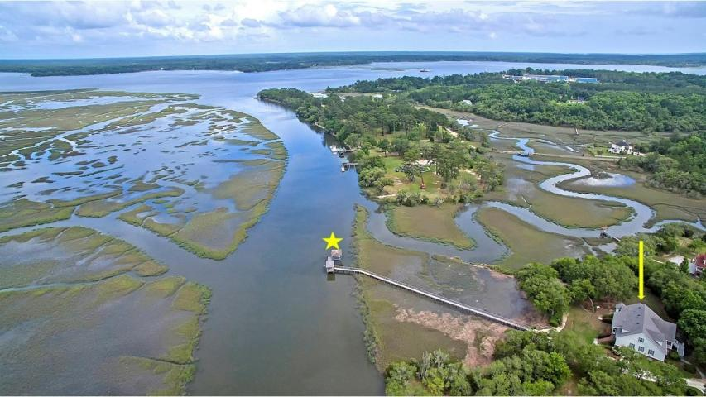

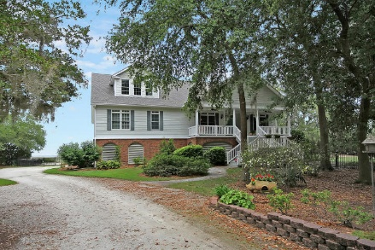
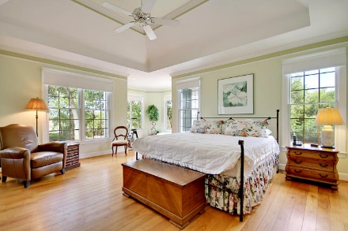
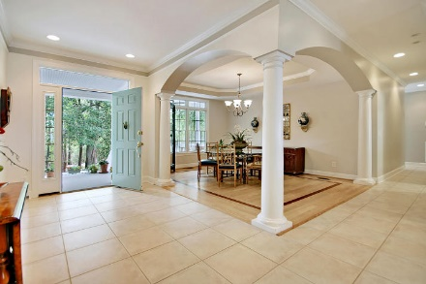
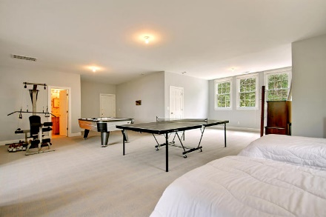
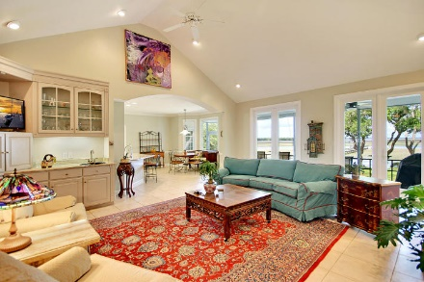
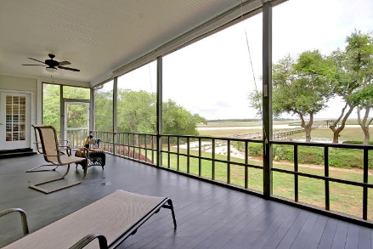
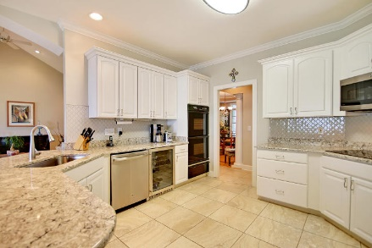
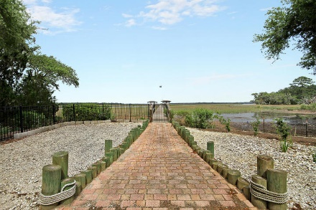
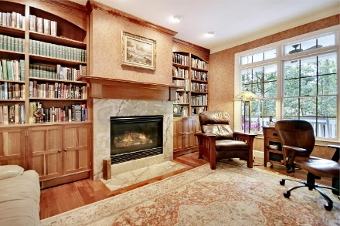
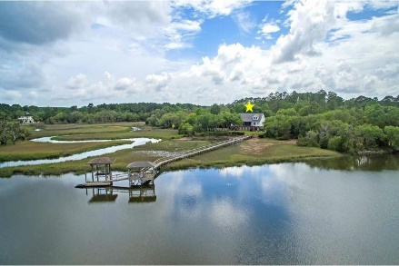
Parkshore Marshfront
Deep Water Super Low Price
4474 S Oyster Bill Road
Oyster Factor Court ~ Meggett, SC 29449 ~ MLS# 18015267 ~ $899,900
Waterfront living on the Wadmalaw River awaits you with this serene and private setting in Yonges Island. Bring along your water vessel and place it onto the boat lift at the end of the gorgeous dock so you can have deep water access within minutes from your very own backyard. Launch a kayak from the floating dock, go crabbing or enjoy cocktails and a nice meal in the covered pavilion portion of the dock. The water views from the expansive back deck, the master suite and throughout the house are ones that you'll love to come home to everyday. The peacefulness found in this location will make everyday feel like vacation. The open floor plan features high ceilings, hardwood floors, a wet bar in the living room, fireplace in the office and an elevator. This home is incredible!
Additional features include:
Dining room has hardwood floors with a beautiful in-law and a tray ceiling
Master bedroom has a tray ceiling, two walk-in closets and a sitting area or reading nook with water views
Master bath has a dual vanity, walk-in shower and soaking tub
Massive FROG/bonus room area with great view and an en-suite full bath
Amazing storage space and workshop on the ground level
Book your showing today!
Chip Walsh chip@mattoneillteam.com 843-822-4663

