Slide 1
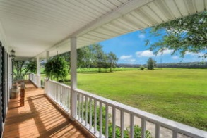
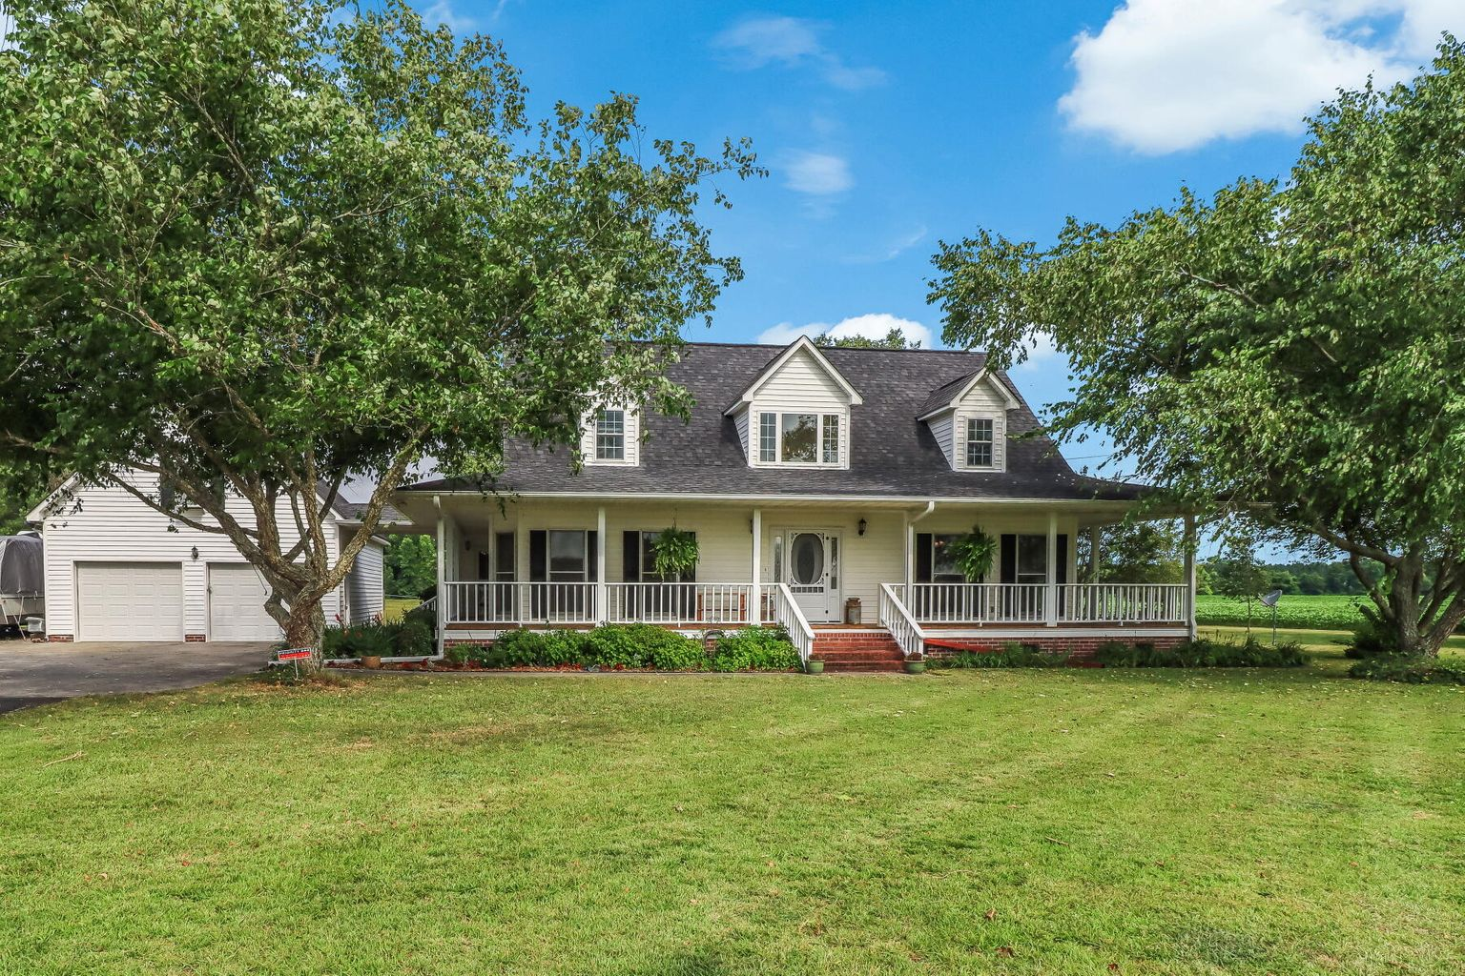
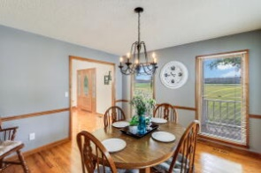
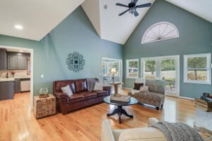
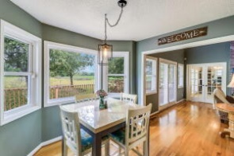
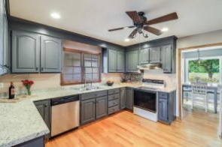
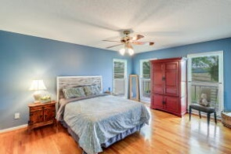
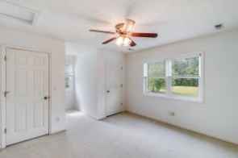
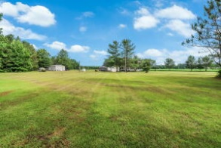
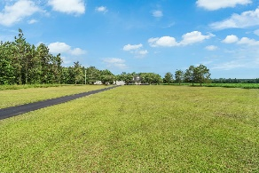


4476 Vance Road Holly Hill, SC 29059 | MLS# 22016307 | $575,000
Just Listed!
SCHEDULE YOUR SHOWING TODAY!
Beautiful country home with over 8 acres surrounded by open fields and mature trees. This home is away from the city life, but only 15 mins to Lake Marion, 35 mins to Summerville, and 55 mins to Charleston. Offering 3 bedrooms, 2.5 baths, and over 2200 sq ft of living space, and a 600 sq ft workshop! This is the perfect spot for horse lovers! Property offers a separate second lot with its own well, power, and septic. This home has wonderful country curb appeal, a huge wrap-around porch, a long driveway leading to the two-car garage and acres of open fields alongside mature trees. Enjoy the scenery and peacefulness while relaxing on the front porch, a perfect place to enjoy some sweet tea after a day of work. Enter the home into the light filled foyer that leads to the large family room. The natural light emanates throughout the space from the wonderful windows and tall second story ceilings. Off the family room is the kitchen eat-in area that leads to the spacious kitchen. The kitchen has numerous amounts of cabinet space along with ample counter space to prepare your favorite meals. Off the kitchen is a conveniently located separate dining area perfect for dinner parties or a holiday dinner with the family. The spacious master bedroom has a large walk-in closet with built in organization and a private en-suite with a dual vanity sink. The bonus room through the French doors off the family room can be used for an office space, a quiet area to sit back and read a book or a kids play area. Two more bedrooms and a full bathroom are located upstairs. Every view or the land out every window gives a calming feeling within. The acreage can be set up for horses, it has existing fencing and a barn. The possibilities are endless with over 8 acres! Make sure to schedule your showing soon before it goes under contract!
Brandon Ray
(843) 499-1928
brandon.ray@carolinaone.com
www.therightrayhome.com
Carolina One Real Estate
900 N Main St
Summerville, SC 29483

