Slide 1
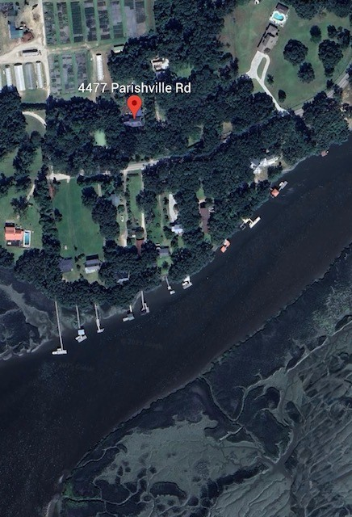


4477 Parishville Road
Off Market Property
Hollywood, SC 29449
Calling all investors or if you are looking to make your own dream come true, this could be the place!
Making appointments for Wednesday January 14th starting at noon.
Properties will need a complete renovation.
Main house is 2500sqft with an ADU of 800sqft.
1.3 acres and just down the street from the public Toogoodoo Boat Landing. Endless possibilities. Call me for more details.
Please do not approach property without an appointment because residents are there.
Kelly Rozier
(843) 209-3129
kellywrozier@gmail.com
Brand Name Real Estate
4 Carriage Lane Suite 106
Charleston, SC 29407

