Slide 1
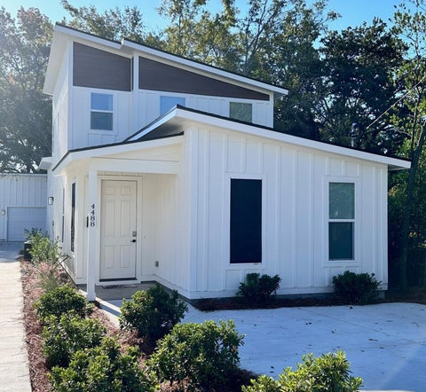
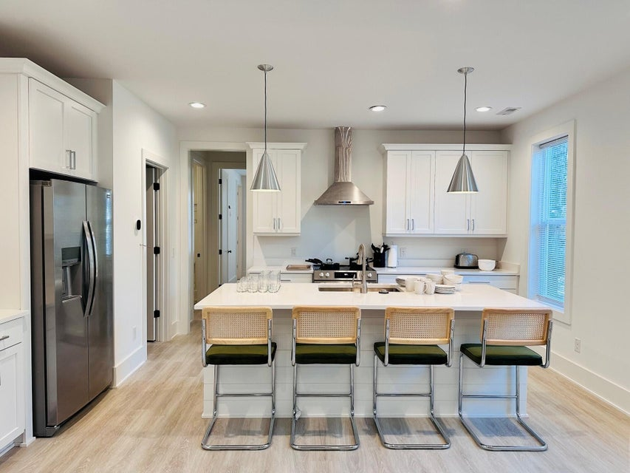
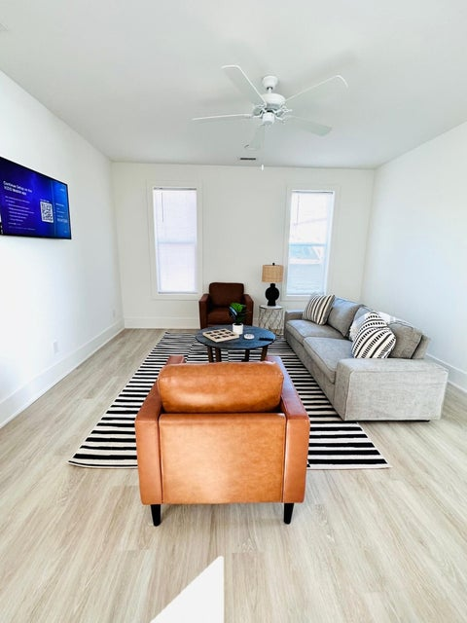
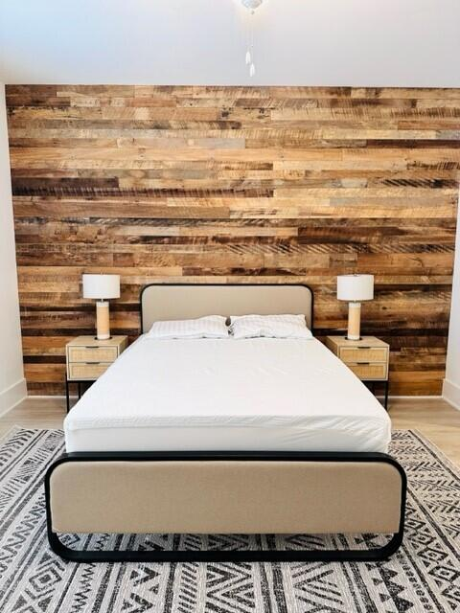
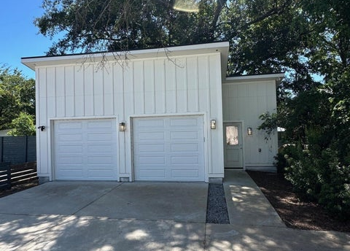
4488 Durant Avenue
Park Circle | North Charleston, SC 29405
MLS# 25023977 | $719,000
PARK CIRCLE SFD WITH COMMERCIAL POSSIBILITIES!
THIS CUSTOM PROPERTY CAN BE USED FOR A MULTITUDE OF USES AND IS A MUST SEE FOR ALL INVESTORS OR SOMEONE LOOKING FOR A GREAT OPPORTUNITY IN AN AMAZING LOCATION!
Welcome Home to 4488 Durant Avenue!! Built in 2023, this home has been VERY lightly lived in and feels like new! It was a custom build by local builder and features all the things you would expect in a new construction home. This modern, craftsman featuring an open floor plan with a large kitchen island, loads of cabinetry space and the perfect dining room adjacent to the kitchen. The large first floor primary bedroom features a custom barnwood accent wall and en suite. Upstairs you will find two nice size bedrooms and a full bath. What sets this property apart is the large garage/workshop located in the rear of the property. This space offers so may options, from an apartment suite for family or additional income ADU, to a working garage with power and water or office/studio space!
And if location is important than this property is what you are looking for! Located directly across from Mixson and shops/restaurants awell as Paradiso, Park Circles premiere family-friendly social club featuring pools, fitness centers and restaurants! Also...park and green space right next door. Everything you could want just steps from the front door. Schedule your showing today!!
Kara Delpino
(843) 860-4166
kara@hbrtwn.com
www.karadelpino.com
Harbourtowne Real Estate
672 Marina Drive, Ste 110
Daniel Island, SC 29492

