Slide 1

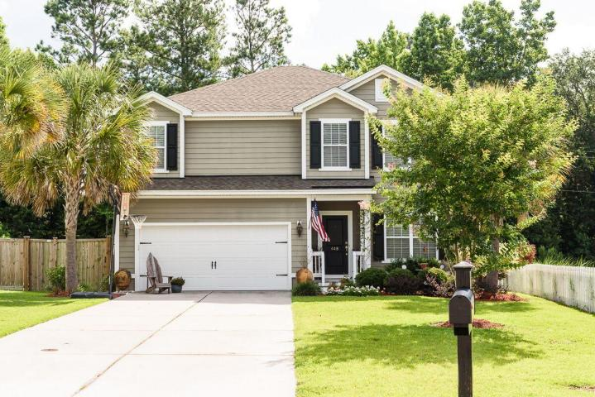
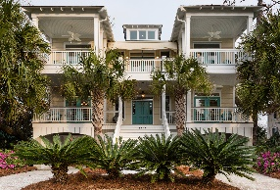
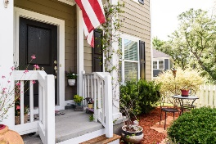
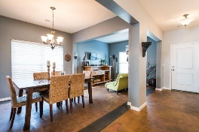
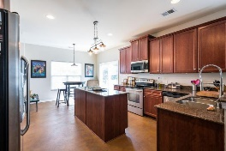
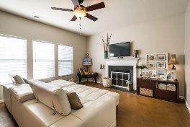
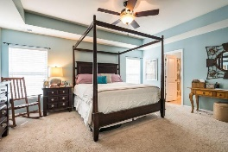
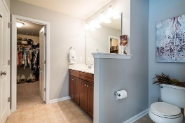

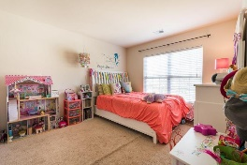
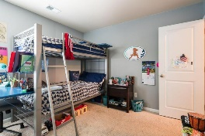
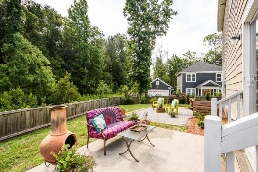
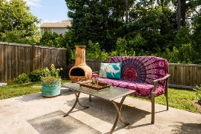
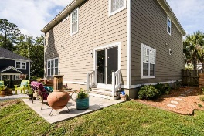


448 Sanders Farm Lane Retreat at Beresford :: Wando :: MLS# 17017431 :: $375,000
Great Home in the Retreat at Beresford!
$1,250,000
Welcome home-great family home close to Daniel Island, Mt. Pleasant, beaches, and I-526! Open floor plan & low maintenance living-check out the stained concrete floors downstairs. Enter the home and see the flex space that could be used as an office, reading room, or second living area as well as a dining area with plenty of room for entertaining & gatherings. The rear of the home includes the kitchen and den where family and guests will want to linger. The kitchen is spacious with stainless appliances and plenty of storage for all of the chefs out there. There is also an eat-in area, a half bath, and doors to the outside and the two car garage. Relax outside on the patio or grill out in your fenced in backyard. Upstairs you will find a large master bedroom with a tray ceiling and a great master bath and walk-in closet. There are three other bedrooms and upstairs bathroom. Large laundry room upstairs for convenience, and plenty of space in the hall for a children's area and reading nook. The new HS is slated to open in August and it is a STEAM school! Check out all this house has to offer.
Andrea Ulmer
(843) 670-6341
aulmer@carolinaone.com www.andreaulmer.com
Carolina One Real Estate :: 628 Long Point Rd :: Mt Pleasant, SC 29464-3032

