Slide 1
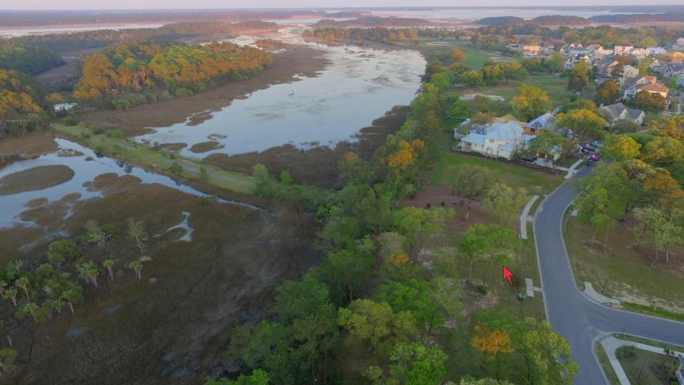
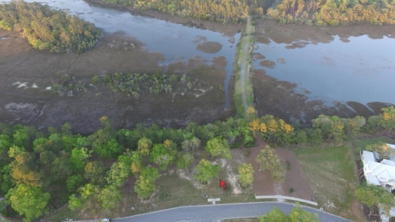
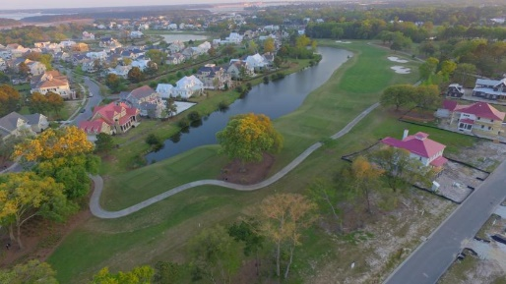
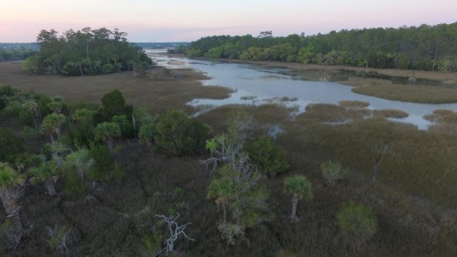
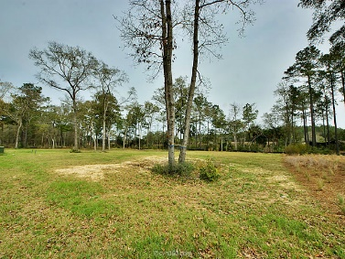
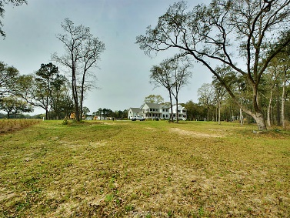
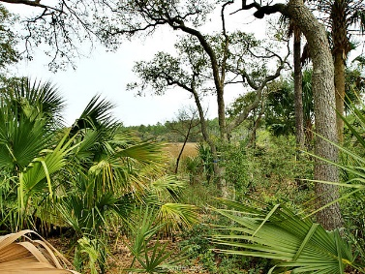
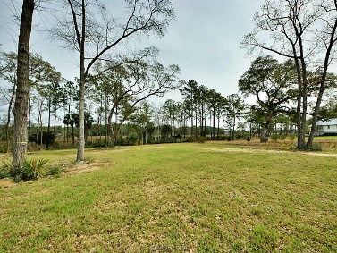


449 Lesesne Street Daniel Island Park Charleston, SC 29492 MLS# 16006515 $489,500
Price Reduced on Beautiful Marshview Lot
Check out this amazing marshview lot on the Park Side. One of the few left for you to build your dream home, or use the current owners approved plans which are included in the price. This lot is a bargain and a great investment! Current owner is relocating and has all plans, approvals, and permits to build on this lot saving you time with DI ARB. Check out in the documents some of the plans and entire PDF files are available to serious buyers. Great opportunity don't miss out! Including you Builders.
Daniel Mykols
(843) 566-5169 | mykols@homesc.com
Infinity Realty | 1250 Fairmont Ave | Mt. Pleasant, SC 29464

