Slide 1
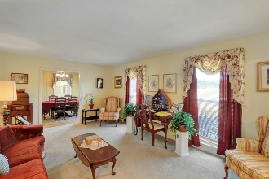
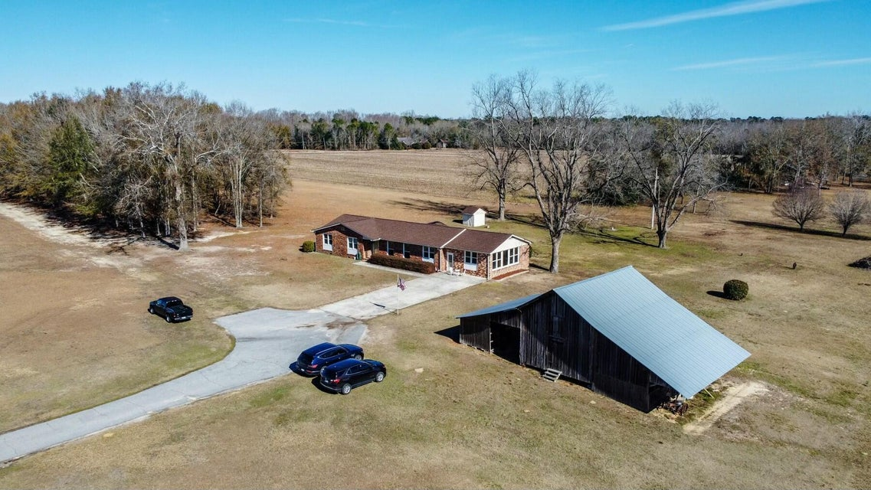
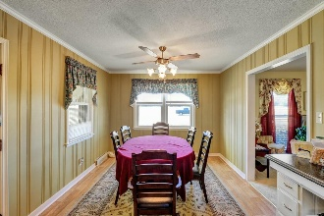
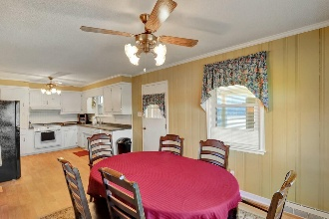
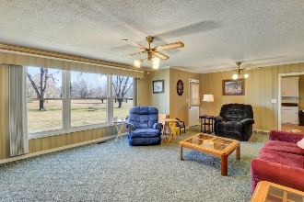
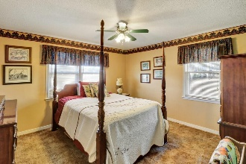
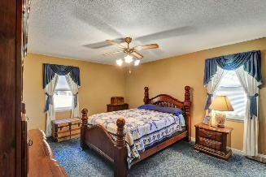
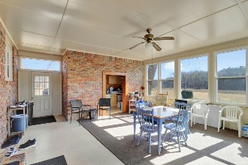
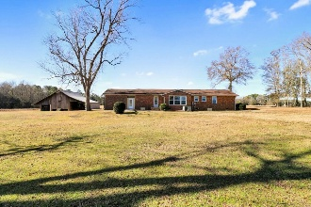
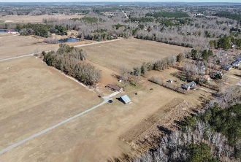


449 Hickory Hill Road
Orangeburg, SC 29115 | MLS# 25001339 | $600,000
Just Listed! Home on 20 Plus Acres!
Open House
Wednesday, 7/20
3-5PM
Charming brick ranch home on 22 serene acres is a true country retreat. Welcome to your dream home nestled in a picturesque country setting! This beautiful brick ranch home offers 1,860 square feet of comfortable living space, featuring 3 bedrooms and 2 full bathrooms, all situated on a sprawling 22-acre lot with breathtaking views. As you approach the property, a long driveway guides you toward the home, creating an inviting atmosphere that sets the tone for tranquility and privacy. Step inside through the foyer, and you are greeted by a formal living room that exudes warmth and charm, perfect for hosting guests or enjoying quiet evenings. Flowing seamlessly from the formal living area, the dining room provides access to a wonderful enclosed patio/sunroom. This versatile space is bathed in natural light and offers the perfect spot to unwind while soaking in the picturesque surroundings. The dining area then leads to a functional kitchen featuring classic white wood cabinets and ample counter space, making meal preparation a breeze. Adjacent to the kitchen, the cozy family room has a large window that frames the stunning backyard view, allowing you to enjoy the beauty of nature from the comfort of your home. An access door leads directly to the expansive outdoor area, where you can easily entertain guests or explore the vast landscape. Down the hallway, you will find the spacious primary bedroom, designed for comfort and relaxation, complete with a convenient en-suite bathroom featuring a walk-in shower. Two more spacious bedrooms offer plenty of room for family or guests, while a second full bathroom, equipped with a tub/shower combo, serves the additional bedrooms. The enclosed patio/sunroom is a standout feature, providing a fantastic spot to appreciate the beauty of the 22 acres that surround you...whether you're sipping coffee in the morning or unwinding after a long day. This lovely brick ranch home combines the best of country living with modern comforts, all in a great location. Don't miss the opportunity to own this serene escape...schedule your private viewing today and experience the perfect blend of space, comfort, and natural beauty!
VIDEO TOUR
Brandon Ray
(843) 499-1928
brandon.ray@carolinaone.com
www.lakelifescstyle.com
Carolina One Real Estate
900 N Main St
Summerville, SC 29483

