Slide 1
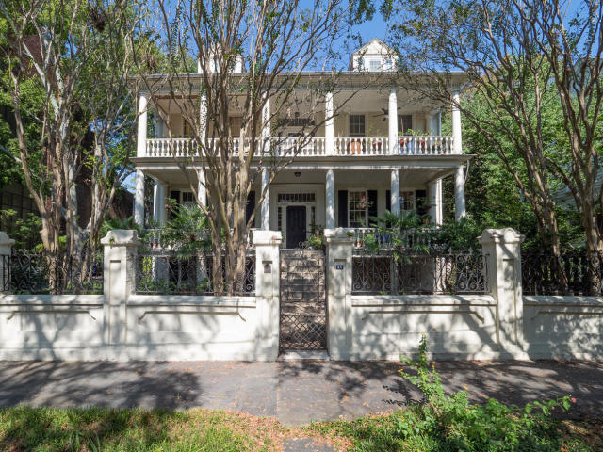
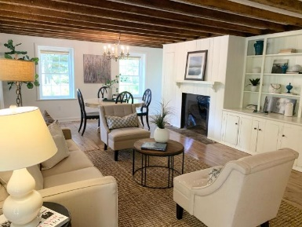
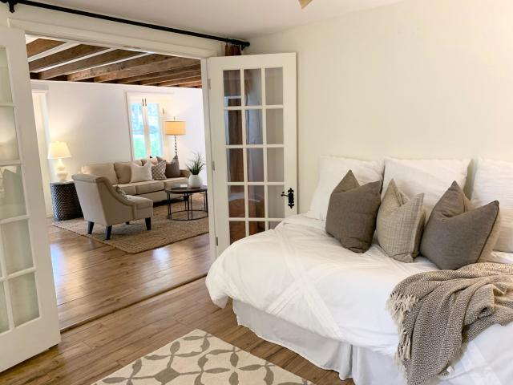
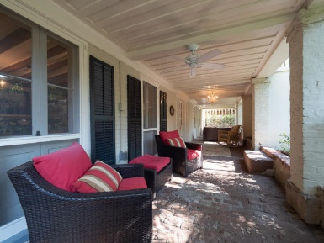
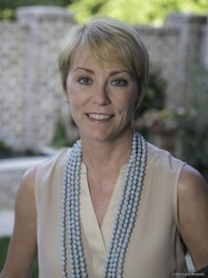

716 Lawton Harbor Drive
44 Charlotte Street A
Wraggborough
Charleston, SC 29403
MLS# 20006496
$549,000
Open House
Sat & Sun
2-4pm
1,288 SF
2 Bedrooms
1½ Baths
Low Regime Fees
Near So Many Points of Interest
A perfect renovated "lock and leave" or full-time home.
Donna Landry
(225) 921-2111
donna.landry@cbcarolinas.com
Picture Perfect Place!
This charming condo has everything you want in your Charleston abode and the location can't be beat!

