Slide 1
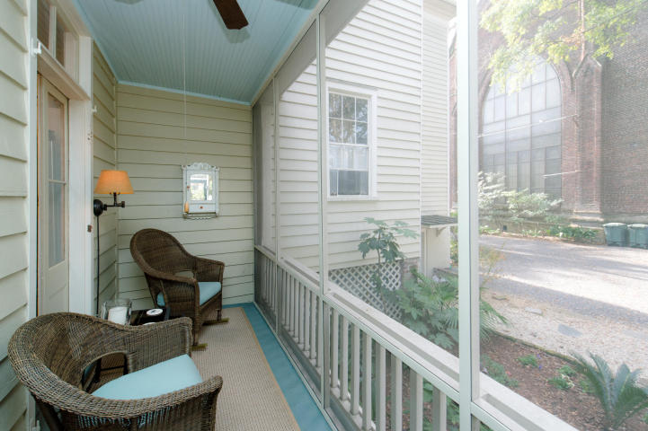
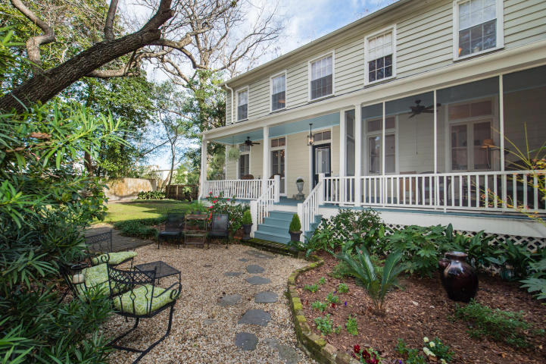
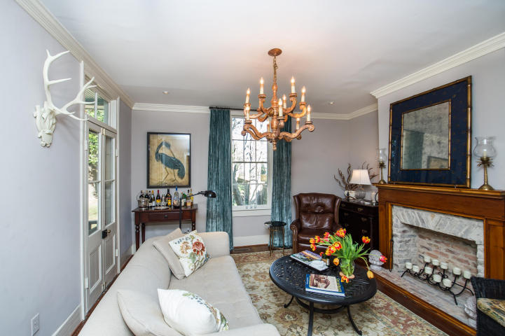
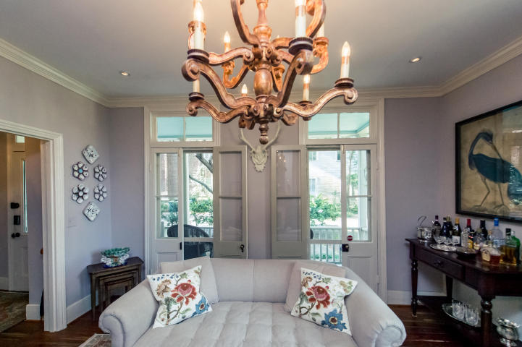
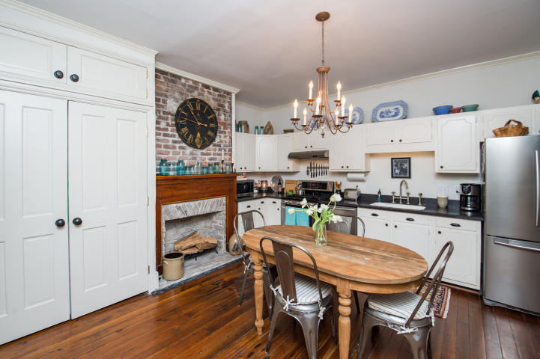
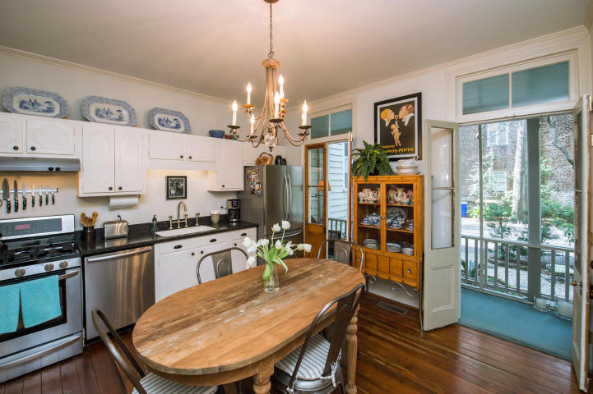
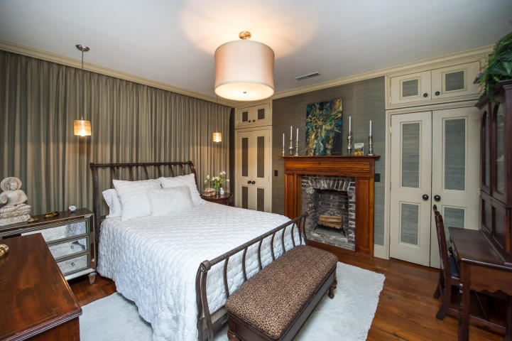
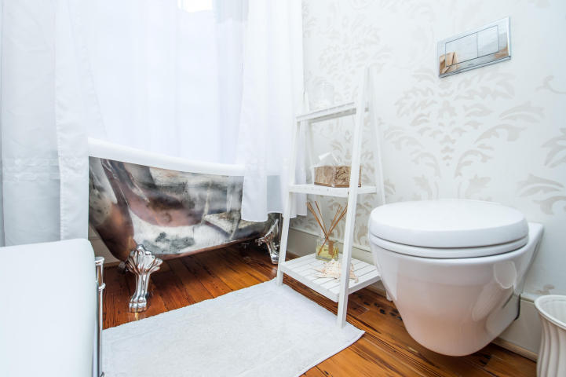
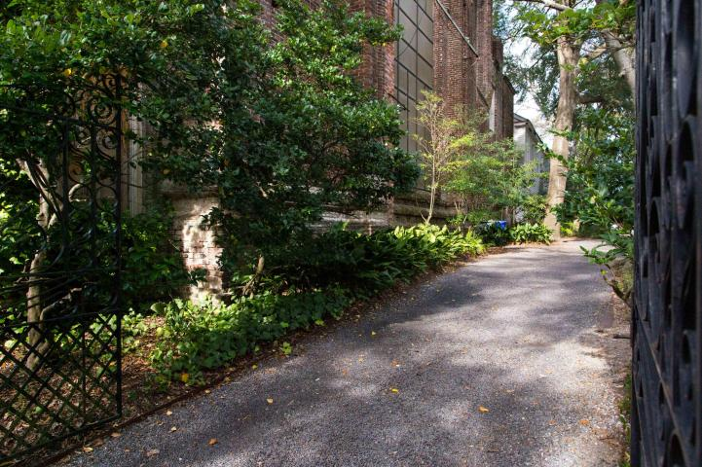
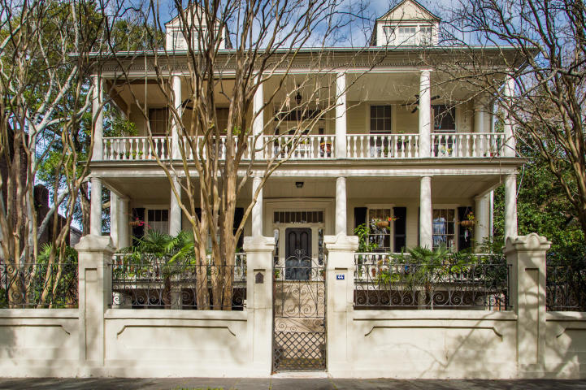

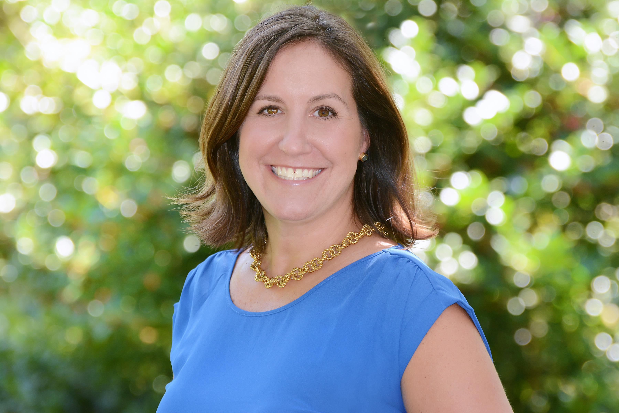
Agent Open House
Thursday 11-1
44 Charlotte Street D
Charleston ~ MLS# 17002641 ~ $819,900
2 Bedrooms ~ 1½ Baths ~ 1,238 sf
Charm. Elegance. Modern Convenience.
History. Location. Privacy.
You will have it all with the exquisite kitchen house
at the Houston House.
This is a rare opportunity on a home that will not disappoint.
Keller Williams Realty
Charleston West Ashley
1180 Sam Rittenberg Ste 105
Charleston, SC 29407
Amy Zonarich
Realtor
(843) 534-3523
amy@amyzonarich.com
www.liveandlovecharleston.com

