Slide 1
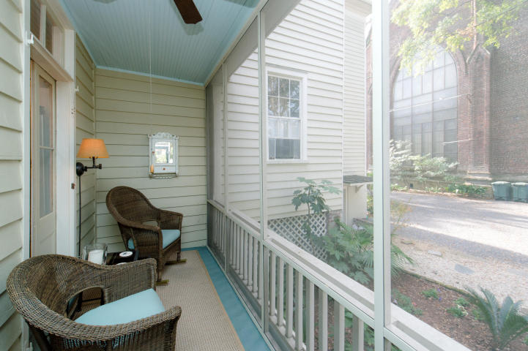
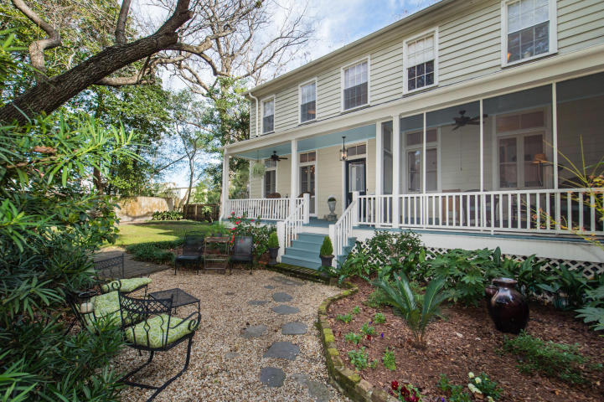
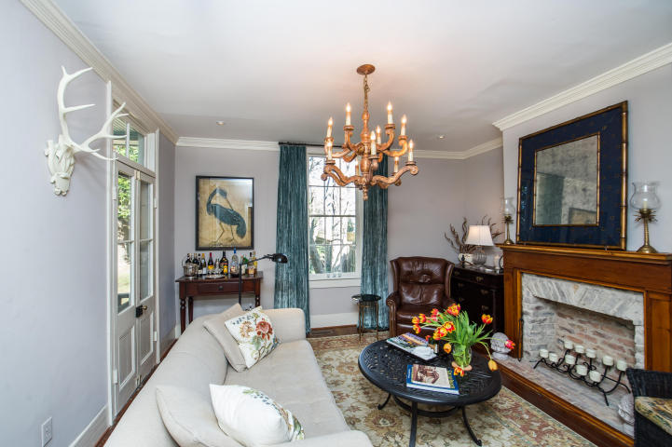
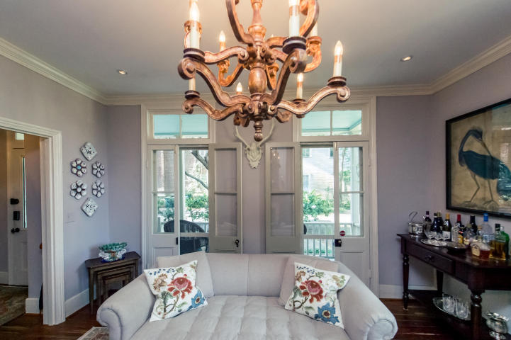
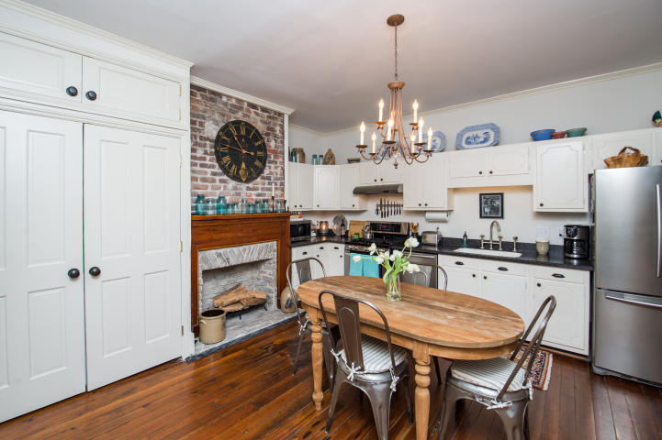
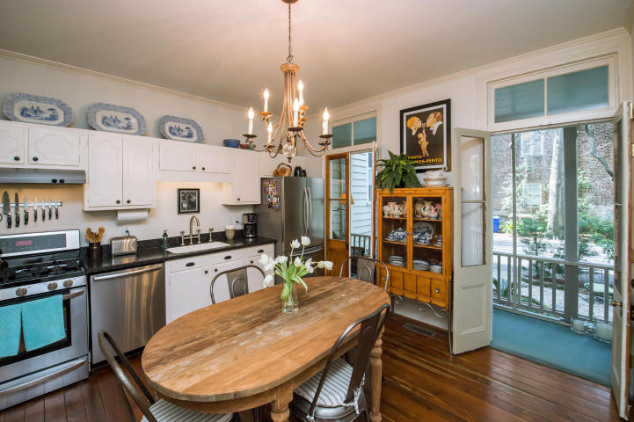
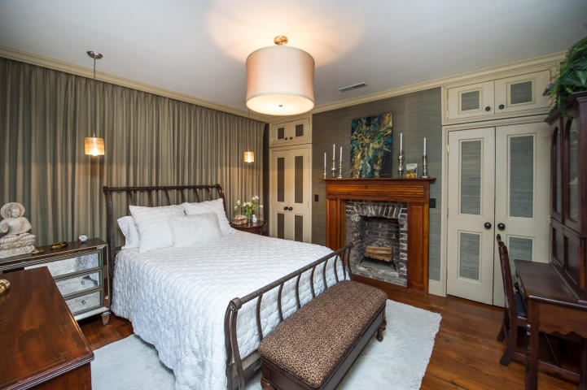
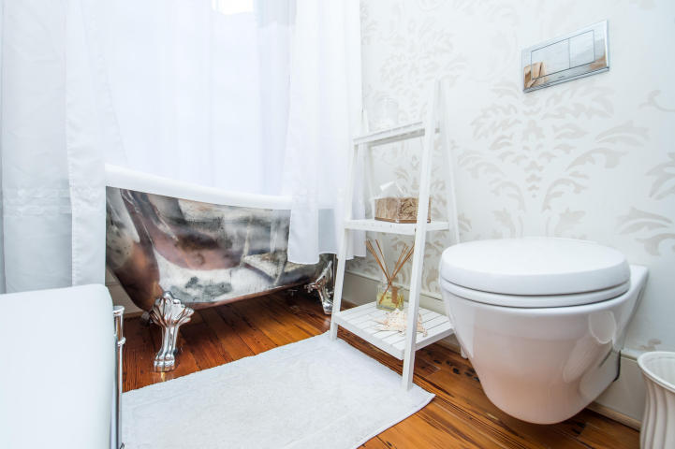
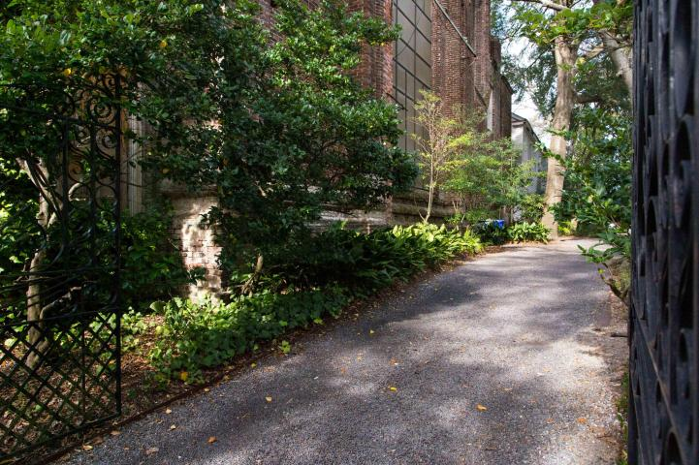
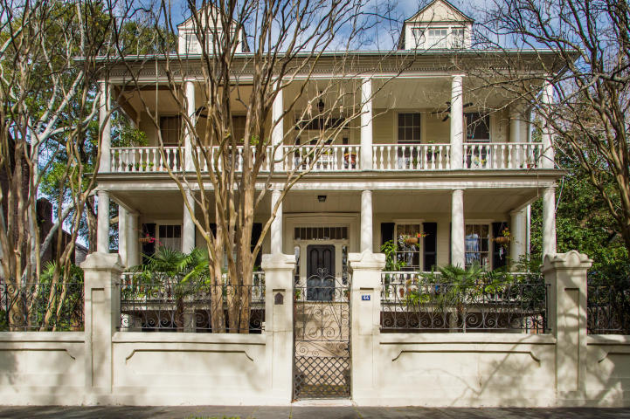


A Rare Opportunity
44 Charlotte Street D
Charleston ~ MLS# 17002641 ~ $789,000
Charm. Elegance. Modern Convenience. History. Location. Privacy. You will have it all with the exquisite kitchen house at the Houston House. This two story residence boasts tall ceilings and is abundant with natural light. The home has been meticulously cared for over the years and it shows. Exterior of the home just underwent a ''facelift''. A half bath was recently added, the roof has been resealed/repainted as well as the porches. Architectural gutters were added. French doors, fireplaces, oversized windows, original hardwood floors and crown molding provide the classic charm. A tankless hot water heater, multiple closets, off street parking and walkability add the modern conveniences. There is a front AND a screened porch and both overlook a patio area. From this location you are walking distance to some of Charleston's best restaurants and the lively Upper King Street area. Enjoy music and the arts at the multi million dollar Gaillard Center just down the street. This is a rare opportunity on a home that will not disappoint.
Keller Williams Realty
Charleston West Ashley
1180 Sam Rittenberg Ste 105
Charleston, SC 29407
Amy Zonarich
Realtor
(843) 534-3523
amy@amyzonarich.com
www.liveandlovecharleston.com

