Slide 1
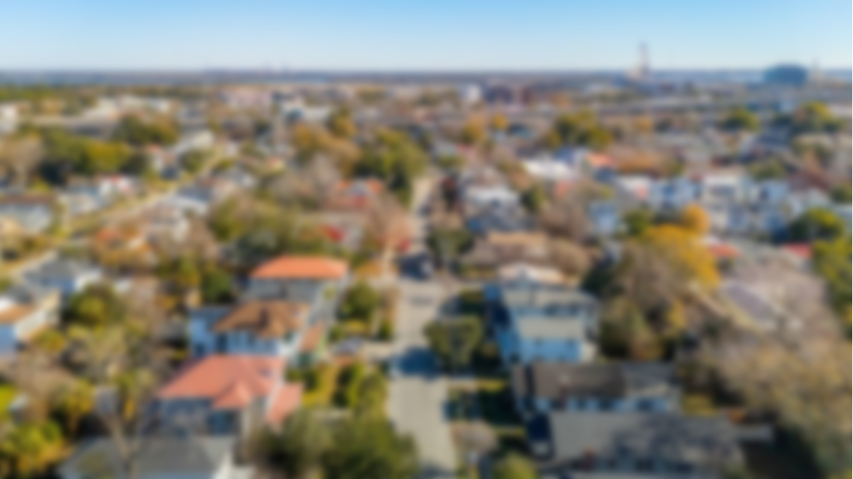
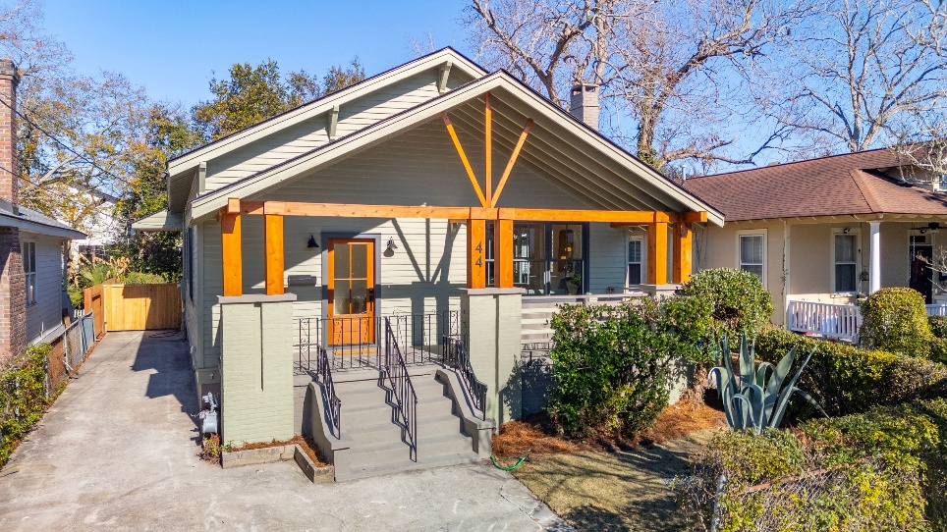
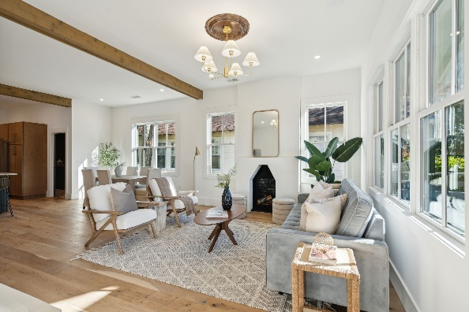
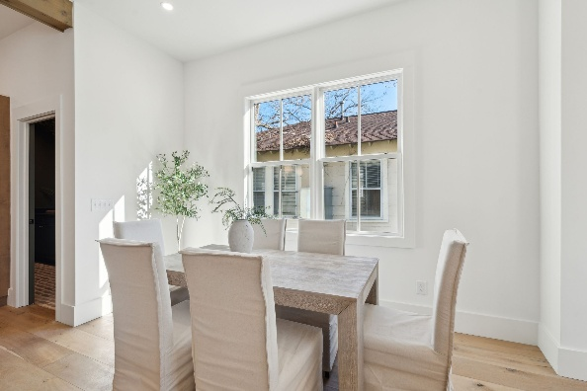
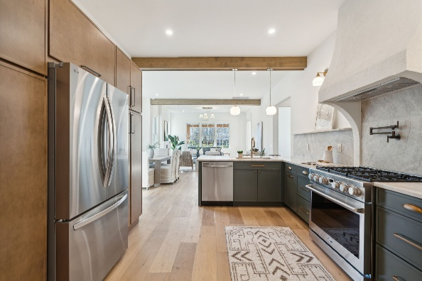
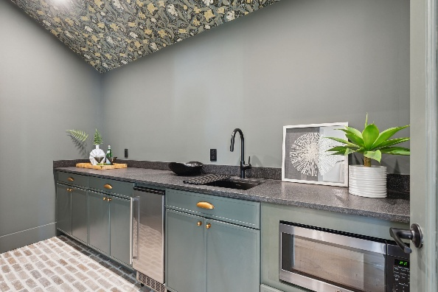
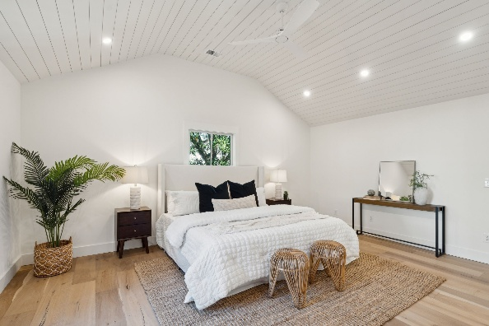
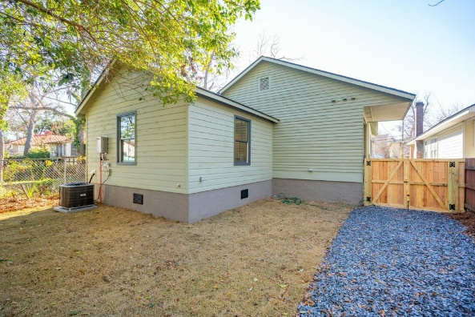
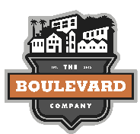
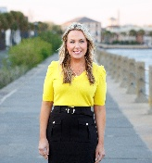
Just Listed North Central Broker Open Thursday 12-2 Light Refreshments Will Be Served
44 Poplar Street
North Central | Charleston, SC 29403
MLS# 25000309 | $1,350,000
Welcome to 44 Poplar Drive, where sophisticated southern living meets urban convenience. This chic, contemporary home with historic charm is located in the heart of the Peninsula. Taken down to the studs in a full renovation in 2024, this home offers a unique opportunity to live on a lush tree-lined street in the desirable North Central community. This vibrant neighborhood has great energy and continues to add popular new walkable restaurants, bakeries, coffee shops, markets, and other small boutiques.
A meticulous and thoughtful restoration has fully transformed this home, seamlessly blending luxurious modern upgrades with timeless architectural features. A hospitable southern front porch welcomes you as you enter the home. Stepping inside you will be greeted with an abundance of natural light filled spaces and open floor plan with all new high end hardwood flooring, tiling, custom cabinetry and countertops, top of the line appliances, lighting, painting and upscale finishes throughout. The well-appointed gourmet custom kitchen and open living/dining is perfect for seamless entertaining. Entering the butlers pantry off the kitchen you will notice the Charleston brick flooring and inviting wallpaper. This room offers additional storage and room for a beverage station. The two secondary bedrooms and a full bathroom are located off the living space. The laundry room offers counterspace for folding and a sink. The private and spacious primary suite is located in the rear of the home and includes a vaulted ship lapped ceiling. Retreat to the elegant primary bathroom that includes an expansive shower, a multitude of high end finishes, and a large walk-in closet.
The backyard oasis offers privacy with the lush vegetation and room for a patio or deck to extend the entertaining outdoors. There is off street parking and additional gravel for golf cart parking in the backyard.
Walk or golf cart to some of Charleston's favorites for a coffee and breakfast at The Harbinger Café and Bakery, lunch at Heavy's Barburger, happy hour and bites at Herd Provisions and Park and Grove, and dinner at XO Brasserie and Edmunds Oast. Centrally located to Upper King Street for shopping and night life, The Citadel, and Hampton Park.
Virginia Landon 803-493-9202
vlandon.realestate@gmail.com
The Boulevard Company | 806 Johnnie Dodds Blvd Ste 100 | Mount Pleasant, SC 29464

