Slide 1
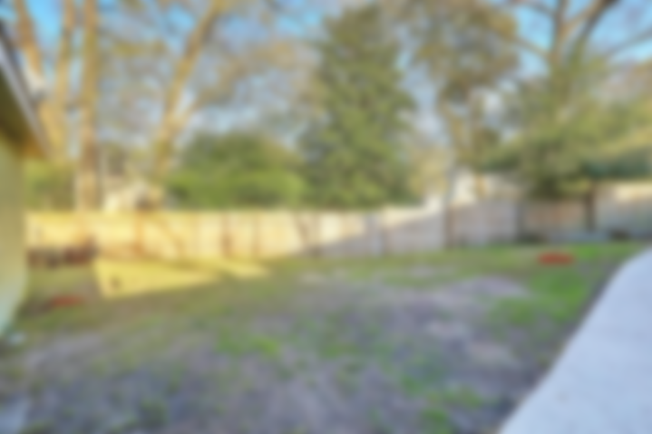
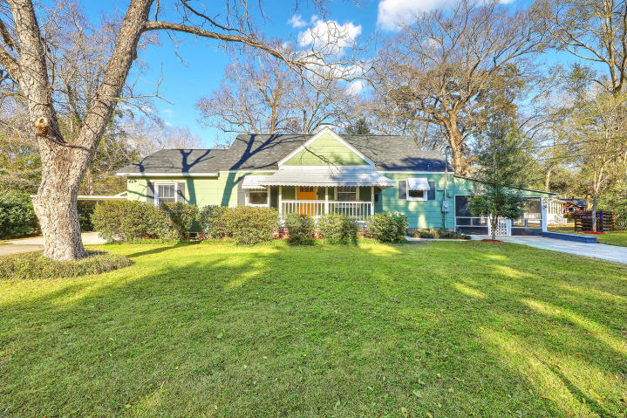
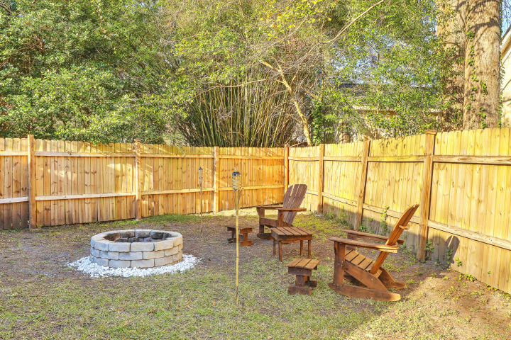
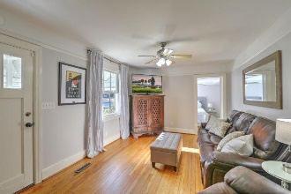
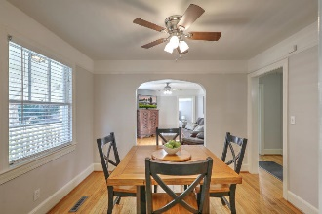
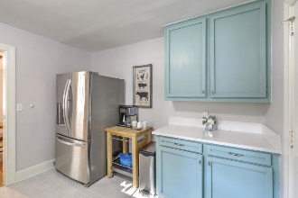
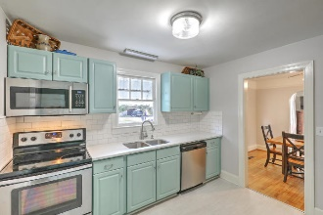
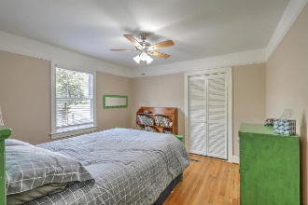
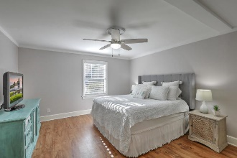
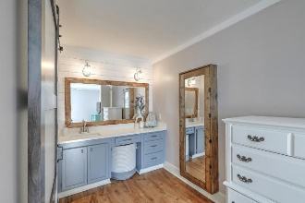
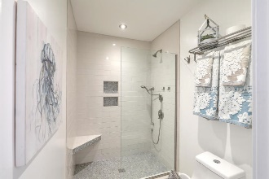
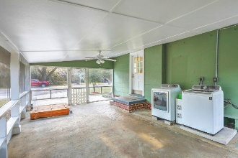
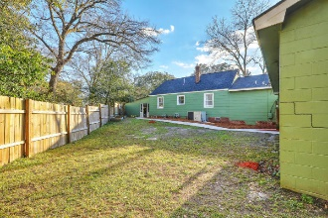

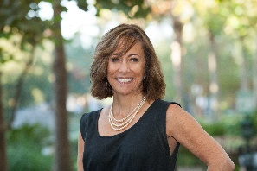
Park Circle | Just Listed! Open House Sat 12-2
4502 Holmes Avenue
North Charleston, SC 29405 | MLS# 19002926 | $294,975
Don't miss this rare opportunity for a lovingly updated home in Park Circle on an oversized corner lot for under $300k! Features of this immaculate home include**Brand new roof in 2018**Updated kitchen w/quartz counters, tiled backsplash and S/S appliances**Spacious Master Suite with brand new spa-like oversized tile shower w/glass enclosure**Renovated guest bath w/shiplapped walls and tiled tub**Two nicely sized guest bedrooms**Fenced in yard w/firepit, providing privacy and space for entertaining** Enjoy quiet southern nights in your screened-in porch which could be easily converted for more living space or back into a carport**750 SQFT Detached garage & carport offering you flexibility for parking & storage or workshop**Lot size qualifies for 2 separate dwellings - lots of potential for a future guest suite or mother-in-law apartment. And, NO HOA OR FLOOD INSURANCE REQUIRED! Just a short bike ride to all the restaurants, shops and bars that Park Circle has to offer as well as an easy walk to the Mixon Club. And the surrounding area is loaded with options for residents to enjoy including the Danny Jones Aquatic Center, North Charleston's Riverfront Park and only blocks away from Felix Davis Community Center, home of the North Charleston Farmers Market from May through October.
Desiree Maurer Office - (843) 416-2000
Mobile - (843) 327-9010 desiree.maurer1@gmail.com
www.yourcharlestonhousesearch.com
Keller Williams Realty 496 Bramson Ct Ste 200 Mt. Pleasant, SC 29464

