Slide 1

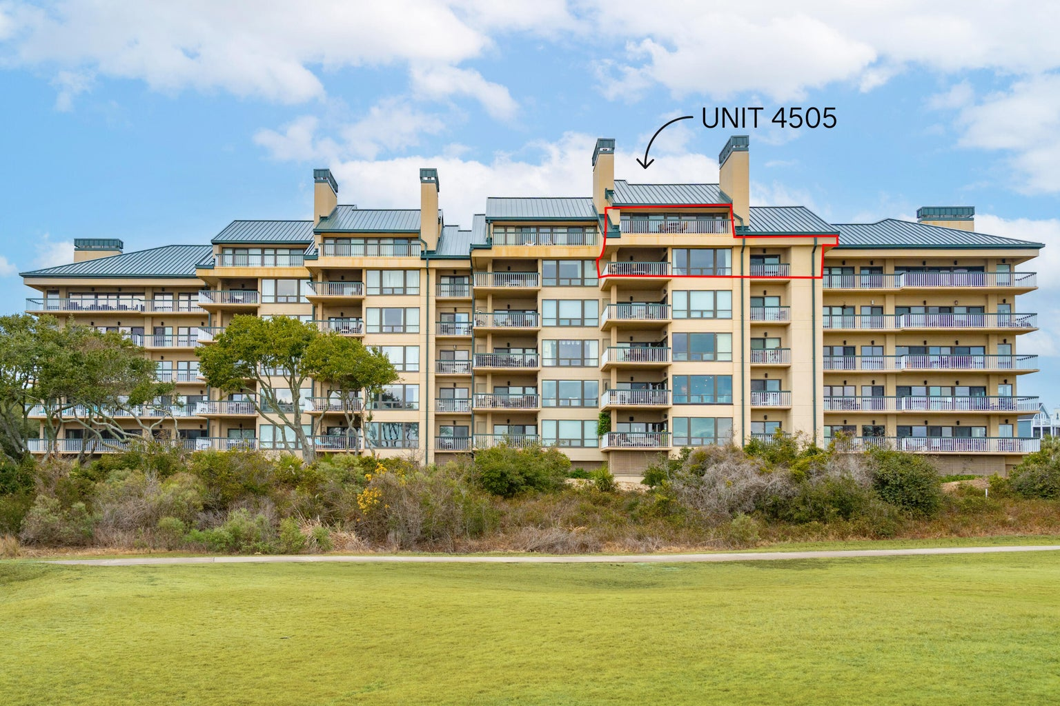
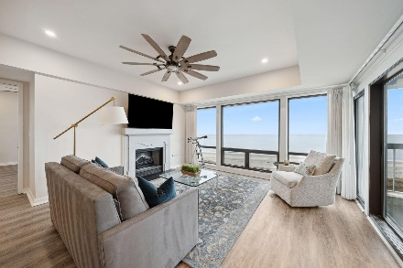
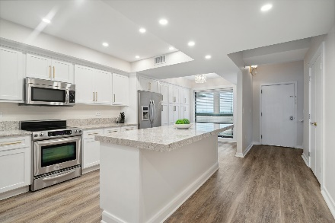
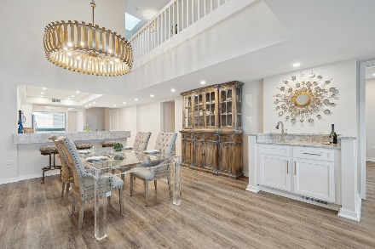
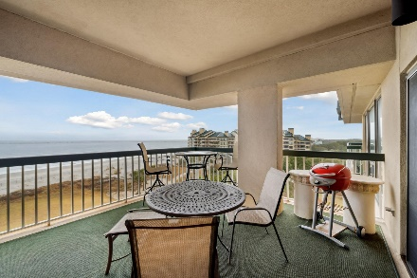
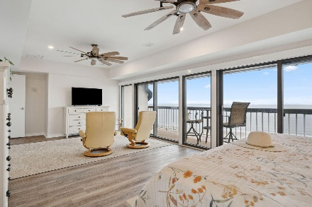
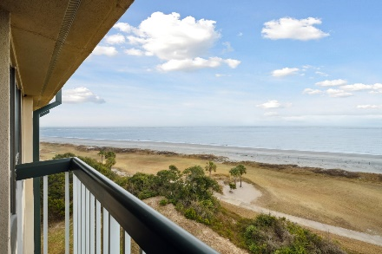

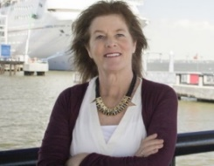
4505 Ocean Club
Wild Dunes | Isle of Palms, SC 29451 | MLS# 24001864 | $3,795,000
Stunning Three Bedroom
Oceanfront Penthouse
This updated and highly coveted two story penthouse in Building 4 showcases Ocean Club at its finest. The open kitchen/dining/living room layout and design delivers the highest and most unobstructed views of the Atlantic Ocean and offers two primary bedroom suites and a third guest bedroom. Each en-suite bedroom has a private deck with a full ocean view. The second floor is a dedicated primary suite with almost 1,000 square feet of living space --it is incredibly spacious with a 26 foot oceanfront balcony running the entire length of the room. Two large walk-in closets provide plenty of extra storage. The unique layout of this unit with its two-story vaulted ceiling enables the addition of considerable square footage--add an extra bedroom, media room, or gym. This penthouse has been recently renovated with high quality construction and materials such as granite countertops, custom cabinetry, high-end appliances, LVT flooring, ice maker and bar, and specialty lighting. Due to its position in the building, natural light flows in from both the Intracoastal and Atlantic waterways and from over 400 square feet of deck space. It is being offered partially furnished, including appliances, electronics, window treatments and bedding (See List of Exclusions).
Ocean Club is a gated community on eight acres of land at the tip of the Isle of Palms. Stunning live oaks surround the community's private residence pool outfitted with two gas grills, picnic areas and night lighting and security cameras throughout the property. Two covered parking spots per unit are available in the garage along with additional storage. Wild Dunes Resort offers two Tom Fazio-designed golf courses, 12 hartrue tennis courts, five pickle ball courts, countless pools, a fitness center, and miles of walking paths. Come sip a morning coffee in the company of soaring pelicans from your private penthouse balcony or go for a long walk on the pristine beach just steps away and treat yourself to the luxury of this lifestyle!
Fantastic Rental Property
Ann Cortes
Office - (843) 886-8110
Mobile - (843) 324-6808
ann.cortes@carolinaone.com
Carolina One Real Estate | 1503 Palm Blvd | Isle of Palms, SC 29451-2280

