Slide 1
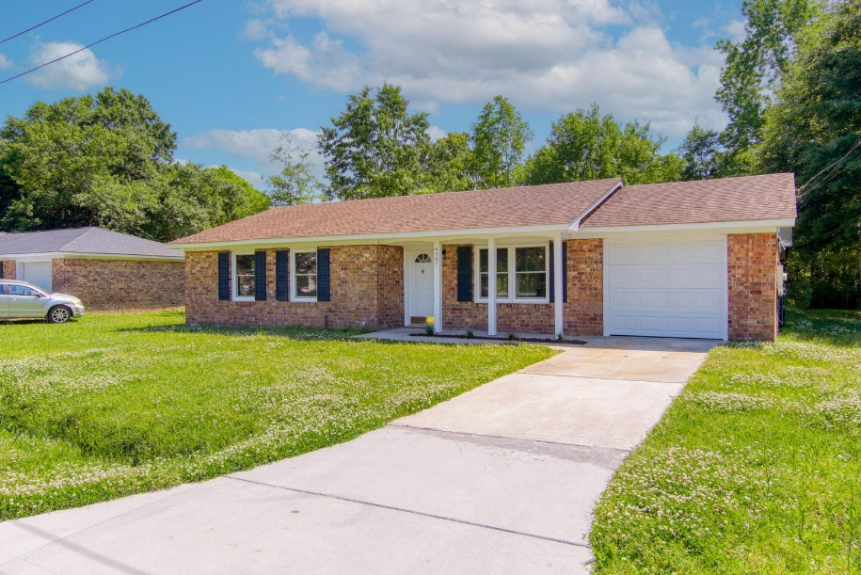
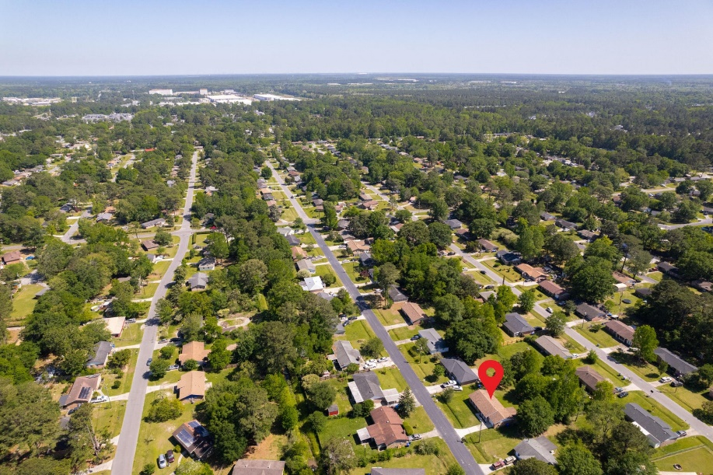
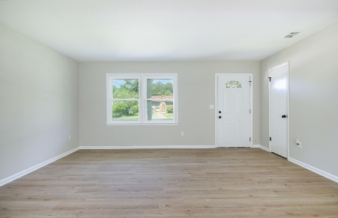
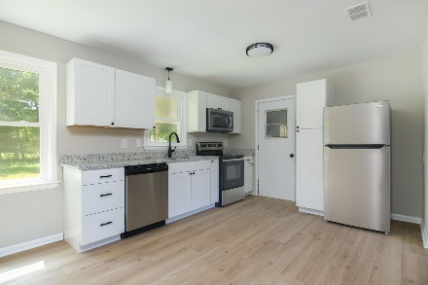
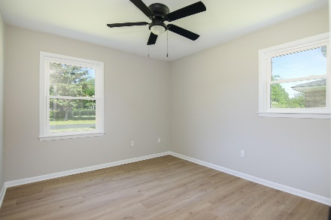
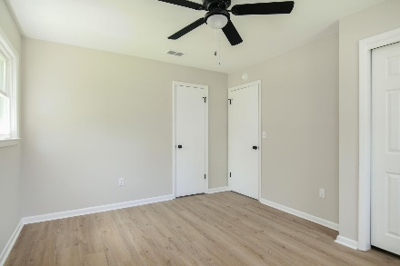
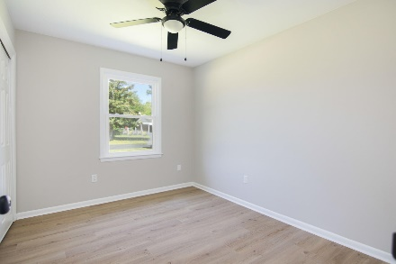
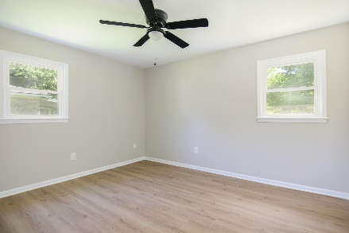
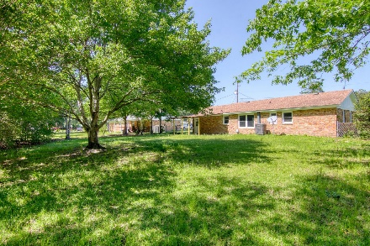
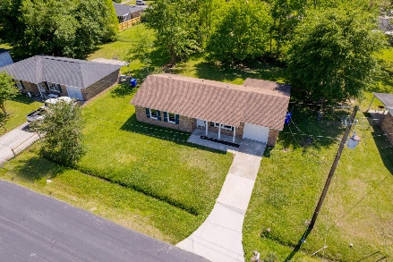
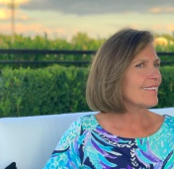


4507 Hardwood Street Woodside Manor | Ladson, SC 29456 MLS# 23008666 | $260,000
JUST LISTED
Come on inside and view your newly remodeled 3 bedroom, 1 full bath home located in the heart of Woodside Manor, a peaceful & pleasant community environment! Must add that there is No HOA. Discover an open concept living space with plenty of natural lighting and which offers many NEW features to include: new wood laminate flooring throughout, new kitchen cabinets, granite countertops both in kitchen & full bathroom, newly installed windows, new HVAC and roof, brand new garage door, state of the art hardware, new large bathroom vanity, newly added covered back porch. Walk out to a LARGE fully fenced-in backyard ready for your outdoor entertainment. This home has great value and is sure to be a smart investment for you as a potential first time buyer or family to enjoy for a lifetime!
Susan Stanley
832-323-5573
susancstanley@gmail.com
Brand Name Real Estate
4 Carriage Lane Suite 106
Charleston, SC 29407

