Slide 1
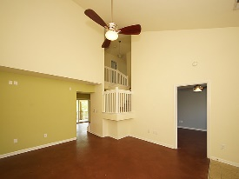
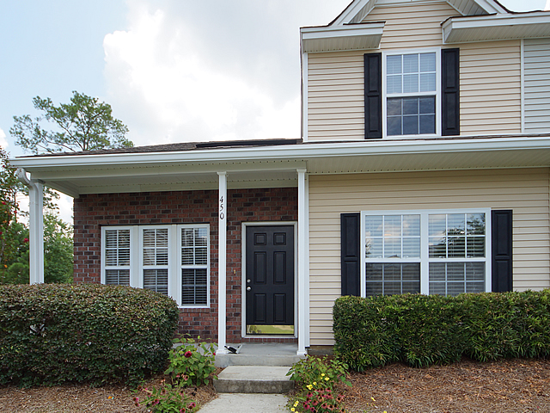
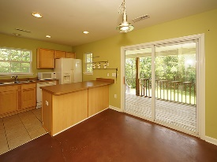
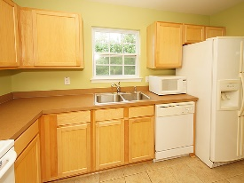
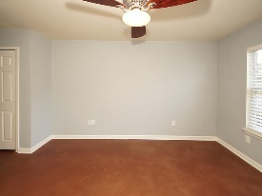
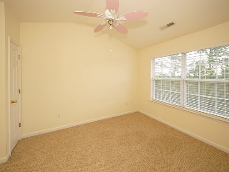
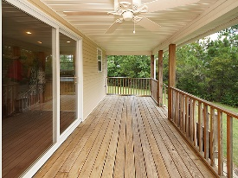
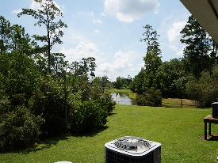


Spectacular 3 Bedroom Town Home ~ Short Sale!
End Unit On The Pond!
450 Doane Way
Beresford Commons
Charleston, SC 29492
Open House Canceled!
Under Contract In 3 Days!
MLS# 17020666 | $170,000
3 Bed / 2½ Bath
Spectacular 3 bedroom town home, end unit on the pond!
Spacious town home and a large screened porch over looking the pond make this a great choice for town home living.
Beresford Commons is conveniently located to Daniel Island, Mount Pleasant and down town Charleston.
Connie White, Broker
C: 843-532-3356
conniesyouragent@gmail.com
Charleston Homes
597 Old Mt. Holly Road
Suite 301
Goose Creek, SC 29445

