Slide 1
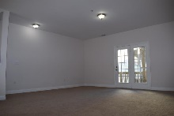
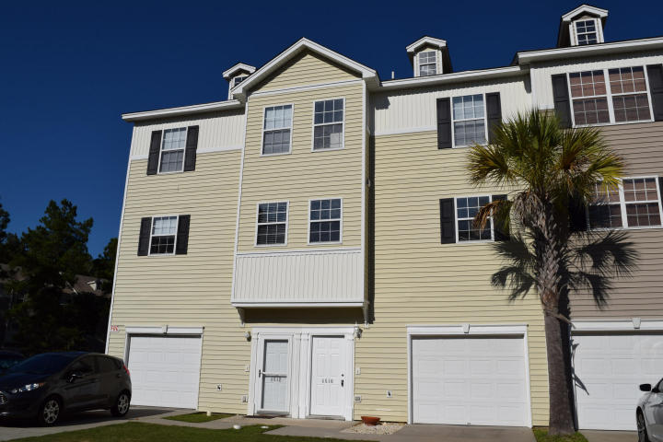
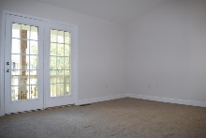
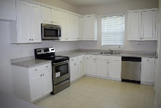
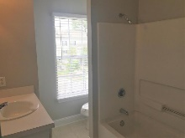
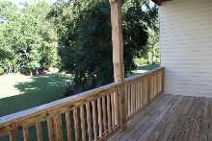
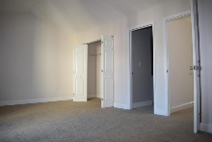
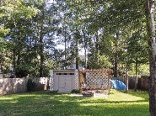
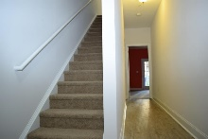
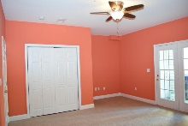
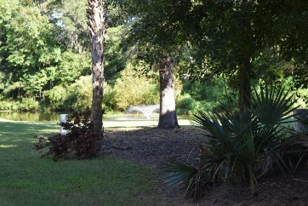
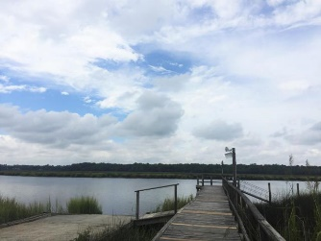
4510 Great Oak Drive
Ashley River Commons ~ North Charleston ~ MLS# 16023072 ~ $157,000
Sat & Sun 1-4pm
Open House This Weekend
$5,000 toward buyer's closing cost.
$5000 agent bonus w/ BIC approval.
3 Bedroom, 2.5 Bathroom townhouse with double decks, and garage. Open floor plan with 9’ smooth ceilings. Freshly renovated with new stainless steel appliances, new flooring, carpet and paint. This hidden gem community is 5 minutes from Boeing and yet quiet and walking distance to the community library. Located near shops and many things to do.
The community is tree lined, has a pool, tennis courts, boat storage and dock and boat launch on the Ashley river. Ideal either a home or a great rental for investors seeking to take advantage of the rapid growth in this area.
*** Listing Agent is a part owner of this property**
Christopher Watson
(843) 471-0956
chris@chriswatson.com Harbourtowne Real Estate | 672 Marina Drive, Ste 110 | Daniel Island, SC 29492

