Slide 1

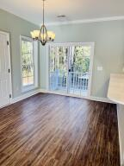
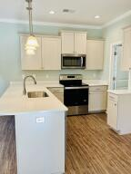
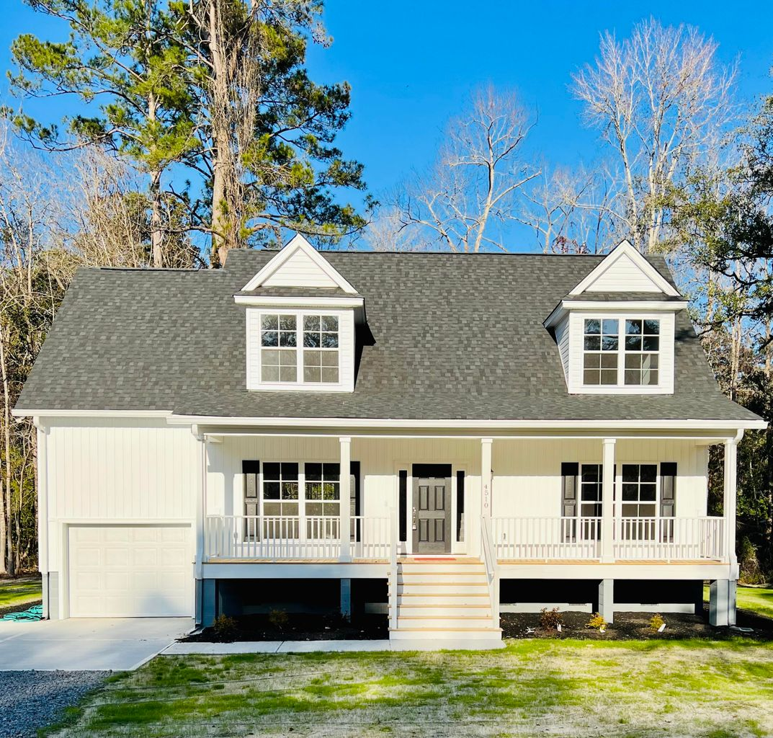
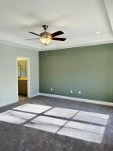

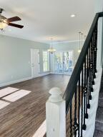
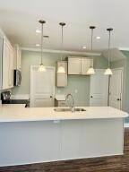

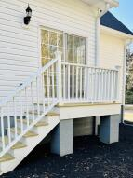


Modern Country Farmhouse
4510 Smoak Road
Meggett, SC 29449 · MLS# 22001058 · $445,000
YES, This home is complete and MOVE IN READY! Took longer than expected to complete, now ready to show. This Brand new home, WITH a full bumper to bumper warranty will be ''repair wise'', worry free for many years. Meaning no big surprise repair expenses. Modern Farmhouse in the highly sought after town of Meggett, NO HOA! 3 Large BR, 2 1/2 bath, Beautiful master ensuite on first floor with tray ceiling, upgraded bath w/ his&her sinks, walk in closet. Two large bright bedrooms and full bath upstairs. 1/2 bath on first floor for guests. Double dormers added upstairs in each bedroom, very bright and roomy. Custom country style interior doors throughout. Quartz Kitchen counter, Soft close Cabinets, and drawers, pantry for storage & large laundry room off kitchen. Quartz Kitchen countertops, Soft close Cabinets, and drawers, pantry for storage & large laundry room off kitchen.Quartz Kitchen counter, LVT Barnboard flooring Kitchen, living & Dining. Tile in all bathrooms, and quartz counter tops in guest bath and upstairs full bath, Granite in Master bath and tile in all bathrooms. Brushed nickel fixtures throughout. Majestic Grand Oaks on property give it that southern charm and now that land has been cleared, the canopies are filling in beautifully.
Attached garage, charming southern style Covered Farmers Porch. Dutchlap white vinyl siding, Black shutters, Charcoal roof. Front door a Charcoal color doorway with glass panels on both sides. Also added two side by side outside concrete parking spots, no car shuffling in the morning. The great thing about a brand new home? It has a 10 year transferable warranty for the new owners. 10 years on anything structural, warranty on appliances, and HVAC, and more. I have a three ring binder with all the info. Move in with no worries. This home is located on a quiet cul de sac. PRTC has installed fiber optic High speed internet on street. Listing agent is one of the owners.
Becky Bouchard
(978) 257-0353
nearbyagent@gmail.com
AgentOwned Charleston Group
902 Savannah Hwy
Charleston, SC 29407
Real Estate ● Mortgage Insurance ● Business Brokerage

