Slide 1

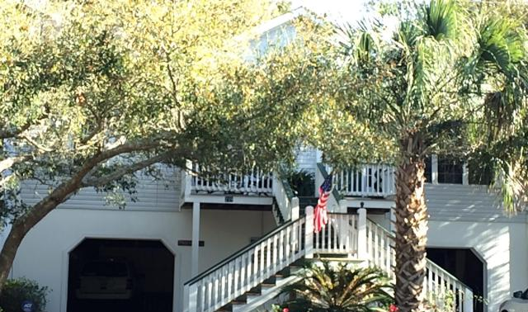

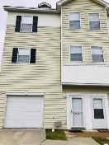
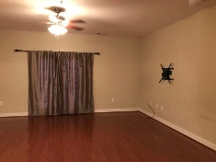

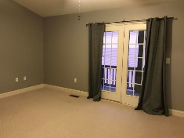
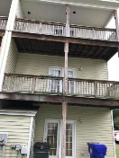
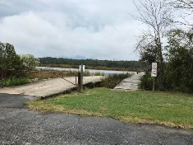
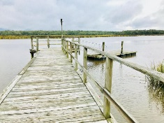

Jane Locke, Realtor
M (843) 819-3508
lockejaneb@aol.com
www.century21properties.com
Ashley River Commons
Great Location ~ Mint Condition!
4512 Great Oak Dr | North Charleston | MLS# 18030257 | $185,000
DRAFT
This townhome has been well maintained and is in mint condition. It is convenient to Boeing, Air Force Base, Bosch, I-26, I-526. It has 3 nice sized bedrooms, three full baths, plus a half bath. It has real wood floors on the first and second floors. The third floor is carpeted. It is an end unit, so it is quiet and private. There are balconies on the second and third levels with a patio and storage closet on the first floor. There is an oversize one car garage with work bench. There is a transferable American Home Shield Warranty in place on the townhome. There are tennis courts, a walking trail, boat dock, club house, boat launch, and boat storage. It is located on the banks of the Ashley River with beautiful mature oaks. Come look at your new home.
Century 21 Properties Plus | 3301 Salterbeck St Suite 100 | Mt. Pleasant, SC 29466

