Slide 1

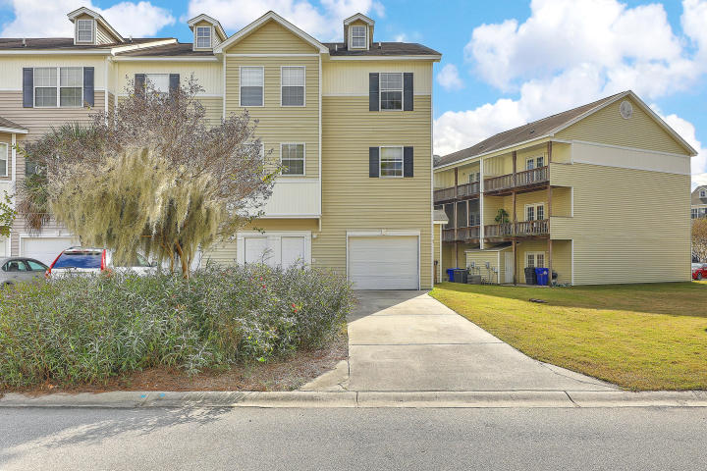
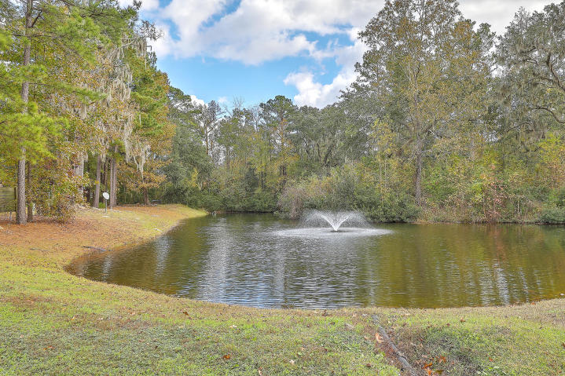
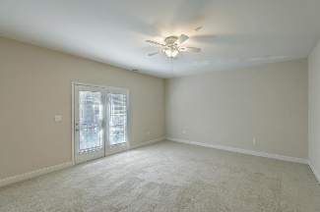
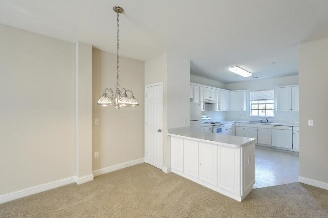
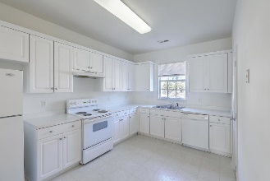
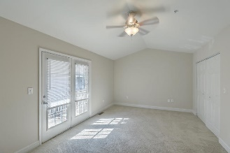
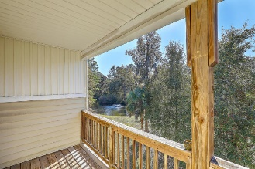
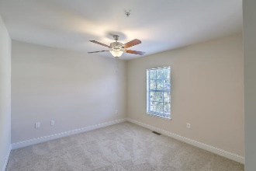
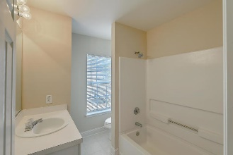
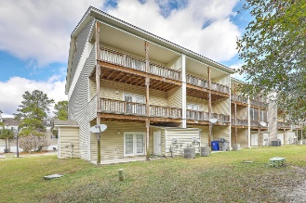
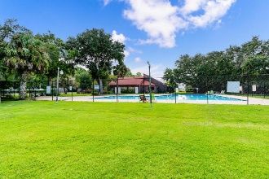



JUST LISTED!
Ashley River Commons | Move-in Ready 3-Story End Unit Townhome
4518 Great Oak Drive
Ashley River Commons | North Charleston, SC 29418 | MLS# 20032922 | $189,975
Location! Location! Location! This FRESHLY PAINTED 3-story end unit townhome, with BRAND NEW CARPET, is ideally situated to Boeing, Joint Base Charleston, Bosch and the airport! As you enter the 1st floor, you will find a large bedroom in the rear that opens to a covered patio. The 2nd floor opens up to a spacious living/dining area, also with a covered porch overlooking a peaceful pond. The large eat-in kitchen has plenty of storage and counter space and a half bath is just around the corner. You will find Dual Owners Suites on the 3rd floor, the main one with vaulted ceilings, a huge bathroom with dual vanities, soaking tub and separate shower and the other which has a walk-in closet. All 3 floors have 9 ft ceilings which makes the unit even more spacious. And, don't forget about the awesome amenities at the River Club which includes the clubhouse, pool, tennis courts, boat ramp with deep water access, boat storage and dock on Ashley River. Close to the public library and schools, this move-in ready home is available now! Schedule your showing today!
Video Tour: http://vimeo.com/488982919
Desiree Maurer
Office - (843) 416-2000
Mobile - (843) 327-9010
desiree.maurer1@gmail.com
www.yourcharlestonhousesearch.com
Keller Williams Realty
496 Bramson Ct Ste 200
Mt. Pleasant, SC 29464

