Slide 1
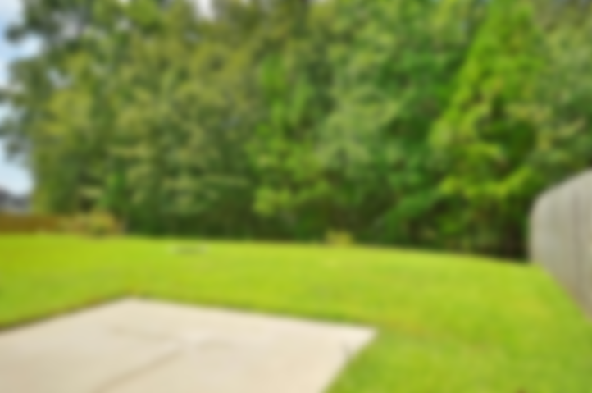
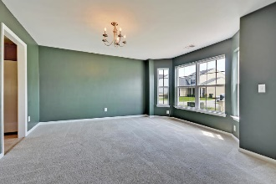
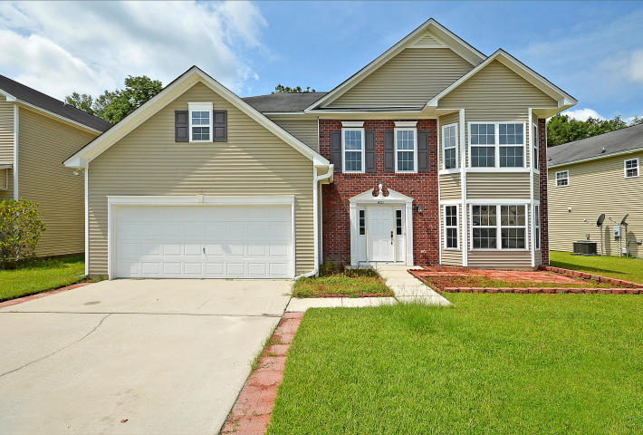
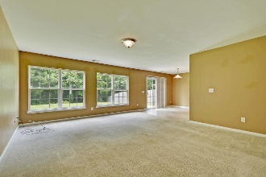
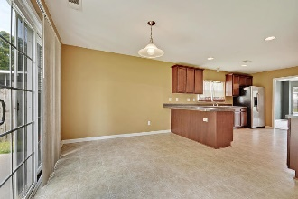
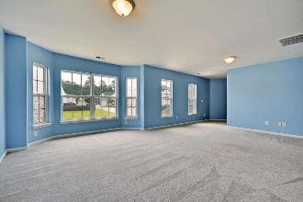
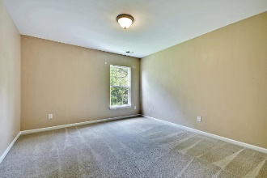
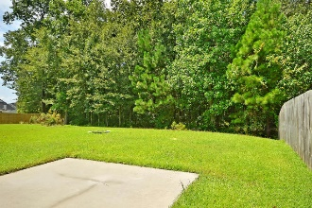
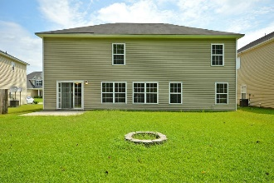
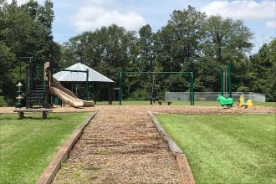


451 Green Park Lane Brickhope Greens | Goose Creek, SC 29445 MLS# 19023553 | $285,000
New to Market!
Asking $1,200,000
MLS# 17023051
3,692 SqFt
4 Bed/3½ Baths
Short Drive to Historic Downtown Charleston & Beaches
Colonial style home in a prime location close to the NWS, Volvo, Mercedes, Spa War, Trident Hospital, Boeing & the USAFB/CHS int'l airport. Enter into the foyer leading into the separate dining room to the kitchen and an extra large family room. The family room has a nice fireplace and doors to the large wooded backyard. The master is down with a spacious walk in closet and ceiling fan. The nice sized master bath has a separate shower, soaking tub & dual sinks. Upstairs is a huge bonus room with four bedrooms, two baths and a large laundry room. There is also a nice playpark in Brickhope Greens. Fresh landscaping in the front yard coming soon!
Gay Slough (843) 452-9708 gslough@carolinaone.com Carolina One Real Estate • 195 W Coleman Blvd • Mount Pleasant, SC 29464
www.gayslough.com

