Slide 1
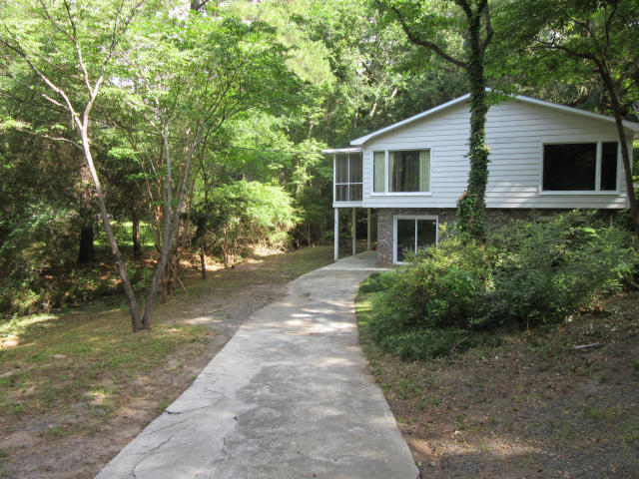
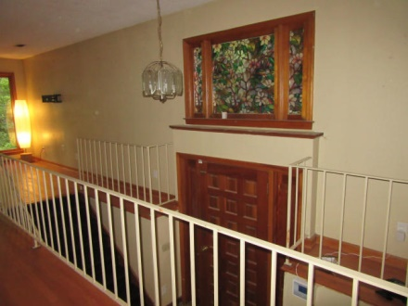
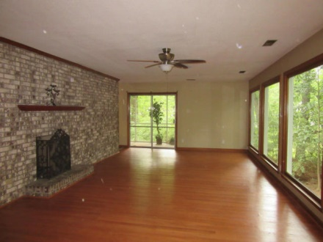
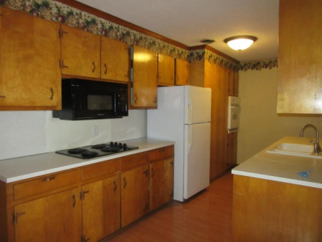
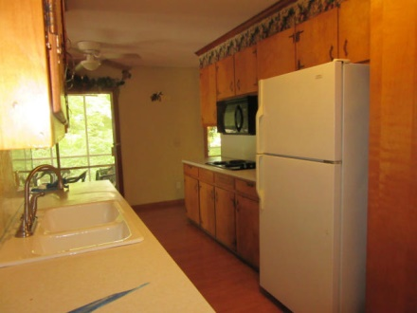
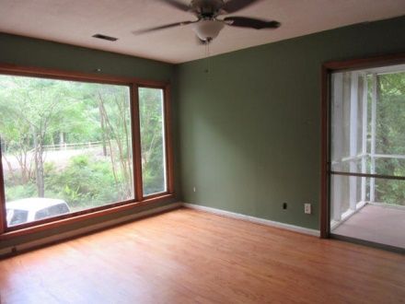
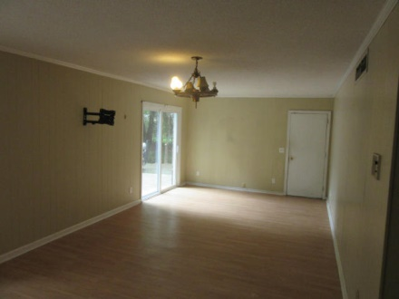
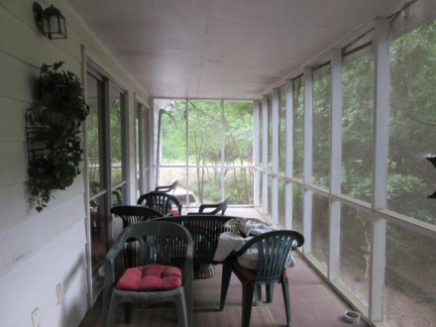
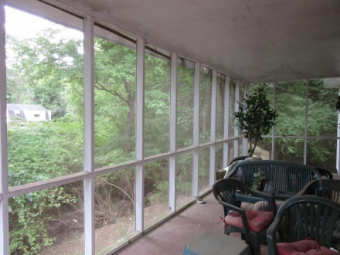
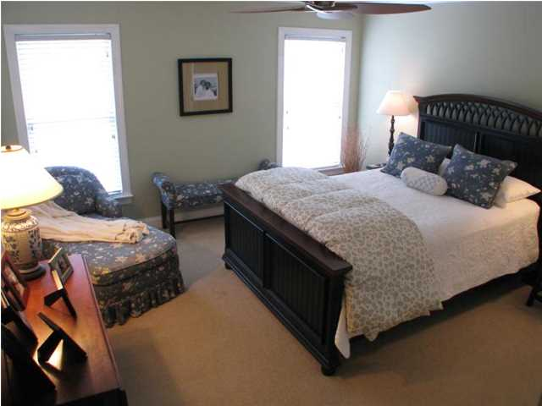
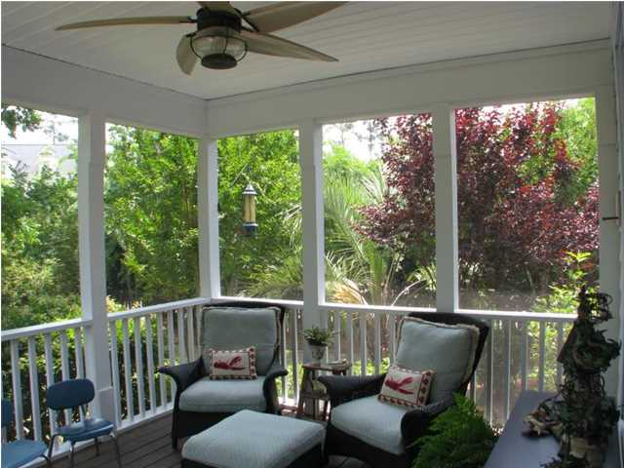
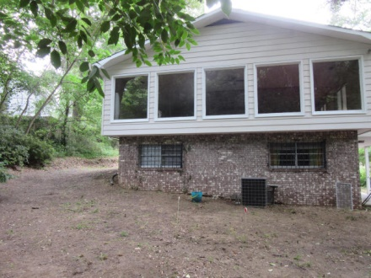
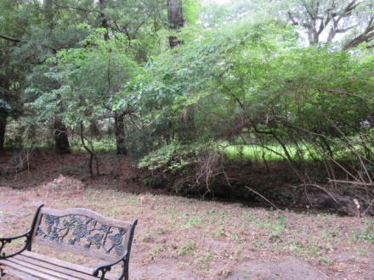


4528 Withers Drive Wando Woods North Charleston, SC 29405 MLS# 15014224 $189,000 5 Bedrooms | 2 Baths | 2,371 sf
Your new home is located in a beautiful well established neighborhood and is minutes from a DEEP WATER boat ramp. Home features 5 bedrooms, 2 bathrooms, great room, family room, eat-in-kitchen, laundry room, screen porch and a carport. The great room has a wall of windows that provide light, lovely view of the live oak trees, wooded yard and a wood burning fireplace set in a brick wall. Kitchen has a electric cooktop, electric wall oven, refrigerator, dishwasher, built-in microwave and pantry. Beautiful red oak hardwood floors, ceiling fans and crown molding add to the charm and character of the home. Master bedroom has wooden French doors, ceiling fan and a unique walk-in closet with built-ins. The large screened porch is just off the great room and overlooks the large back yard. Attic stair pull down provide easy access to storage and there is additional storage under the stairs. Located just minutes from downtown, schools, College of Charleston, Boeing, Air Force Base, Bosch, North Charleston Coliseum, Charleston International Airport, restaurants and Tanger Outlets.
Great location and minutes from deep water
Debbie Toombs
843-345-7895 debbie.toombs@cbunited.com
www.cbunited.com

