Slide 1
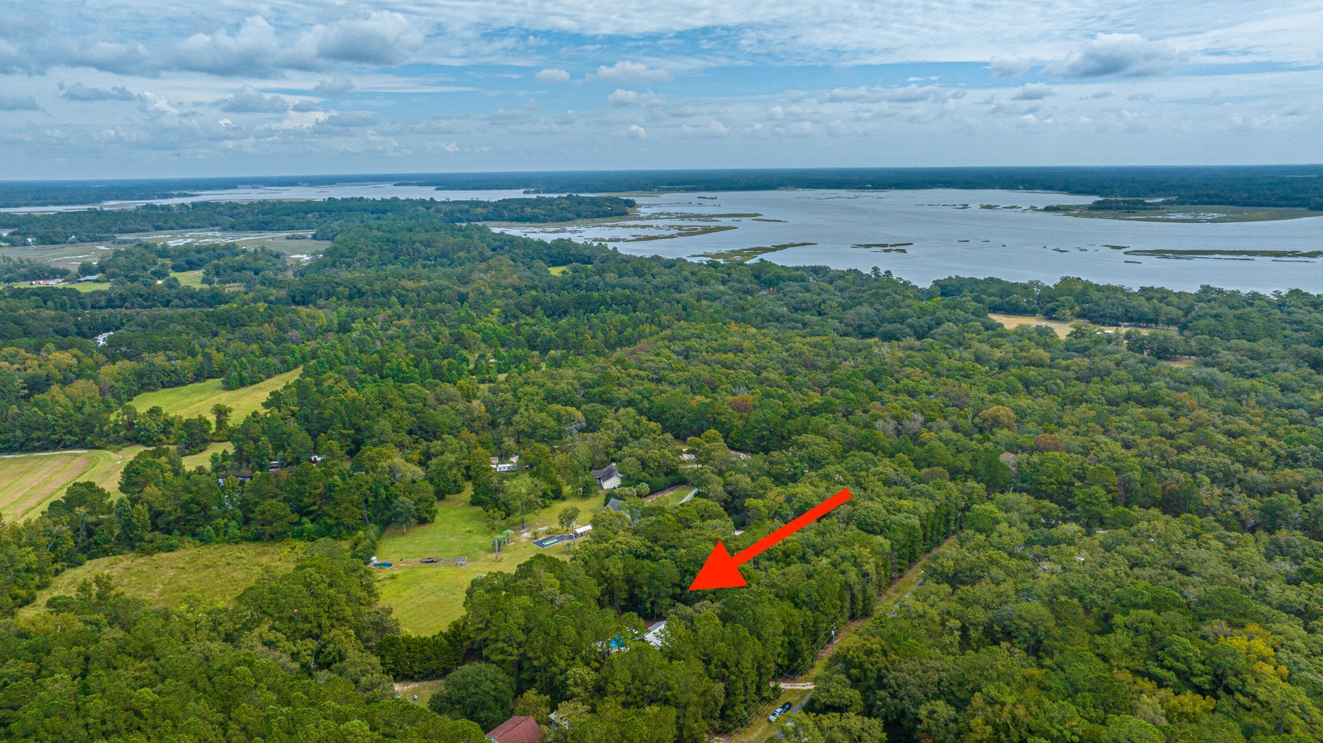
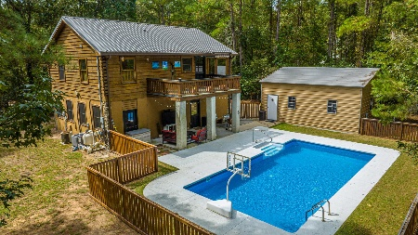
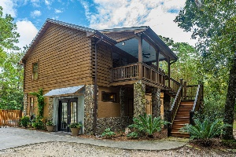
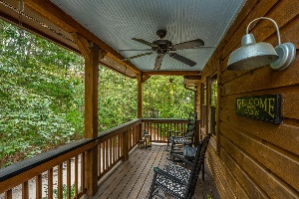
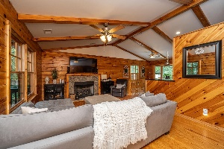
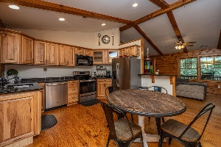
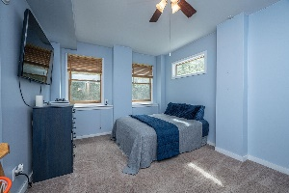
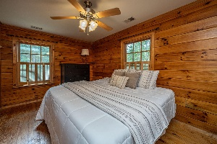
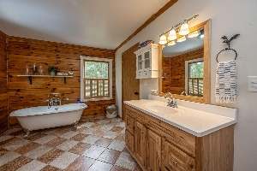
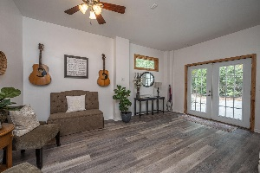
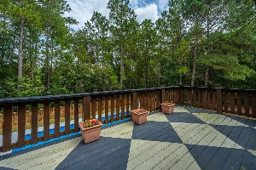
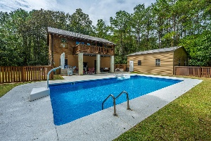
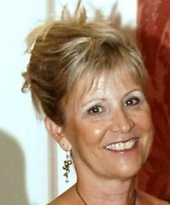

4529 Bobby Towles Drive Quigley Farms | Hollywood, SC 29449 MLS# 23023132 | $549,000
LISTED UNDER APPRAISED VALUE • MOTIVATED SELLER!
Priced below appraised value. Unique, private cabin on wooded one acre parcel with oversized garage and inground pool. Upper living area features New Heart of Pine hardwood floors. Current owners have added multiple upgrades (see documents). NO FLOOD INSURANCE NEEDED. Both house and garage have metal roofs. POA $250/year is for road maintenance. No other restrictions. 2 driveways to enter and exit.
Mary Warren ABR, RSPS, REALTOR
Mobile - (843) 224-6272
mwarren@carolinaoneplus.com
Carolina One Real Estate | 1265 Folly Rd | Charleston, SC 29412

