Slide 1
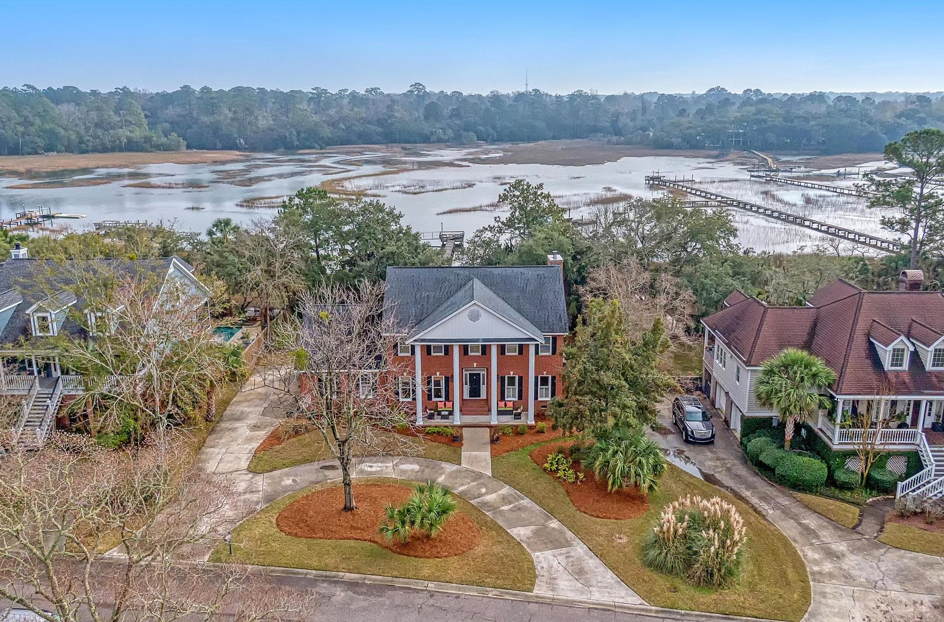



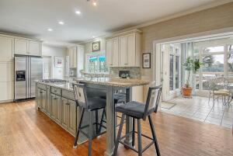

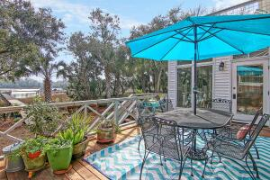
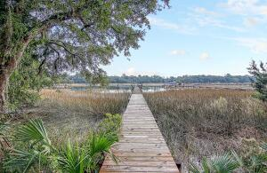


452 Rice Hope Drive
Longpoint · Mount Pleasant, SC 29464
MLS# 22002129 · $1,900,000
Rare Opportunity For Close in Water Front
Rare Opportunity to own a home close in with a private dock and floater on a tidal creek. This traditional brick home with a gorgeous full front porch and awesome curb appeal showcases 9-foot ceilings, handsome hardwood flooring and an abundance of natural light. Formal living and formal dining rooms or could be used as an office as the current owners have. The kitchen is large, perfect for entertaining family and friends, and has fabulous views of the Boone Hall Creek from the kitchen sink. The living area opens to the kitchen and a sunroom to enjoy loved ones fishing from the dock or arriving for a visit by boat. From the dock, you can see the Cotton Dock at Boone Hall. This home features a front staircase and a rear staircase near the kitchen in case guests want to have a midnight snack. Upstairs you will find a large owner's suite with all the amenities you would expect plus a sun porch overlooking the stunning water views. There are 3 other nicely sized bedrooms on the second floor that share a full bath with a granite countertop/double sink vanity in addition to a huge bonus room with a bath making this an ample 5 bedroom home. Longpoint is in the heart of Mt Pleasant convenient to Highway 17, I-526, and Downtown Charleston. The neighborhood has a public county park that is just a short bike ride away. Close to beaches, shopping and restaurants make this a premier location. This is kind of property is extremely hard to find on the water.
Take a video tour: https://vimeo.com/663215458
Stan Huff
843-670-2835
stan.huff@agentowned.com
Jill Marcacci
843-297-5590
jill@agentowned.com
www.agentownedrealty.com
AgentOwned Realty Co. Preferred Group, Inc. | 824 Johnnie Dodds Blvd | Mt Pleasant, SC 29464

