Slide 1
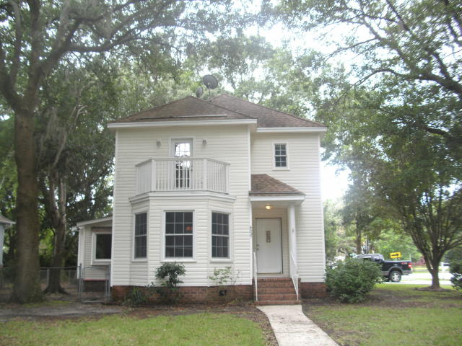
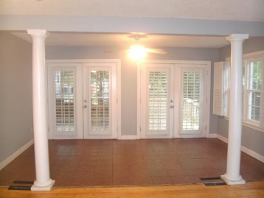
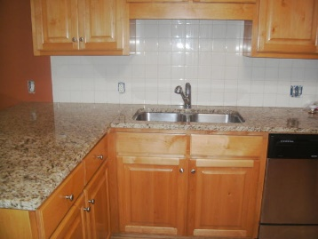
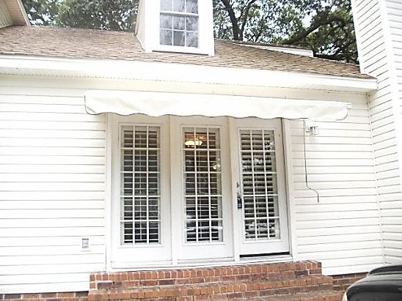
Just Listed…Near Boeing & Airport
Just Reduced!
4537 Paramount Drive
Wando Woods | 2,550 Sq Ft | MLS# 16014506 | $230,000
One of a kind custom built 2550 square foot house, 3 bedroom, 2.5 bath with a loft and screened in porch. No home owners association fees or dues. New paint, stove, AC and carpet. Seller will pay for a one year home warranty. Easy access to 526/26, Boeing and Airport.
Pate Maguire, Realtor
(843) 442-4322
patemaguire@aol.com
The Group, LLC | 2060 Skyhawk Ct | Mt. Pleasant, SC 29466

