Slide 1
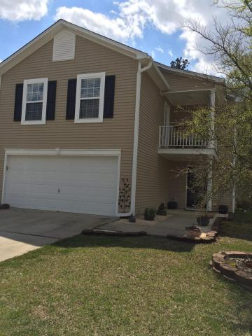
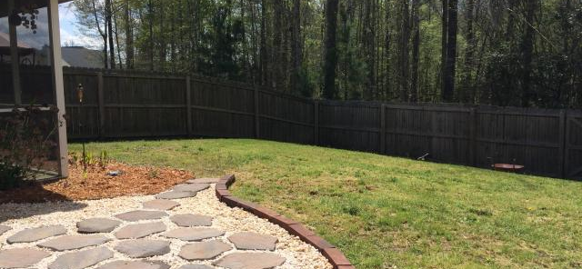
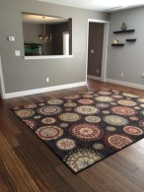
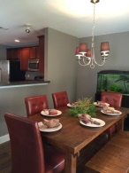
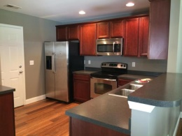
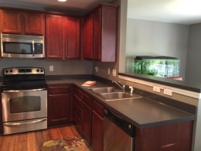
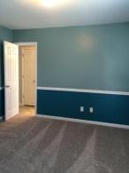
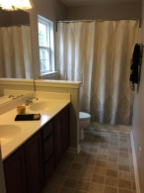
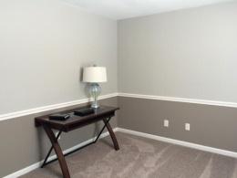
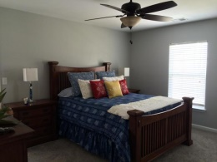
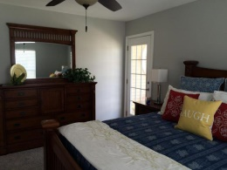
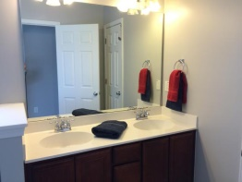
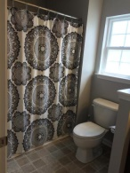
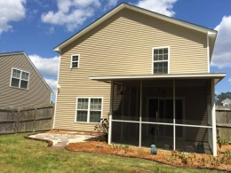
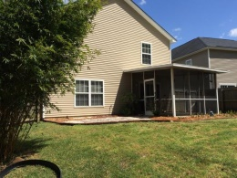


BETTER THEN NEW!
453 Green Park Lane
Brickhope Greens
Goose Creek
MLS# 15009635
$185,000
Gorgeous scraped HARDWOODS throughout 1st Floor plus NEW CARPET and FRESH PAINT throughout! Wonderful 2-story Charleston Single w/ porch off the Master Suite. Bright Family Room leads to the Cook's kitchen and separate dining space. 36'' cherry-stained maple cabinets + Crown Molding + Recessed Lighting + Stainless Steel Appliances(including side by side refrigerator) + lots of counter space = ''PERFECT FOR ENTERTAINING.'' Dining area leads to screen porch and flag stone patio overlooking wetlands behind. Upstairs are 3 good sized bedrooms and 2 full baths and laundry room. Master Suite has large walk in closet and access to upstairs porch. Washer and Dryer convey as well as all window treatments. Two car garage and beautiful landscaped yard complete the picture!
Geri Lipps
843-810-8398
glipps@carolinaone.com

