Slide 1
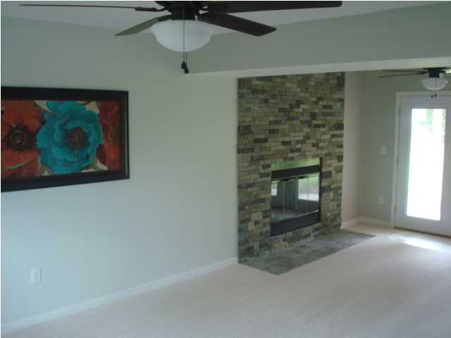
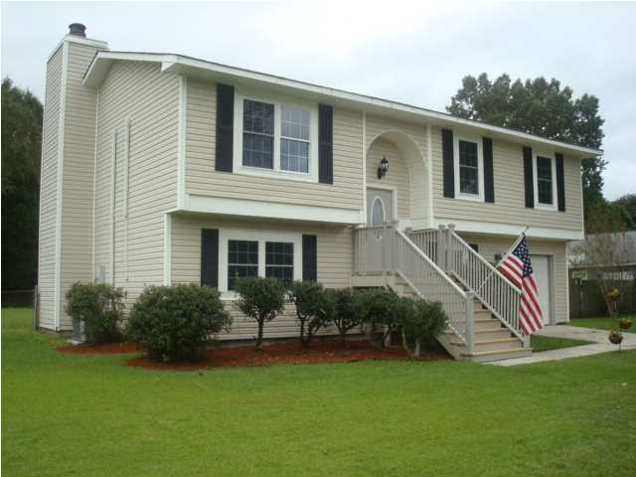
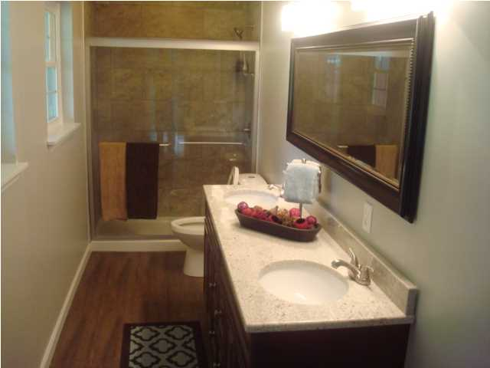
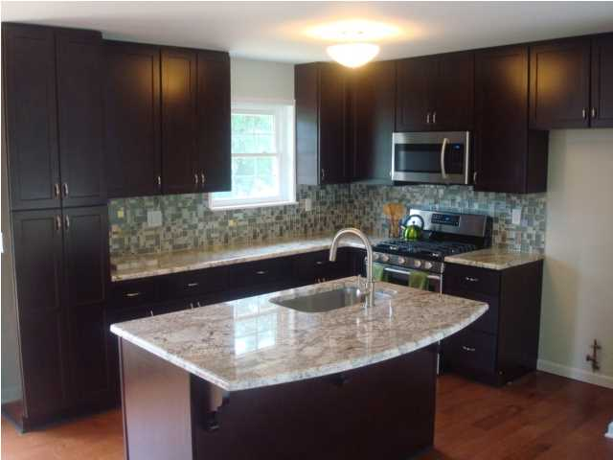
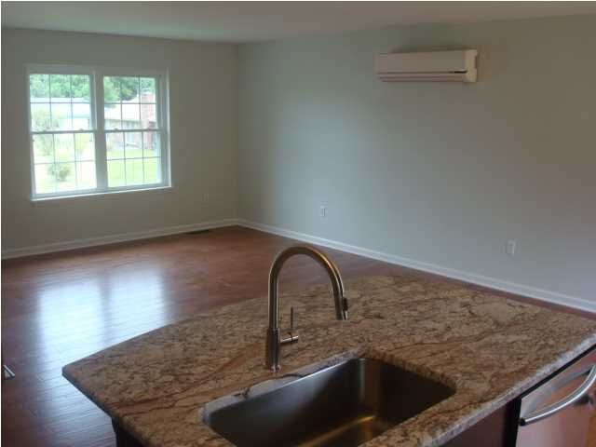
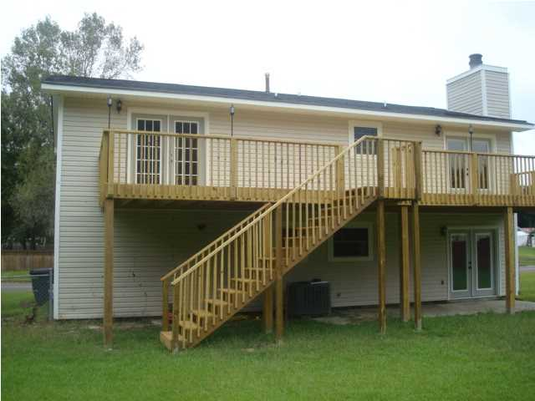
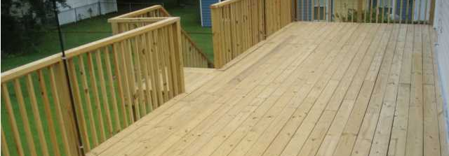
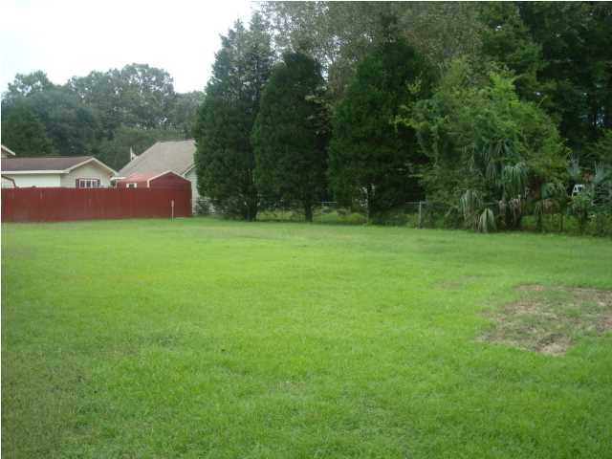
1 Mile from Boeing - Totally Renovated and Upgraded
Master Bedroom or Family Room w/Fireplace
Totally Upgraded Master Bath
Granite Countertops &
New Stainless Steel Appliances
4 Bedrooms totally Renovated and Upgraded
Open Floorplan
Rear View of Home
40 Foot Long Elevated Rear Deck
Huge Fenced Back Yard
4541 Covington Dr – North Charleston, SC
AND completely upgraded and renovated!!! Only 1 mile from Boeing...So close you could ride your bike! Just 5 minutes to I-526 and 7 minutes to I-26 and Tanger Outlet Mall and less than 30 minutes to downtown Charleston and the beaches. This home has a very unique floor plan...As you enter the home you can either go up to the main living area with living room, kitchen and 3 bedrooms or go down a few steps to what could be a large master bedroom with fireplace or if you don't need 4 bedrooms can be a family room or even a separate mother-in-law living area. The kitchen has new granite counter tops and new high end appliances. This beautiful home has been professionally remodeled from top to bottom and features an open concept living/kitchen area. All new flooring throughout, smooth ceilings, new window and doors as well as new high end appliances. A new 400 square foot elevated deck has been added to the rear of the home for entertaining. The master suite (first floor) has a huge rock fireplace and custom built doors going to the bath and walk in closet. The master bath has a tile shower, granite dual vanity and lots of space to add shelving or seating.
MLS# 1425842 ~ $188,000
Rick Willis
843-327-3017
rwillisteam@gmail.com
The Group, LLC

