Slide 1
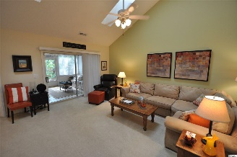
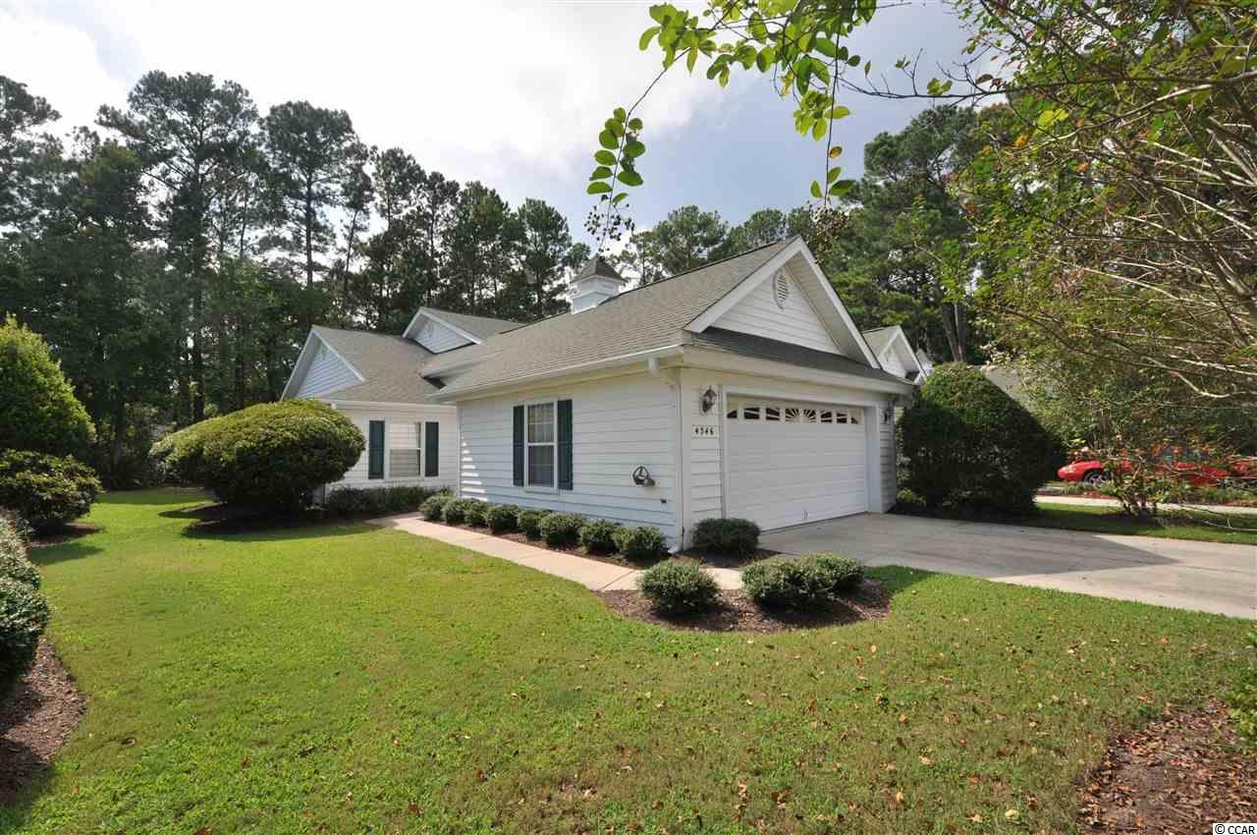
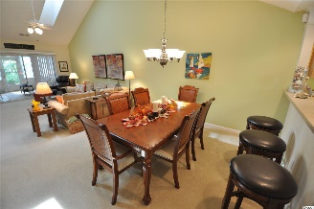
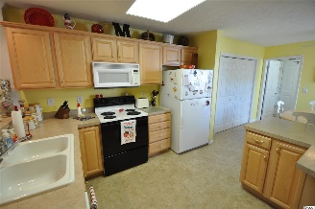
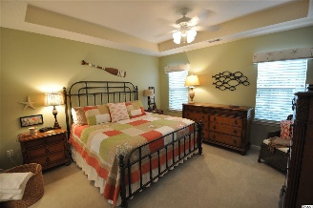
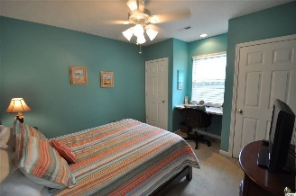
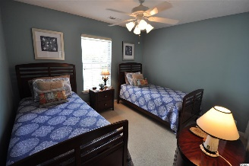
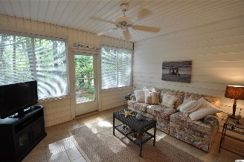
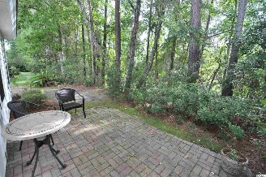
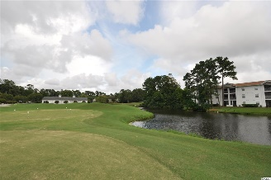
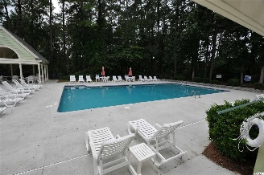


4546 Eastport Blvd #101
Eastport ~ Little River, SC 29566
MLS# 1719277 ~ $189,900
Welcome to Eastport in the charming Hamlet of Little River where living is easy, safe, carefree and oh so convenient! The Garden Homes at Eastport seem compact, but LIVE BIG! These houses are particularly desirable as they combine the best of a spacious detached-home-residence with the minimal-maintenance-lifestyle of a condo. Plus, low HOA fees include exterior yard maintenance, and the yard is on a sprinkler system. Eastport has ease of location as well to shopping, the finest and fun restaurants, recreation, beaches, the Little River Waterfront and major roads and highways. This lovely ICW community itself also features the signature Valley at Eastport Golf Course, with its own clubhouse & grill, and owners' pool.
This Garden Home is only steps from the pool & amenity center and enjoys front views of the 18th green, putting & chipping areas and clubhouse. Yet it is situated on a very private wooded lot that adjoins a secluded wetlands enclave with pond view, providing a pretty backyard setting from its well-enjoyed Carolina room and bricked patio, accessed from both the living room and master bedroom. This peaceful respite which invites quiet enjoyment of its natural surroundings can never be developed.
The beautiful, immaculate split-bedroom, two-bath pleasing floor plan features master with large ensuite, a double-car garage and windows in every living area. With high ceilings and lots of luxury extras, this delightful, rare beach-house opportunity offers unexpected space, comfort and even BIGGER VALUE!
Deborah Collins
843-424-9013
dctidewater@yahoo.com
Connie Ross-Karl
702-306-2643
conniesross@aol.com
NEW WAY PROPERTIES MYRTLE BEACH

