Slide 1
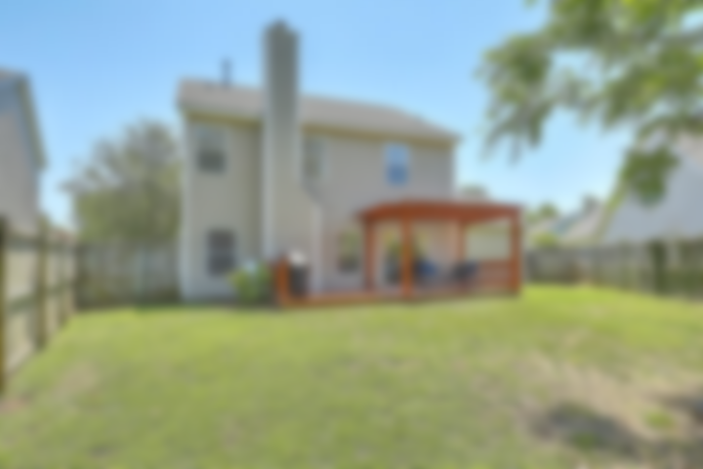
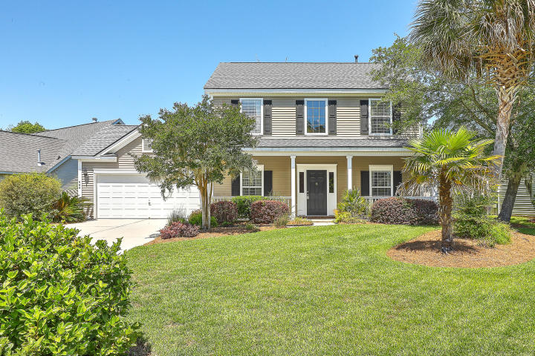
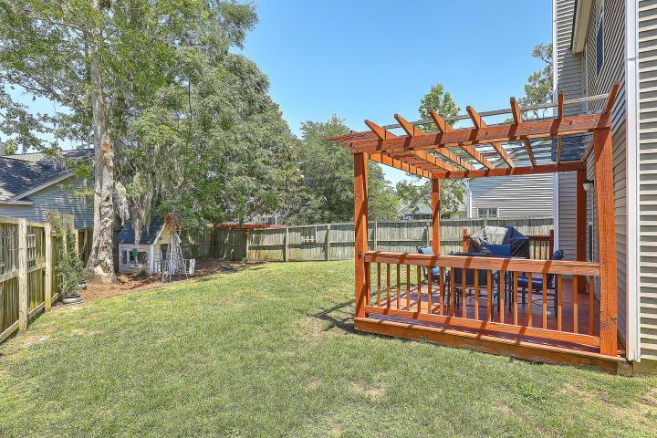
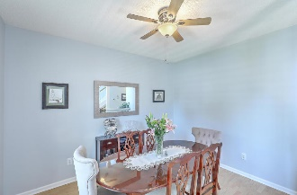
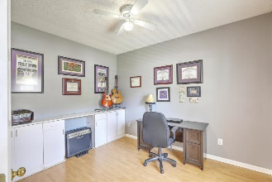
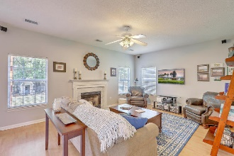
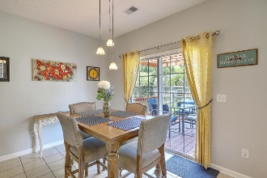
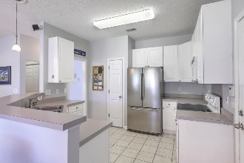
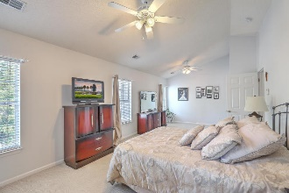
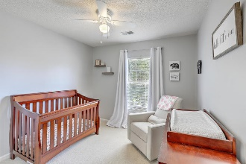
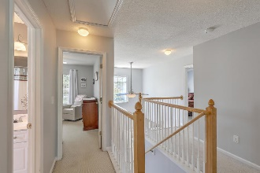
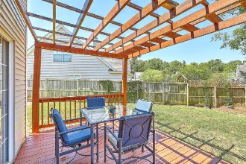



JUST LISTED! Grand Oaks | Lovely Move-in Ready Home
454 Maple Oak Lane
Grand Oaks Plantation | Charleston, SC 29414 | MLS# 20012870 | $314,975
This wonderful, well maintained home, located in the desirable Grand Oaks Plantation, is ready for its new owners! Can't you imagine sitting on your front porch enjoying some sweet tea??!! As you enter this lovely home, you will be greeted by a formal Dining Room on the left and Study with French doors on the right. Stroll past the powder and laundry rooms into the open family room with fireplace and eat-in kitchen with breakfast nook. Upstairs there is a spacious Master en Suite with sitting area and master bath with a separate garden tub and large shower. 2 nicely sized bedrooms and a full bath are just down the hall. The yard has great curb appeal with Palm Trees and nice landscaping. The back has a great deck with pergola for hanging out with friends or watching the kids in the fenced backyard. With the Bees Ferry Recreation Center just around the corner offering multiple recreational opportunities and the neighborhood pool down the street, you'll love the location in this neighborhood that's perfect for everyone, including your 4-legged family members! Be sure to wave hello to the neighbors you see walking, biking, and jogging on any given day. The newly constructed shopping plaza at the entrance to Grand Oaks Plantation has a brand new Harris Teeter and shops and restaurants as well as a gas station across the street. The convenience of having multiple grocery stores nearby will make life easy for you. Grand Oaks is conveniently located to multiple grocery stores, shopping and restaurants, which makes it easy to enjoy all that Charleston has to offer. Just a short trip to the beach or downtown Charleston, you are going to love living here! **3-D Virtual Tour Available Upon Request!
Desiree Maurer Office - (843) 416-2000
Mobile - (843) 327-9010 desiree.maurer1@gmail.com
www.yourcharlestonhousesearch.com
Keller Williams Realty 496 Bramson Ct Ste 200 Mt. Pleasant, SC 29464

