Slide 1
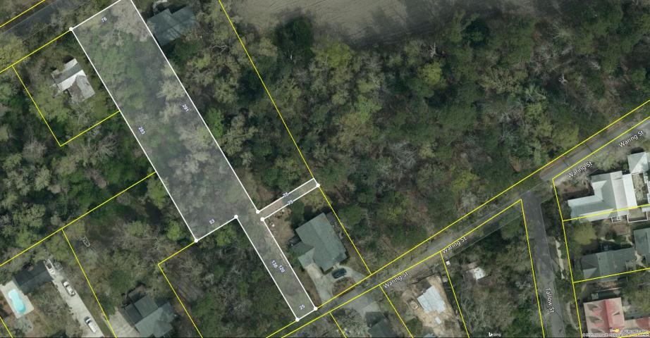
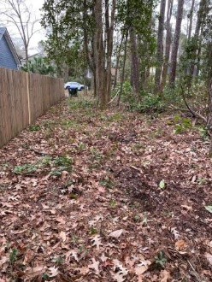
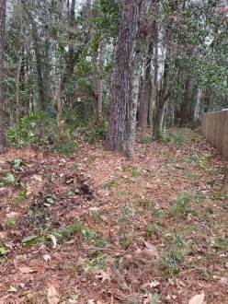
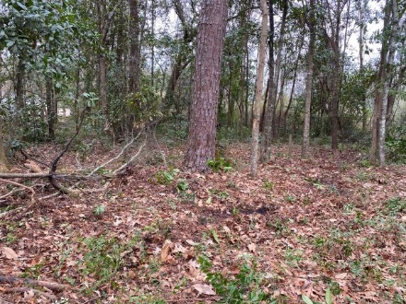
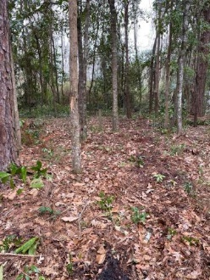
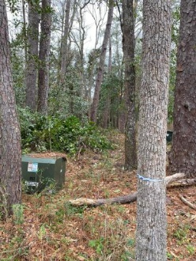


454 Waring Street
Summerville, SC 29483 · MLS# 20001431 · $125,000
Open House Saturday
12:00 until 4:00
Build Your Dream Home in the Heart of Summerville
Open House Saturday 8/24/19
12:00 until 4:00
NO longer a best kept secret, 454 Waring is located in the heart of the Lowcountry and boasts an array of scenic offerings and culturally entertaining activities. Summerville, SC is known as the place where flowers bloom by the acres, sweet tea is measured by the gallons alongside world-class cuisine, all served with a side of Southern Charm! This half acre plus lot is approximately 1 mile from Historic Downtown Summerville and offers an excellent opportunity to build your dream home near a national historic district. This is your chance to be a golf cart trail drive (or walk) away from where the annual Flowertown Festival happens! If you have a desire to build that home you've always dreamed of right close to city living in a cozy suburban neighborhood... don't wait!!!
454 Waring is minutes from I-26 with easy access to the Volvo and Mercedes Benz production factories, Boeing, Charleston International Airport, and Downtown Charleston (all approximately 30 minutes or less away)
James Hopkins
(843) 708-5930
James.Hopkins@AgentOwnedRealty.com
AgentOwned Premiere Group
1800 Trolley Rd
Summerville, SC 29485

