Slide 1
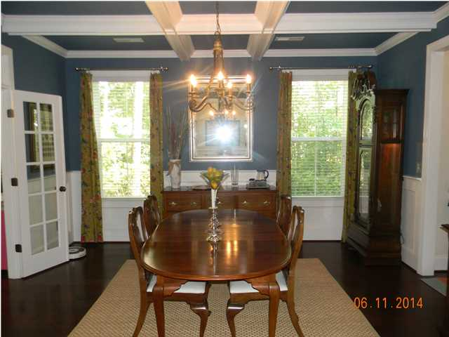
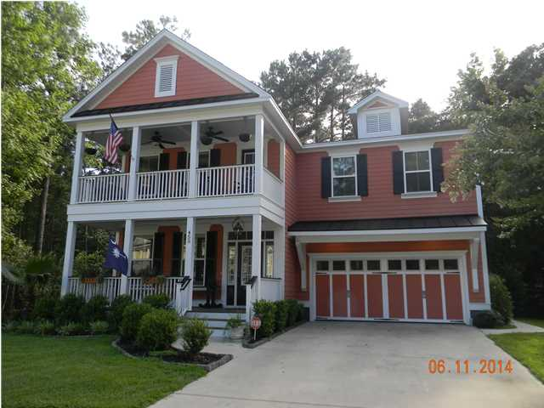
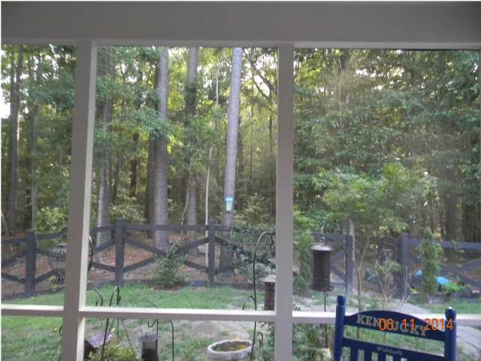
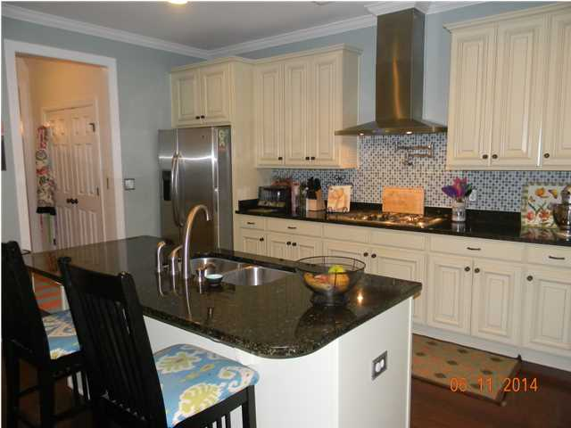
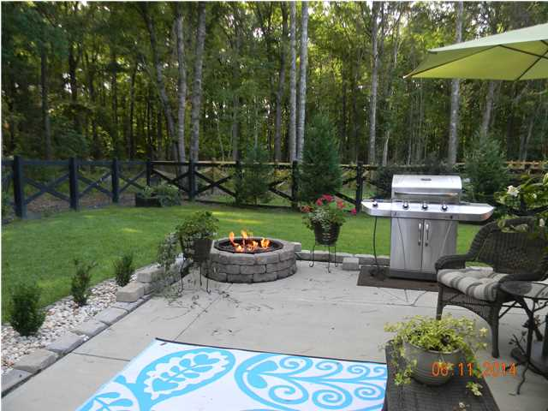
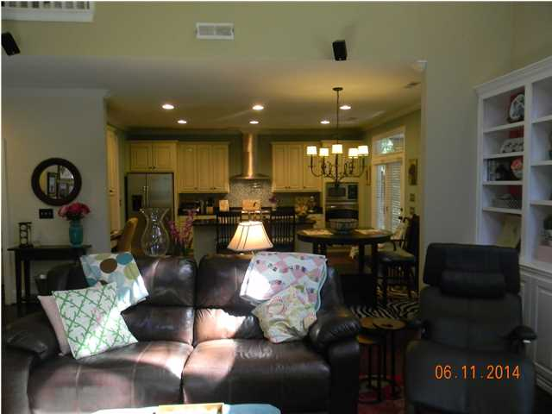
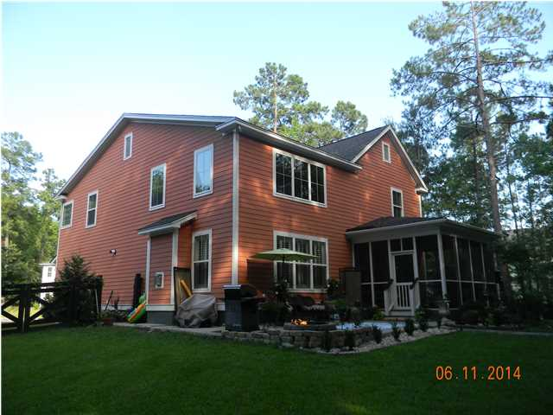
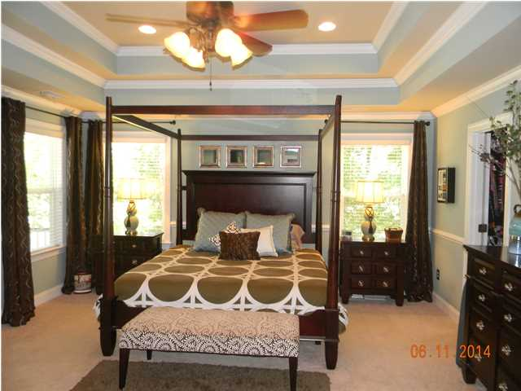
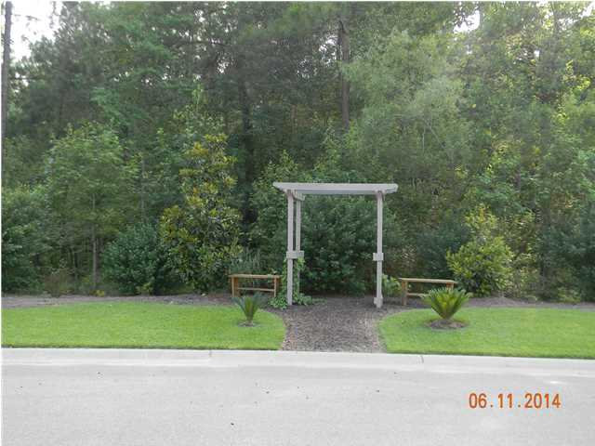


Open House – Saturday 11-2
455 Brick Kiln Dr
Branch Creek – Summerville – MLS# 1415997 – $369,000
Absolutely Gorgeous home with upgrades galore! Located on beautiful lot that backs up to protected wetlands/woods. This home offers so many custom features beginning with the hardwood flooring on the first floor, study with built in cabinets and desk, formal dining room with coiffered ceiling, wainscoating and French doors, the kitchen has a five burner gas cook top with a pot filler, convection oven, granite counters, butlers pantry(walk in), breakfast bar, built in desk and big eat in area. Family room has two story ceiling with stone fireplace that is beautiful, built in book cases and window seat with storage. Windows are tinted, Plantation shutters. Master bedroom suite is unbelievable has double tiered ceiling with double crown molding, bead board and chair railing and many windows and its' own porch off of the bedroom. The master bathroom has two separate sinks, garden tub and separate shower and big linen closet. Upgraded cabinets throughout and fixtures. There is another bedroom that could be another master bedroom it has its own bathroom and walk in closet. The other two bedrooms share a Jack and Jill bathroom and both have big closets. There are designer colors throughout this home. There is also a screen porch off of the kitchen with its own tv and there is a patio with a firepit that is hooked up to its own gas line that could also be used for a grill. All porches are freshly painted. This is a very private back yard with wooded area on the side and in the rear and wooded area across the street in this cul-de-sac. Tankless gas hot water heater. Even the garage has two ceiling fans and storage shelving. There is a play park in the neighborhood.
Sherrie Lindberg, Realtor
843-532-2002
lindbergsherrie@gmail.com
www.erawilderrealty.com
ERA Wilder Realty, 125-F Wappoo Creek Dr, Charleston, SC 29412

