Slide 1
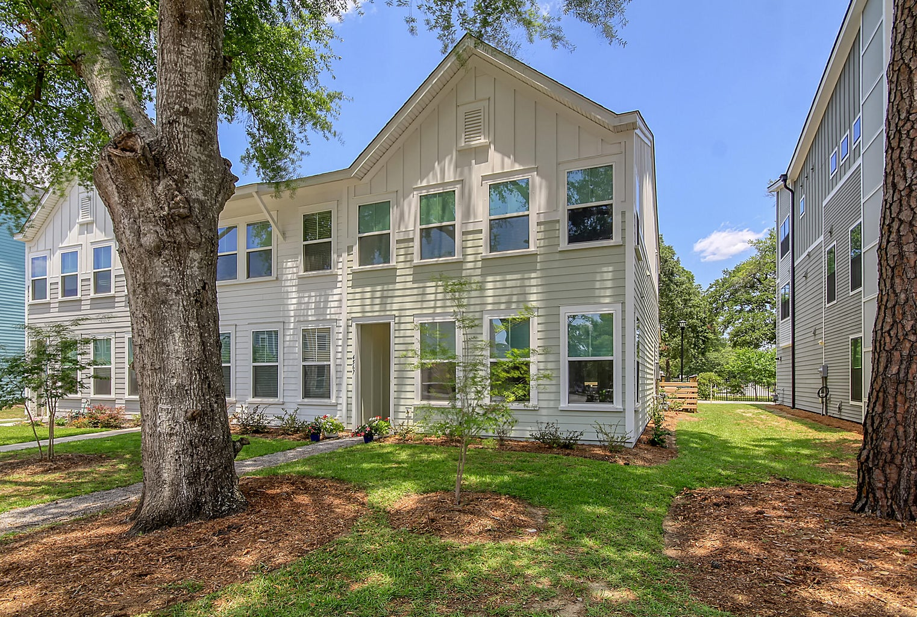
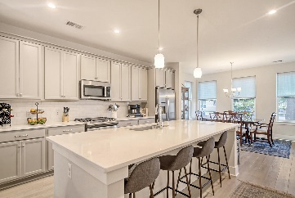
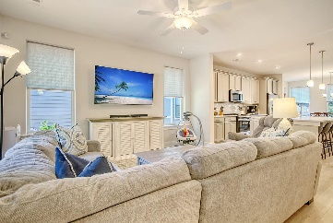
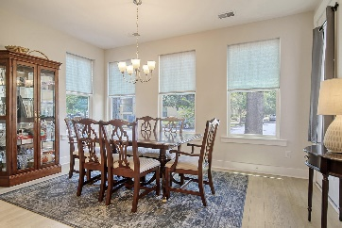
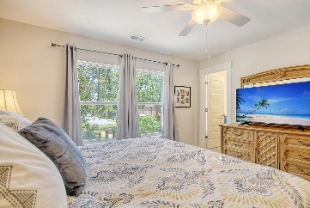
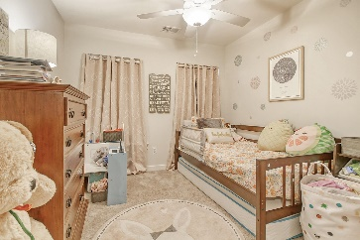
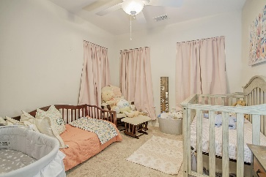
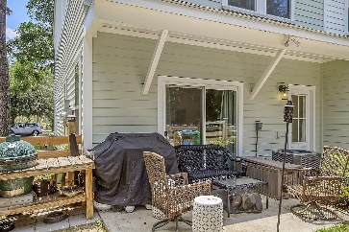
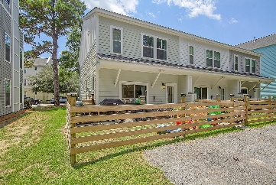

4567 Summey Street
Park Circle · North Charleston, SC 29405
MLS# 23014583 · $435,000
New Low Price Mixson/Park Circle Townhouse!
Beautiful END UNIT 3 bedroom, 2.5 bath townhouse in highly desirable Mixson Subdivision in Park Circle. Upon entering the townhouse you are greeted with an open floor plan, gorgeous luxury vinyl plank floors, and an abundance of natural light! To the right is the spacious dining room that is open to the chef-inspired kitchen with HUGE island with room for 4 stools, stainless steel appliances, gas range, stunning gray painted cabinets, white quartz countertops, deep single bowl sink, tiled backsplash, and pantry. The kitchen is open to the family room that is large enough for a sectional sofa and oversized TV. Next is an office nook/mudroom that leads to the fenced backyard with a patio that is perfect for entertaining and grilling! The primary bedroom suite is on the second level and features a full ensuite bathroom with luxurious shower. There are two additional nicely sized bedrooms upstairs that share a full bath. Finally, on the second level is a laundry room. Behind the townhouse outside of the wooden fence are two parking spots. There is also additional street parking in the front. Mixson in Park Circle is a planned community that has club memberships available, Mixson Club, that residents can join and has a pool, gym, and social events.
Stan Huff
843-670-2835
stan.huff@agentowned.com
Jill Marcacci
843-297-5590
jill@agentowned.com
www.agentownedrealty.com
AgentOwned Realty Co. Preferred Group, Inc. | 824 Johnnie Dodds Blvd | Mt Pleasant, SC 29464

