Slide 1
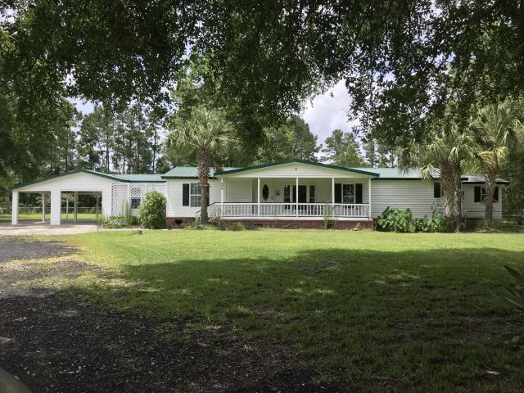
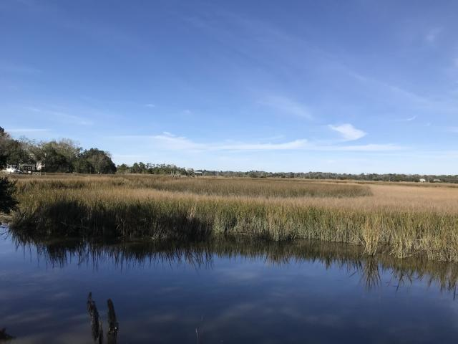
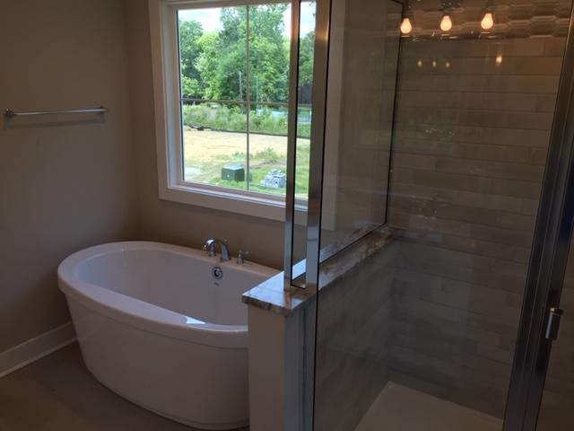
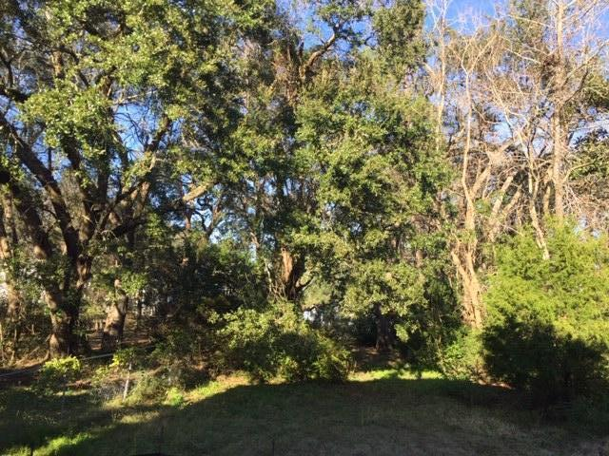
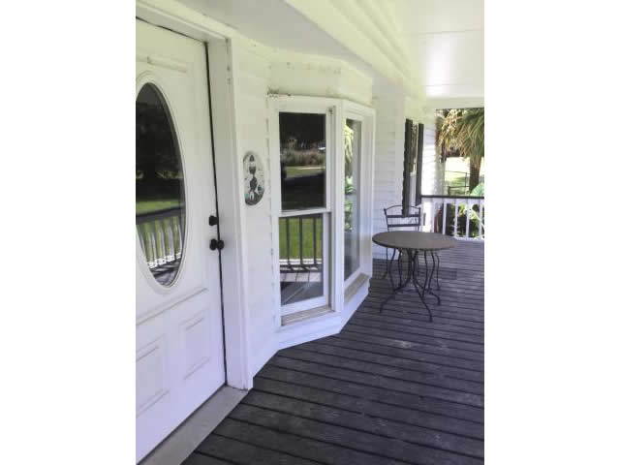
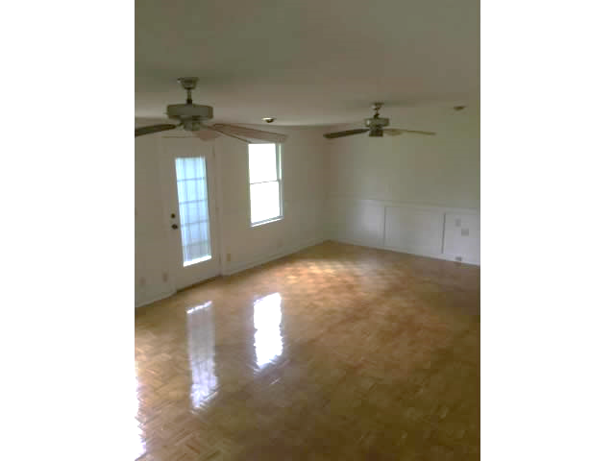
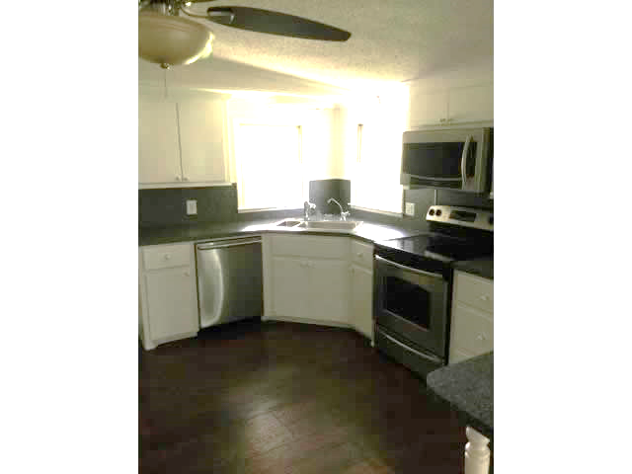
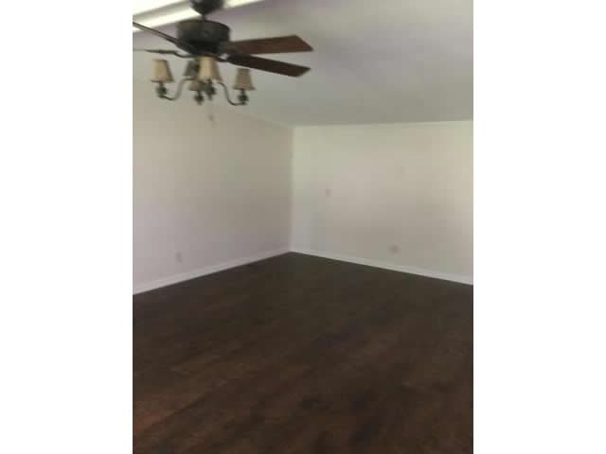
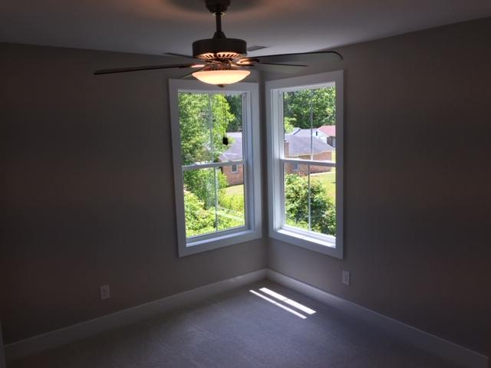
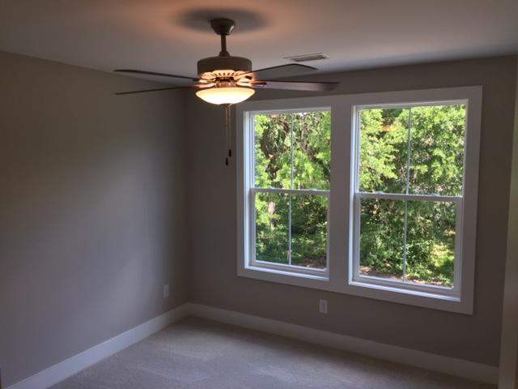
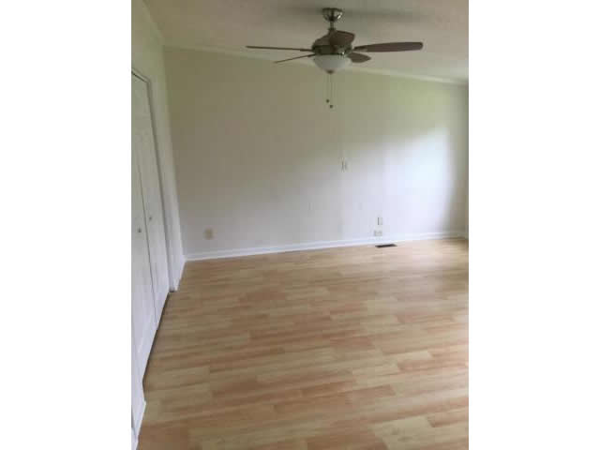
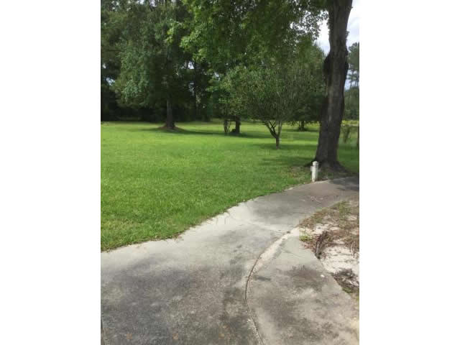
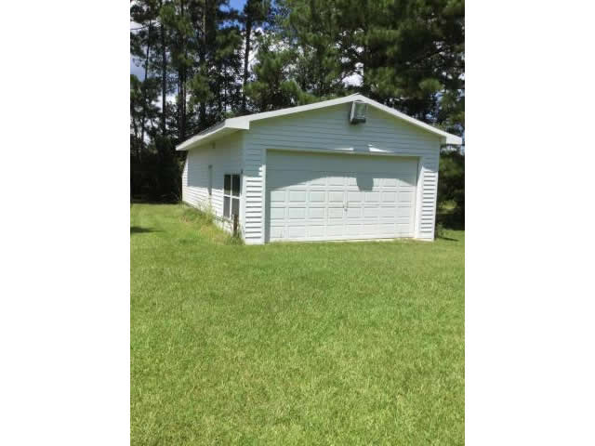
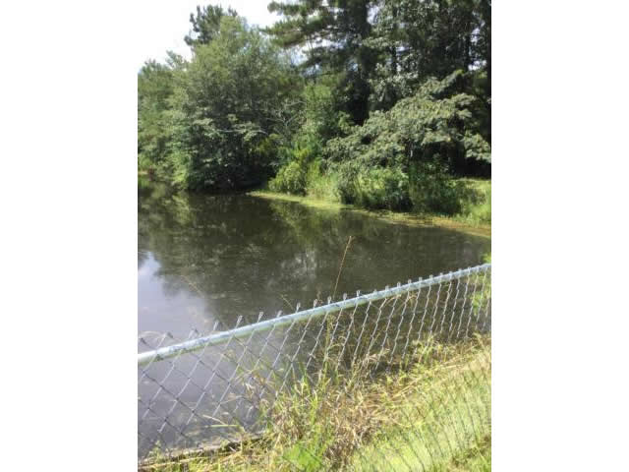


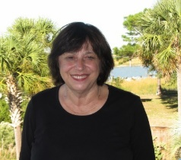
RIGHT AT AN ACRE OF LAND & A GREAT LOCATION!!!!!
456 Mary Lou Lane
Moncks Corner, SC 29461
MLS# 20015524
$325,000
5 Bedrooms :: 2 Baths :: 2,3681 sf
MAKE THIS YOUR HOME TODAY. PERFECT FOR THE FAMILY THAT WANTS SPACE FOR QUIET LIVING. HARDWOOD FLOORS, TILE AND PARQUET FLOORS. HAS OVERSIZED 2 CAR GARAGE. POND IN REAR. RELAX AND FISH AWHILE. FENCED AREA FOR A GARDEN METAL ROOF WITH HARDY PLANK SIDING. FRONT PORCH FOR THE AFTERNOONS AND EXTRA LARGE PATIO WITH CARPORT.
Eric Draper
(843) 442-7118
eric.draper@gmail.com
Judith Hartin
843-834-1972 | jnhartin@comcast.net
www.coastalpropertiescharleston.com
Metro Realty Group LLC | 1231 Columbia Ave | Irmo, SC 29063

