Slide 1
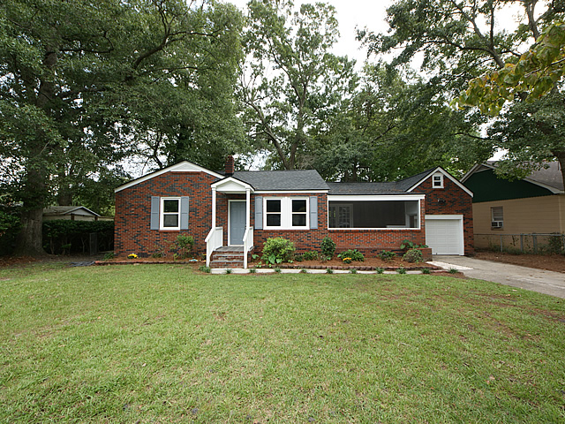
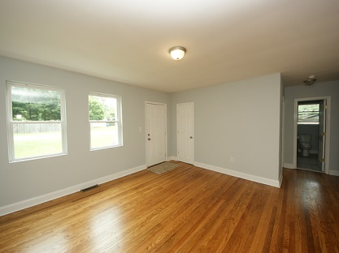
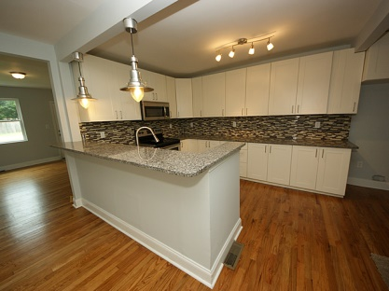
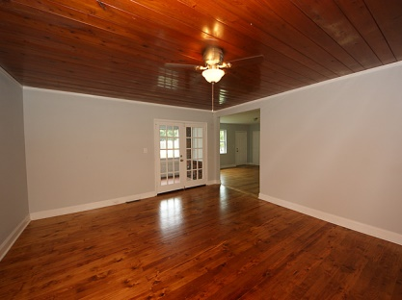
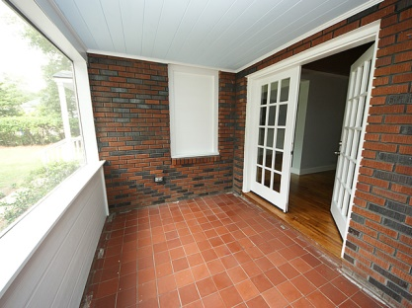
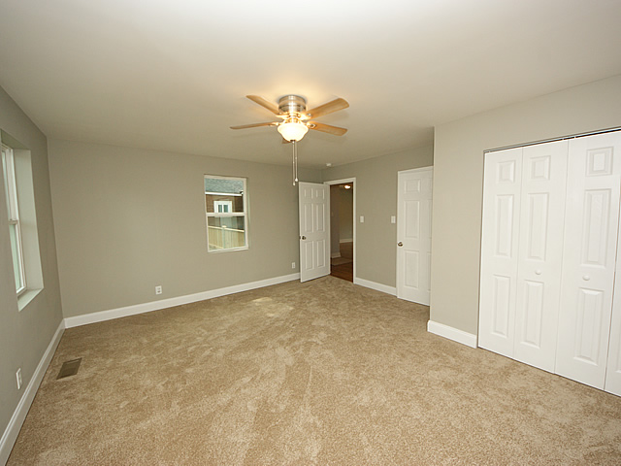
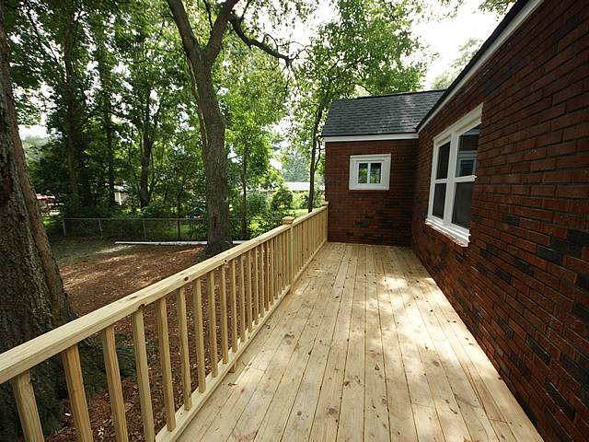

4574 Fern Pl Park Circle North Charleston, SC MLS# 1424624 $224,900 1,608 Sq Ft - 3 Bedroom - 2 Bath
Open House Sunday 1-3
Welcome to this charming 3 bedroom 2 FULL bath home located in the highly desired Park Circle neighborhood. This classic brick home has been COMPLETELY RENOVATED while keeping the original charm intact and is ready for a new owner. The renovations include a new 30 year architectural roof***open concept floor plan with completely new kitchen including all new stainless appliances, granite counter tops, new cabinets, and new pendant lighting***new windows throughout***larger than average master for homes in this neighborhood with en suite***new HVAC condensing unit***refinished gleaming hardwood floors in the living areas and bedrooms***new tile floors in both bathrooms***expanded front screened in porch***newly installed landscaping***new deck in the backyard***new paint throughout***both bathrooms have been completely upgraded***no detail has been spared! This home also features a full one car garage with lots of additional storage space above that could also be converted to living space. Nice sized lot with a private backyard. This home is walking distance to Mixson Bath and Racquet club where pool membership and restaurant options are available. This home is also walking distance to the Park Circle downtown area that features quaint shops and restaurants with a small town Main Street setting. Centrally located to shopping, schools, parks and recreation, not to mention quick access to interstate, this home has much to offer. Come see this remarkable home and community for yourself today. This home will not last long!
Jeff Gallman
Mobile: 843-729-5741
jeff@gallmanpropertyServices.com
Southern Shores Real Estate
107 S. Main St
Summerville, SC 29483

