Slide 1
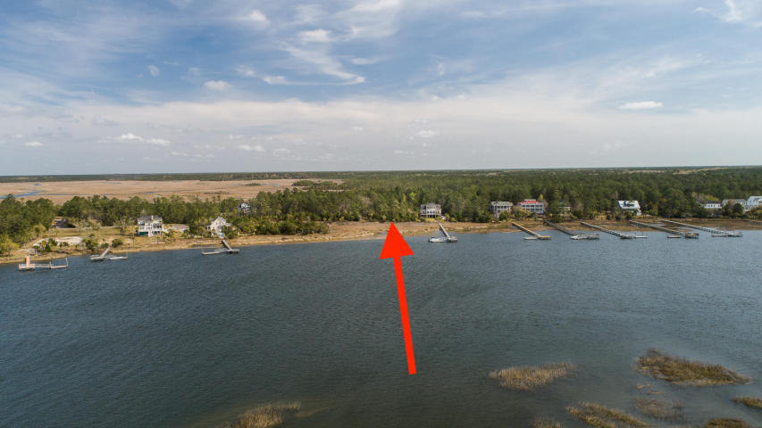
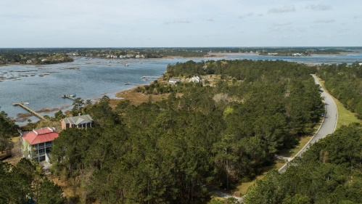
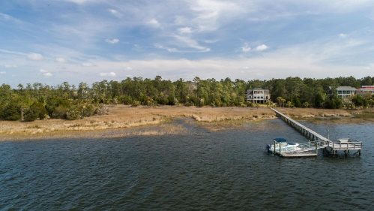
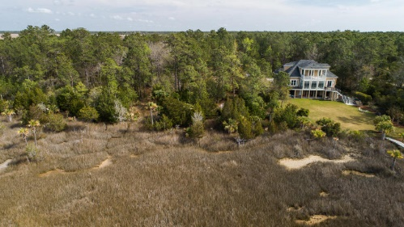


Deep Water Home Site Dock permit and new critical line survey in hand
4584 Cape Island Drive
Big Paradise Island • Mount Pleasant • MLS# 18009038 • $438,000
Super cool location on waterfront lot in Paradise Island. Dock permit and updated Critical line survey in hand to Deep Wando Access. Now that 41 Bridge is open, Bring your boat and enjoy. Not many lots with Dock permits in hand in this neighborhood. Recent survey available for review. Water, sewer, power are all available.
Tim Rogers
REALTOR®
(843) 412-2221
Tim@TimRogersRealty.com • www.TimRogersRealty.com
AgentOwned Preferred Group • 824 Johnnie Dodds Blvd • Mt. Pleasant, SC 29464

