Slide 1
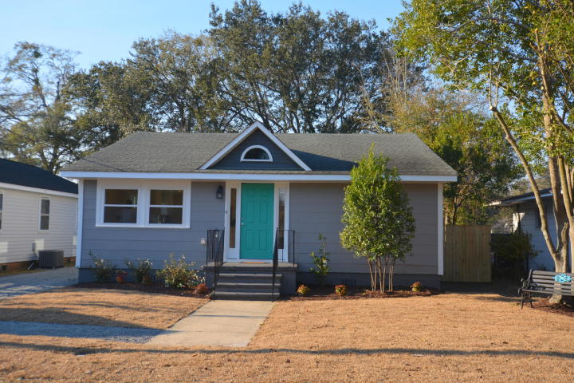
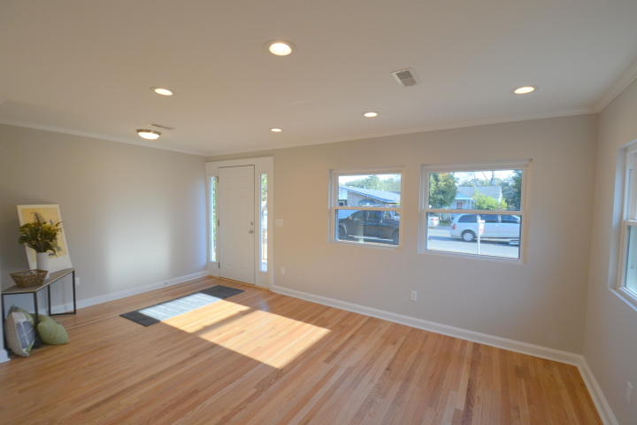
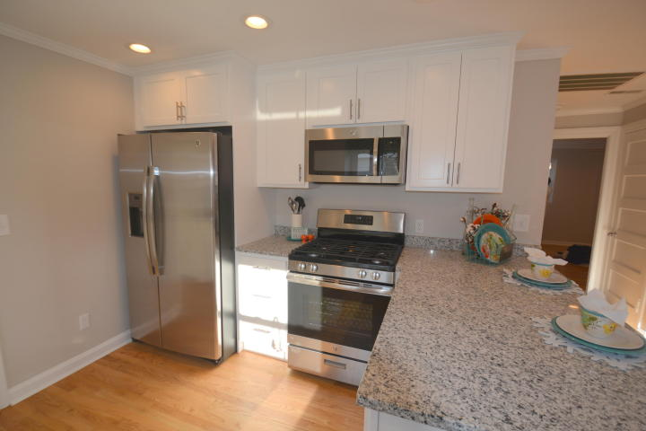
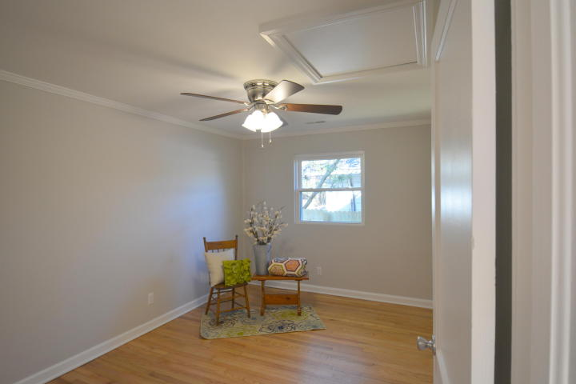
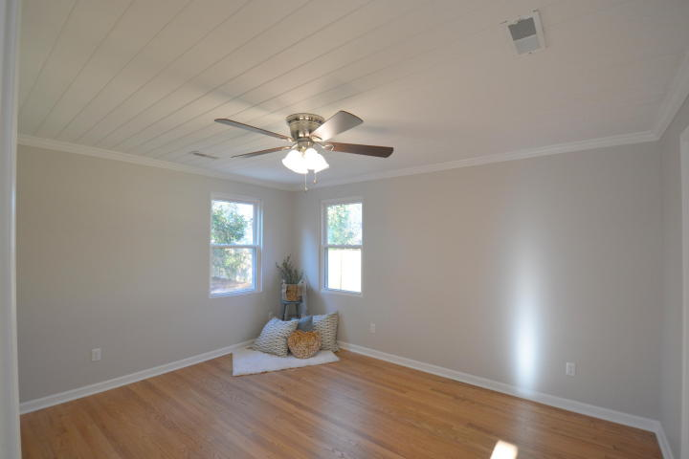
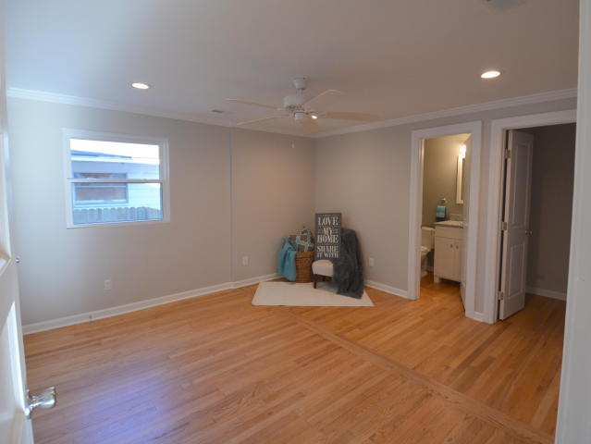
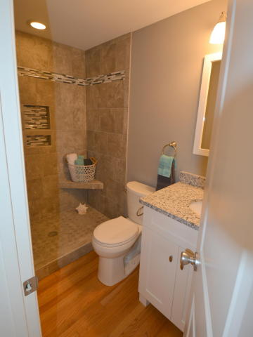
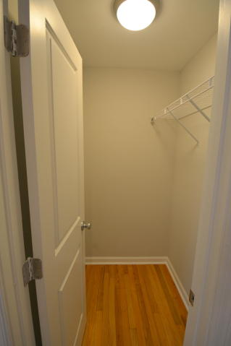
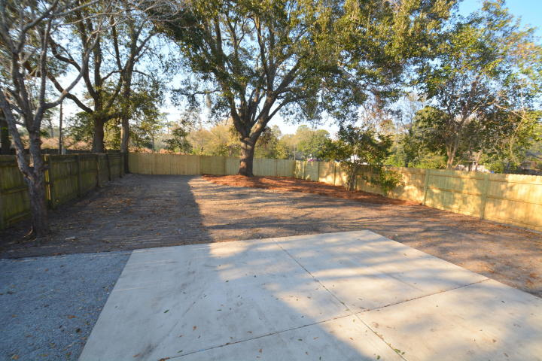
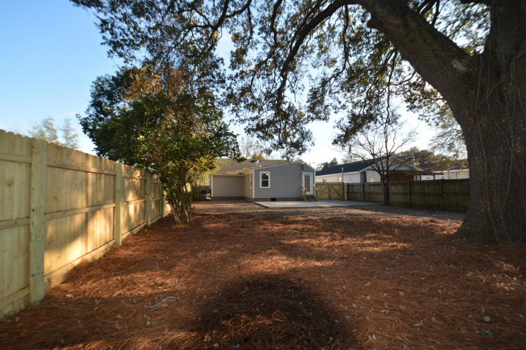


Open House in Park Circle ~ Saturday & Sunday 1-4
Hosted by Sarah Graham 843-693-0620
Buy.......Build.....Begin
4587 Durant Avenue
Park Circle | North Charleston | MLS# 18000135 | $310,000
Welcome to 4587 Durant Avenue. This renovated home has 3 Bedrooms, 2 and one half Bathrooms with 1313 square feet of wonderfully re-designed floor space. Enjoy an open floor plan, new kitchen with custom granite counter tops, GE Stainless Steel package with Natural Gas Range, Side by Side Refrigerator, Microwave and Dishwasher. The large Stainless Steel Sink is under a window and has an InSinkErator Garbage Disposal. The floor plan has been opened up allowing so much natural light. Among the new and upgraded features are: Rinnai Gas Tank-less Hot Water System, Energy efficient windows, New plumbing, New Electrical, New light fixtures, New Plumbing fixtures, New custom tile bathrooms, New Vanities, All new paint inside and out, Smooth Ceilings, New Crown Molding, Separate Mud Room and Laundry area, Double Pantry with shelves, New driveway and walkway, New privacy fenced in back yard, Re-finished Hardwood floors though out and so much more. Please check out the list of upgrades and improvements in the document section. The large back yard also has a Large Grand Oak tree in the back corner, additional parking and a four hundred square foot patio. New Landscaping planted in the front, Sod in front yard.
Bob Ramella, Broker
CRS, CDPE, RCC, e-Pro
(843) 330-8300
bob@bobramella.com | www.bobramella.com
Keller Williams Realty Charleston | 496 Bramson Ct Ste 200 | Mt. Pleasant, SC 29464

