Slide 1
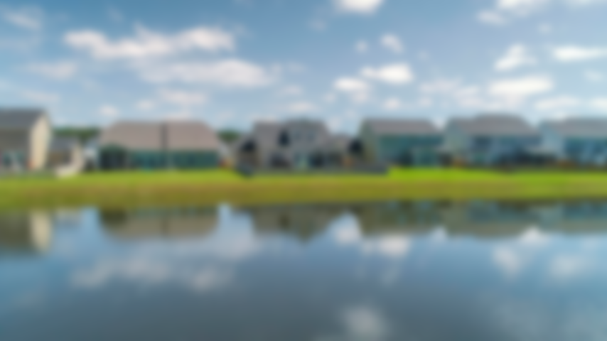
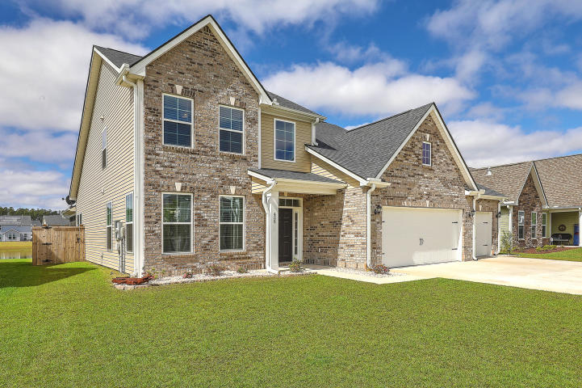
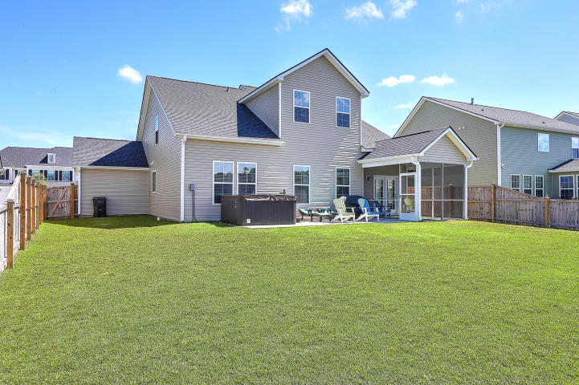
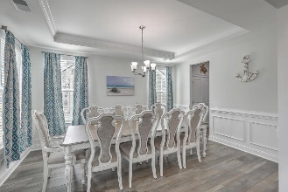
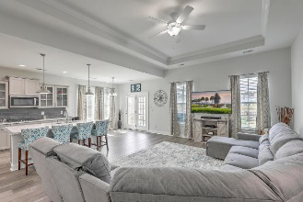
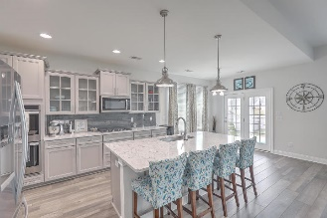
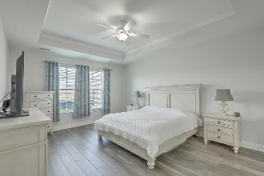
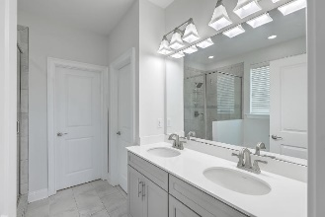
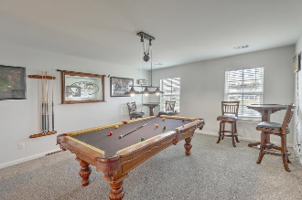
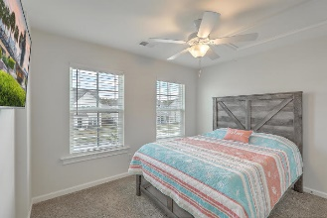
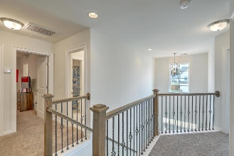
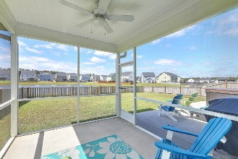
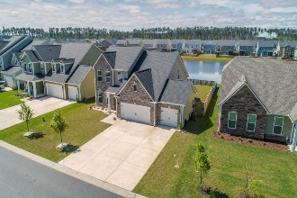

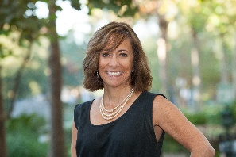
JUST LISTED! Like-New Cane Bay 5BR/3.5B Home w/3-Car Garage
458 Spectrum Road
Cane Bay Plantation | Summerville, SC 29486 | MLS# 20008809 | $358,975
Welcome to this nearly new Middleton plan with 3-car garage located on a wonderful pond homesite. Upon entering, you are greeted with a grand 2-story foyer with a dining room that leads to the fabulous open concept gourmet kitchen which features butler pantry, double wall ovens, all gas stainless appliances, plentiful storage and counter space, large island and breakfast area. The light and airy Family Room is great for entertaining and directly off the kitchen is a screened porch that opens to a large patio and fenced-in yard, overlooking a peaceful, serene pond. Your spacious master suite is also on the 1st floor and includes a tile shower with separate bath, dual granite countertop raised vanities and a separate toilet room plus a closet with plenty of storage space. The laundry room is conveniently located on the first floor as well coming in from the 3-car garage. A powder room off of the foyer finishes the first floor. As you go up the hardwood stairs you are greeted with a giant bonus room with French doors, this could be a 5th bedroom as there are 2 large storage closets. Also on the 2nd floor are 3 bedrooms, one having its own full bath making it a great guest suite, mother-in-law suite or child's private bedroom. There is an additional full bath with separate tub and shower room plus dual granite-topped vanity which is accessible from the hall for the other 2 bedrooms.
Magnolia offers a pool and a kid's playground and all of Cane Bay has miles of walking or jogging trails for all to enjoy. Looking for more fun for the family? Join the YMCA that features a 54,000 sf sports facility with a 25-meter swimming pool, basketball court, library and so much more. Convenient to schools, a shopping center that has boutiques, gas stations, restaurants and a grocery store, plus more, you won't want to miss this opportunity to live in Magnolia at Cane Bay!
Take a virtual walk-through at http://vimeo.com/401198179
Desiree Maurer Office - (843) 416-2000
Mobile - (843) 327-9010 desiree.maurer1@gmail.com
www.yourcharlestonhousesearch.com
Keller Williams Realty 496 Bramson Ct Ste 200 Mt. Pleasant, SC 29464

