Slide 1
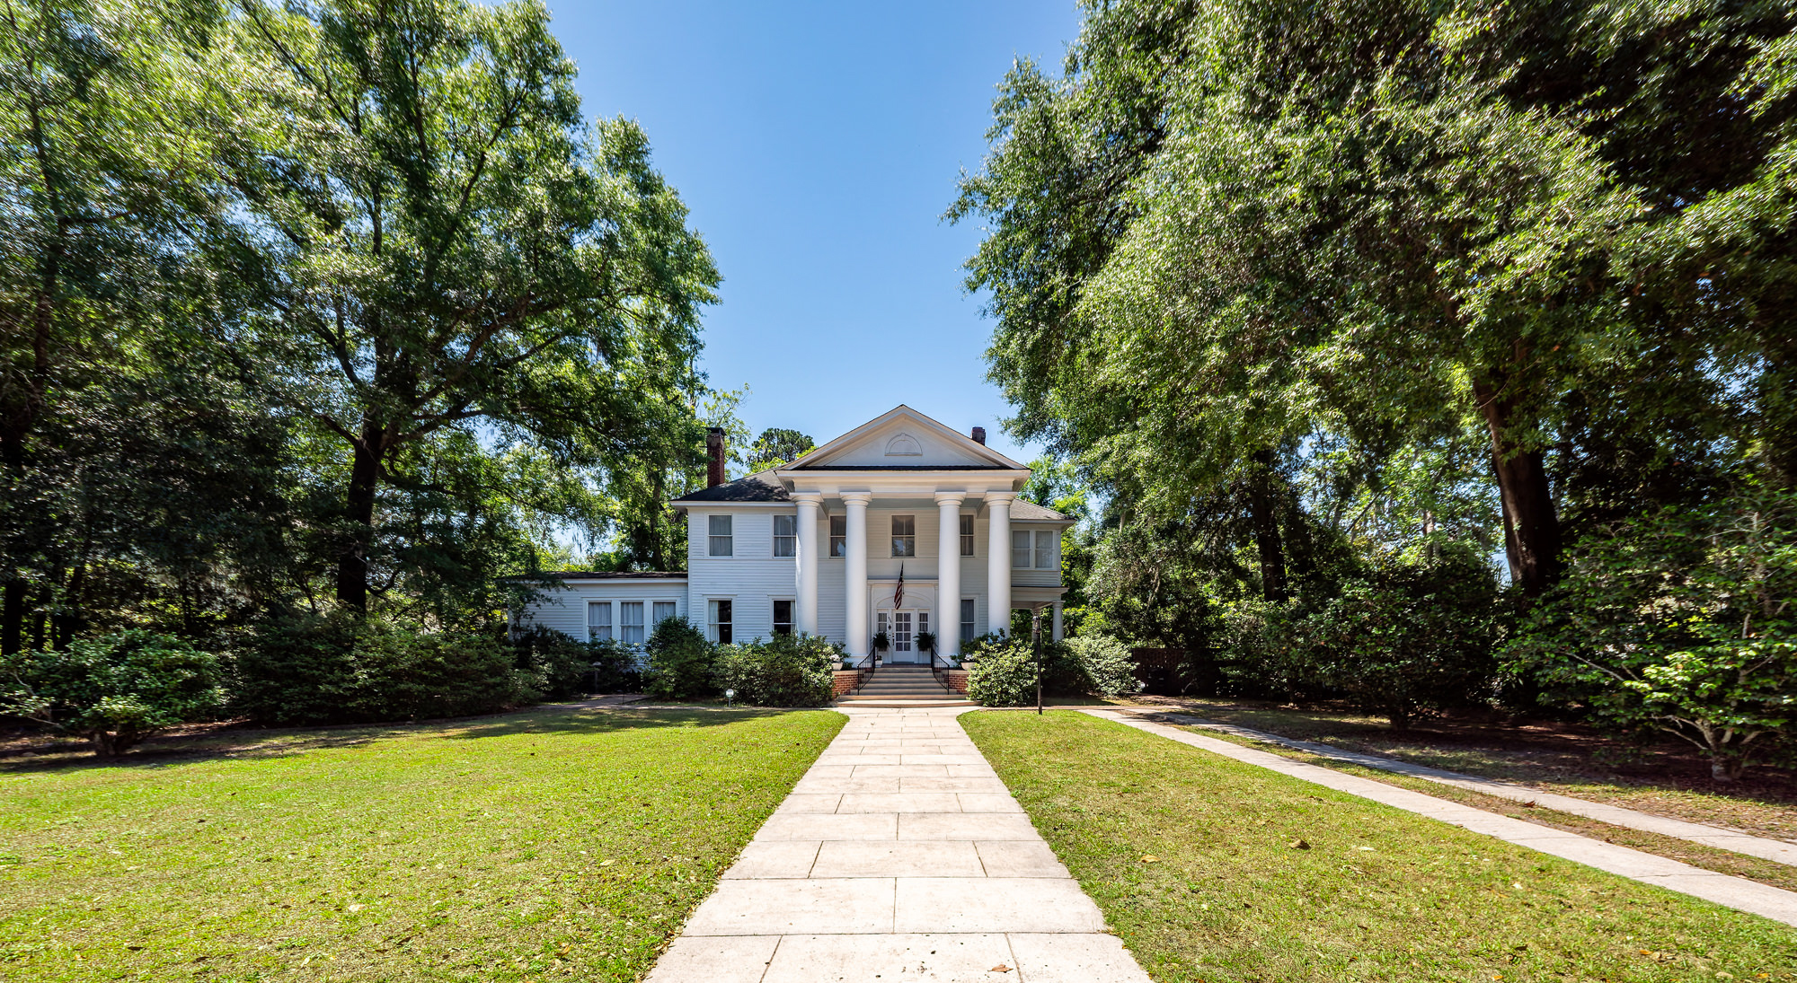

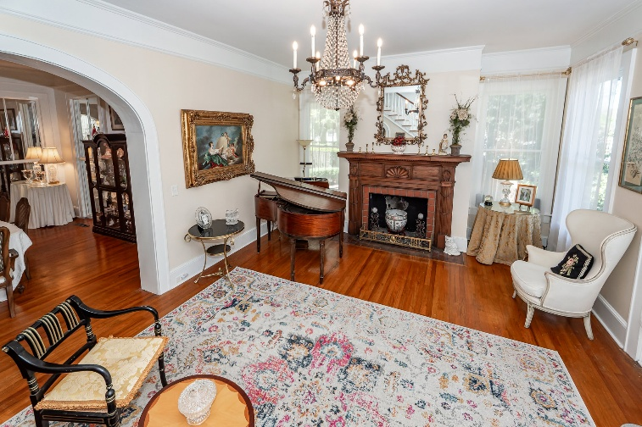
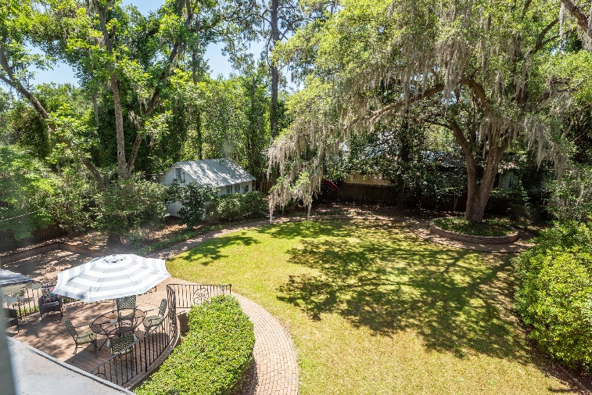

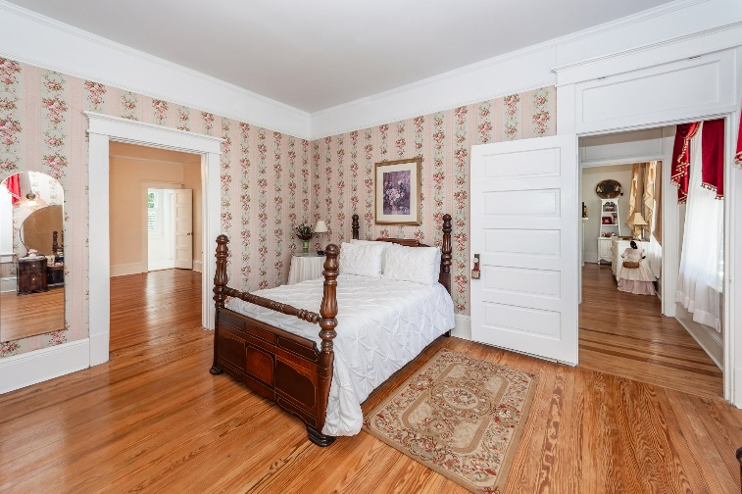
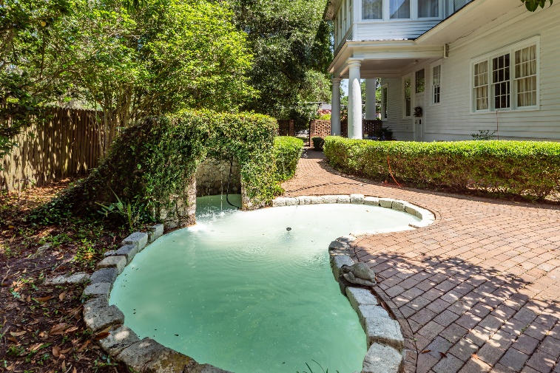


Watch the video to see more!
UNIQUE Jewel Box in the
OLD WALLED CITY
Historic Mansion with
Detached guest cottage &
Bed and Breakfast License
FIRST TIME EVER ON THE MARKET!
Step into this stunning Greek Revival home that retains all the historic details that Charleston architect JD Newcomber had in mind when he built it in 1880. Set on a full half-acre "mini-estate", the grounds of the Stokes-Hiott mansion were designed by the legendary landscape architect Robert E. Marvin. Beyond wrought iron gates on both sides of the Mansion, are brick walkways that meander around a centuries-old oak tree surrounded by a brick seat wall and dozens of azaleas and camellias among a koi pond and stone grotto. Dream BIG! With 7 bedrooms and 5 baths the mansion includes a detached GUEST COTTAGE and a transferable BED AND BREAKFAST license. Hand-carved Cypress fireplace Mantles, Mirrored floor to ceiling windows create magical spaces
458 Hampton Street
Walterboro, SC 29488
7 Bedrooms | 5½ Baths | 4,217 sf
Ellen Leigh Murray
843-813-2006
chaspremierprop@bellsouth.net
Handsome Properties, Inc
53 Broad St
Charleston, SC 29401

