Slide 1
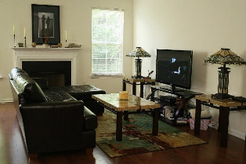
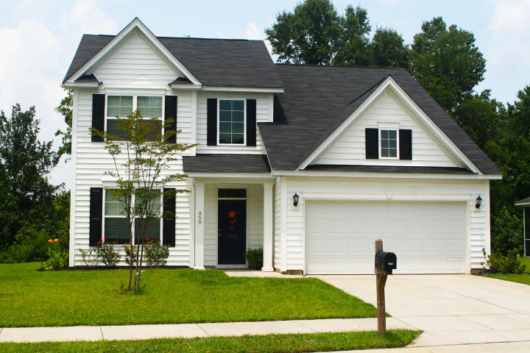
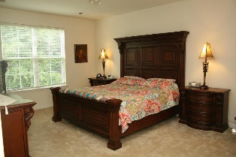
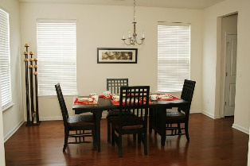
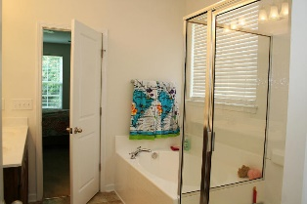
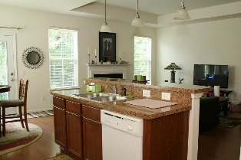
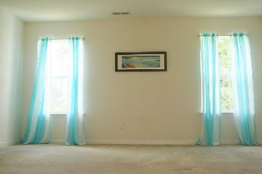
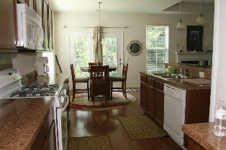
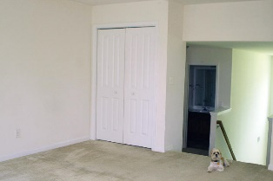
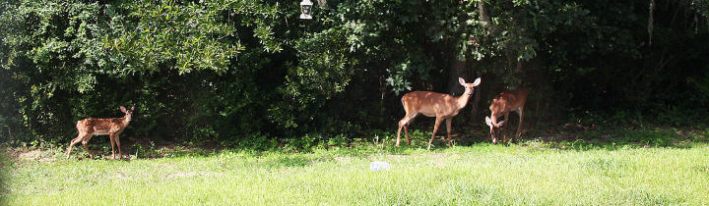


459 Delmont Drive
Goose Creek, SC 29445
MLS# 15018518 ~ $228,000
Great 4 Bedroom Home in Sophia Landing
Just Reduced!
This immaculate 4 bedroom, 2.5 bath home is perfectly situated on a wooded preserve lot in the beautiful community of Sophia Landing. Great open floor plan complete with downstairs master bedroom and formal dining room. Many interior features including wood floors, fireplace, eat-in kitchen, master bedroom with large walk-in closet & dual sinks and so much more! Three bedrooms upstairs plus an over sized bonus/play room. This home is the Middleton model with over $38,000 in builder upgrades. Remainder of builder's 10 year warranty is transferable to the new owner. Community offers neighborhood pool and play park. Great location convenient to SPAWAR, Boeing and I-26. Make this home a must see!
Adam Rafferty
M (843) 424-0610 :: O (843) 884-7300
adam@agentownedrealty.com
AgentOwned Preferred Group | 824 Johnnie Dodds Blvd | Mt Pleasant, SC 29464 | www.agentowned.com

