Slide 1
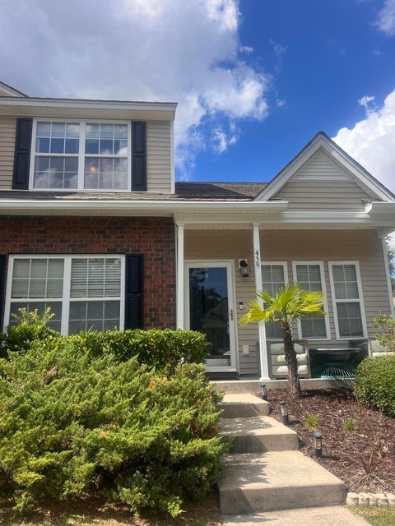


2.5% Coming Soon in Beresford Commons!!
459 Doane Way
Beresford Commons · Wando, SC 29492 · MLS# 24025435 · $377,000
Beresford Commons is a great community close to Daniel Island and the restaurants and shopping of Point Hope! It's proximity to 526 makes a quick ride to the airport easy. Entering this end unit townhome you see Acai wood flooring, and the primary bedroom on the first level. The kitchen has granite counters, eat in area, Stainless kitchen appliances are only 2 years old and the refrigerator is Samsung with ice maker and 2 drawers below. Sliding doors lead out to the screened in porch overlooking the pond! There is the open concept staircase leading up to two additional bedrooms with large walk-in closets, and a full bath.
Therese Jenkins
843-568-9748
therese@beautifulhomesllc.com
Beautiful Homes Realty
130 River Landing Dr #7322
Daniel Island, SC 29492
www.theresejenkins.com

