Slide 1
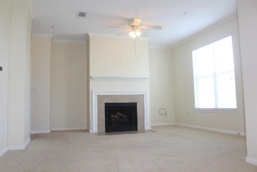
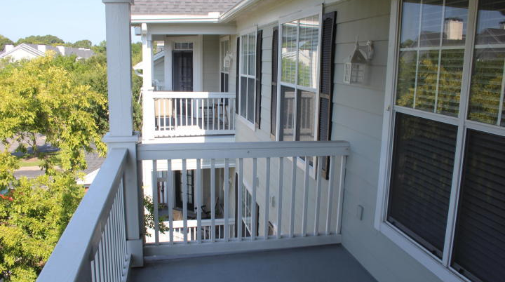
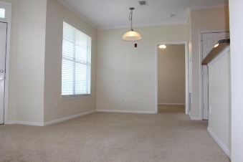
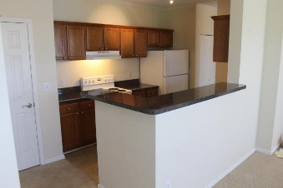
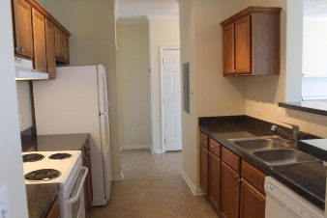
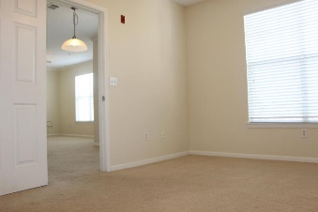
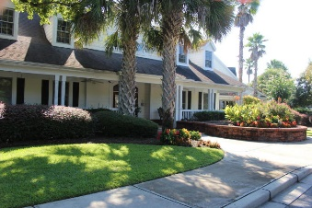
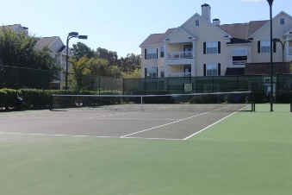
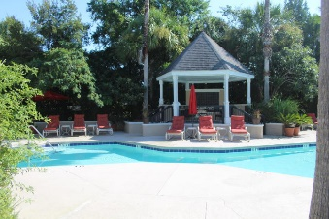


45 Sycamore Avenue #1035 Concord West of The Ashley ~ Charleston MLS# 15022302 ~ $132,000
LOCATION! LOCATION! LOCATION!
Enjoy the ease of living close to downtown and the popular Avondale shopping district with restaurants, salons & boutique shops; short drive to The College of Charleston, MUSC, Roper and VA hospital.
This 3rd floor condo is the perfect location for your next home. Lovingly maintained-the condo is move in ready with NEW dishwasher, NEW Refrigerator, and nearly NEW washer and dryer.
Enjoy the benefits and security of living in this gated and maintenance free community so you have time to enjoy the 2 swimming pools, tennis court, fitness center with new equipment, club house and beautifully landscaped complex with picnic & bbq areas throughout. Community dog park, skate park and bike path adjacent to complex. Everything is here-except you. Come see today!
Margaux L Kilgallen, REALTOR
Cell - (843) 670-4035 mak@beresfordrealty.com
Beresford Realty, LLC 672 Marina Dr Ste 206B| Charleston, SC 29492
www.beresfordrealty.com

