Slide 1
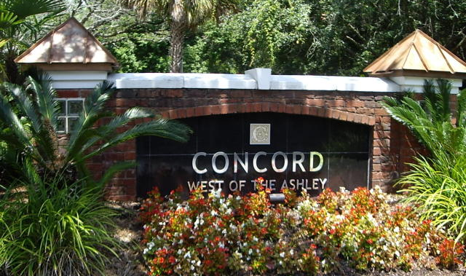
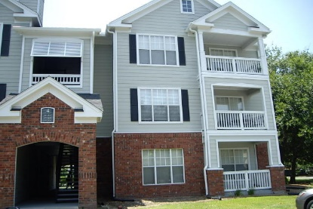
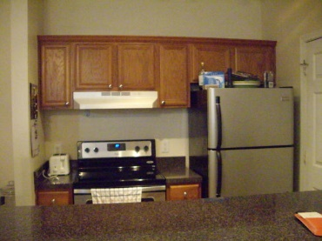
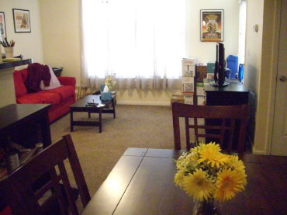
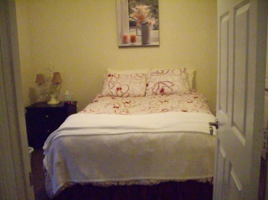
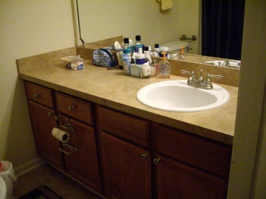
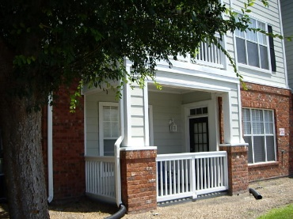
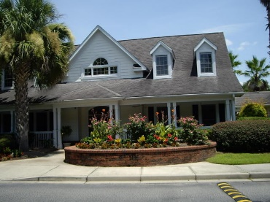
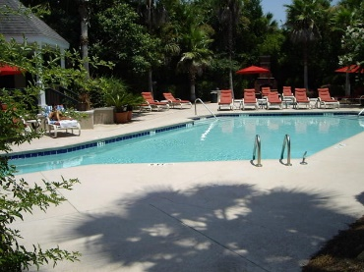
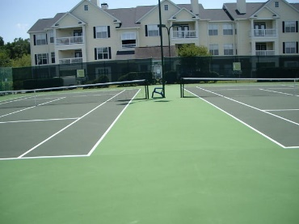
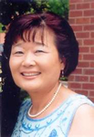

45 Sycamore Avenue #418 Concord West of The Ashley Charleston, SC 29407 MLS# 15019441 $129,500
One bedroom and one bathroom condo located on the first floor in Concord West of Ashley. Gated community with club house, two pools with grilling stations, hot tub, fitness center, movie room and tennis court.
Close to MUSC, college of Charleston and The Citadel. Very convenient location between Hwy 17 and 61. This corner unit one bedroom has ceramic tile in kitchen and bathroom, walk in closet, large living area with open kitchen and a private porch overlooking tennis court.
New stainless steel appliances, blinds and washer and dryer convey. Hot water tank and HVAC are only about 3 years old.
Great income source for investment.
Thank you for showing!
Cathy Rosenblum
843-817-7869
crosenblum@comcast.net

